Slide 1
Structures: Strings
CPSC 217: Introduction to Computer Science for Multidisciplinary Studies I
Winter 2023
Jonathan Hudson, Ph.D.
Instructor
Department of Computer Science
University of Calgary
January 9, 2023
Copyright © 2023

Slide 2
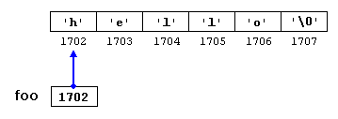
Strings
Strings are basically wrappers of an immutable tuple of character symbols
In non-Python Strings are just a type of list (technically known as array C++/Java)
Ex. foo = “hello”

Slide 3
String creation

Slide 4
Strings
Strings are immutable. Meaning, their values cannot change after it has been created.
Ex.
greeting = "Hello, world!"
greeting[0] = 'J' # ERROR!
print(greeting)
Do this instead
greeting = "Hello, world!"
newGreeting = 'J' + greeting[1:]
print(newGreeting)
print(greeting)
Jello, world!
Hello, world!

Slide 5
Creating String Variables
Form: var = “”
The string object must be enclosed with either a single quote (') or double quote (").
Single quote and double quote are interchangeable: “Hello World!” == ‘Hello World!’
If your string object contains single quotes, then enclose it with double quotes, or vice versa:
myStr1 = “Jonathan’s lecture ROCKS!”
myStr2 = ‘The students agreed: “Yes, it does!”’

Slide 6
Creating String Variables
Use triple single quote (''') or double quote (""") to create a string that spans multiple lines.
myStr3 = '''hello
my name is Jonathan'''

Slide 7
Accessing characters

Slide 8
Accessing Single String Characters
Using indexing operator you can access a single character from a string.
Python uses square brackets to enclose the index
Course = "CPSC 231"
m = Course[2]
print(m)
lastchar = Course[-1]
print(lastchar)
Index
S
1

Slide 9
Escaping

Slide 10
Escaping Characters
\\ → Backslash (keeps \)
\’ → Single quote (keeps ’)
\” → Double quote (keeps ”)
\n → Newline, end of line
\t → Horizontal tab
…
When Python sees the backslash (\), it treats the following character as a part of string

Slide 11
Escaping Characters
Sometimes, you need to include special characters in your string, such as backslash (\), single quote, double quote, newline (\n), tab (\t), etc.
Ex. I want to print the string She said, "It’s a beautiful morning!" and a newline afterwards.
>>>print("She said, "It’s a beautiful morning! "\n")
SyntaxError: invalid character in identifier
backslash \ is used to indicate that the character is part of the string and to indicate the special character newline (\n)
>>>print("She said, \"It’s a beautiful morning!\"\n")
She said, "It’s a beautiful morning!"

Slide 12
Concatenation

Slide 13
String Concatenation
Combine two or more strings together
Example appending the last name “Smith” to the first name “John”
print('John', 'Smith')
print('John'+'Smith')
What is the difference between these calls?
>>> print ('John', 'Smith')
John Smith
>>> print ('John'+'Smith')
JohnSmith

Slide 14
Formatting

Slide 15
String Formatting – Old-old-school way
This original way of formatting strings:
>>>name = input(“What is your name hooman?”)
Jonathan
>>>print(”Hello %s!” % (name))
‘Hello Jonathan!’
%s a place holder of string type
% marks the start of
the format specifier

Slide 16
String Formatting – Old-school way
This next way of formatting strings:
>>>name = input(“What is your name hooman?”)
Jonathan
>>>print(”Hello {}”.format(name))
‘Hello Jonathan!’
{} is a placeholder
Format function takes arguments that are each variable to fill into each placeholder

Slide 17
String Formatting – New-school way
This new way of formatting strings:
>>>name = input(“What is your name hooman?”)
Jonathan
>>>print(f”Hello {name}”))
‘Hello Jonathan!’
f-string
Variable name filled into {}

Slide 18
String Formatting – Float Formatting
You can format floats to have specific width (padding) and precision.
width is 10
precision is 3
someValue = 12.12345
print("someValue = %10.3f“ % (someValue))
outputs
Precision = 3
someValue = 12.123
width = 10

Slide 19
Operations

Slide 20
String Operations - Illegal
message - 1
"Hello" / 123
"15" + 2
Most
simple expressions
illegal

Slide 21
String Operations - Concatenation
message - 1
"Hello" / 123
"15" + 2
fruit = "banana"
bakedGood = " nut bread"
print(fruit + bakedGood)
Most
simple expressions
illegal
Legal concatentation

Slide 22
String Operations
message - 1
"Hello" / 123
"15" + 2
fruit = "banana"
bakedGood = " nut bread"
print(fruit + bakedGood)
Illegal
concatenation
print("Go" * 6)
name = “Dinos"
print(name * 3)
print(name + "Go" * 3)
print((name + "Go") * 3)
GoGoGoGoGoGo
DinosDinosDinos
DinosGoGoGo
DinosGoDinosGoDinosGo
Repetition

Slide 23
Methods

Slide 24
String Methods
NOTE: A method is a function that is associated with a specific object/class.
Other functions include:
capitalize, join, strip, count, center, replace, ljust, rjust, find, rfind, …
For more details, refer to: https://docs.python.org/3/library/stdtypes.html
ss = "Hello, World"
print(ss.upper())
print(ss.lower())
HELLO, WORLD
hello, world
Outputs

Slide 25
String Methods - count(), strip(), and replace() Examples
ss = " Hello, World "
els = ss.count("l")
print(els)
print("***" + ss.strip() + "***")
print("***" + ss.lstrip() + "***")
print("***" + ss.rstrip() + "***")
news = ss.replace("o", "***")
print(news)
3
***Hello, World***
***Hello, World ***
*** Hello, World***
Hell***, W***rld
Outputs

Slide 26
Slicing

Slide 27
String Methods - The Slice Operator
A substring of a string is called a slice.
The slice operator [n:m] returns the part of the string from the n’th character to the m’th character.
Including the first but excluding the last.
singers = "Peter, Paul, and Mary"
print(singers[0:5])
print(singers[7:11])
print(singers[17:21])
Peter
Paul
Mary

Slide 28
String Methods - The Slice Operator
n and m are optional, their default values are 0 and len(str)-1, respectively
name = "CPSC 231"
print(name[:])
print(name[3:])
print(name[:6])
CPSC 231
C 231
CPSC 2
If n or m have values larger than the length of the string, no error is returned
name = "CPSC 231"
print(name[100:200])
print(name[:200])
print(name[100:])
'‘
‘CPSC 231‘
''

Slide 29
String Methods - The Slice Operator
name = "CPSC 231"
print(name[-1:])
print(name[:-1])
print(name[-8:-1])
1
CPSC 23
CPSC 23
n and m can be negative values

Slide 30
split()

Slide 31
String Methods - split()
The split() function takes a string argument (delimiter) returns a list of words of the original string split on this delimiter.
a = "this is a string"
a = a.split(" ")
print(a)
['this', 'is', 'a', 'string']

Slide 32
len()

Slide 33
The len() function
len(str) returns the number of characters in a given string.
fruit = "Banana"
print(len(fruit))
6
fruit = "Banana"
sz = len(fruit)
last = fruit[sz] # ERROR!
print(last)
Error! Starts from zero
fruit = "Banana"
sz = len(fruit)
last = fruit[sz-1]
print(last)
a

Slide 34
Examples

Slide 35
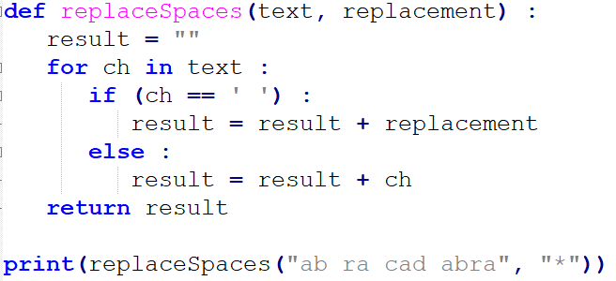
Example
ab*ra*cad*abra

Slide 36
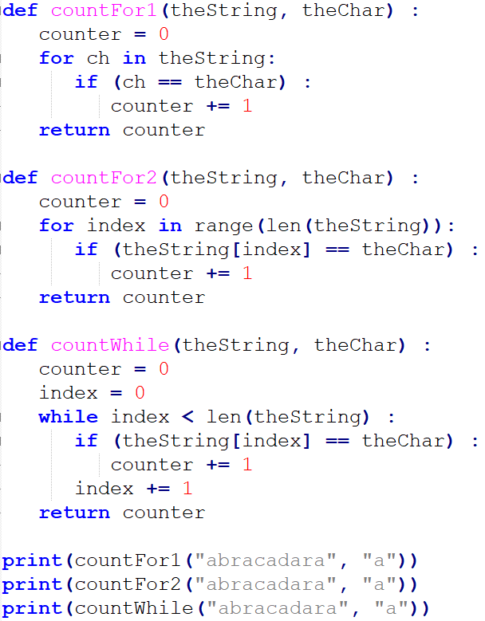
5
5
5

Slide 37
Onward to … file and exceptions.
Jonathan Hudson
jwhudson@ucalgary.ca
https://pages.cpsc.ucalgary.ca/~jwhudson/

