Slide 1
Likert Scales
…are the meaning of life:

Slide 2
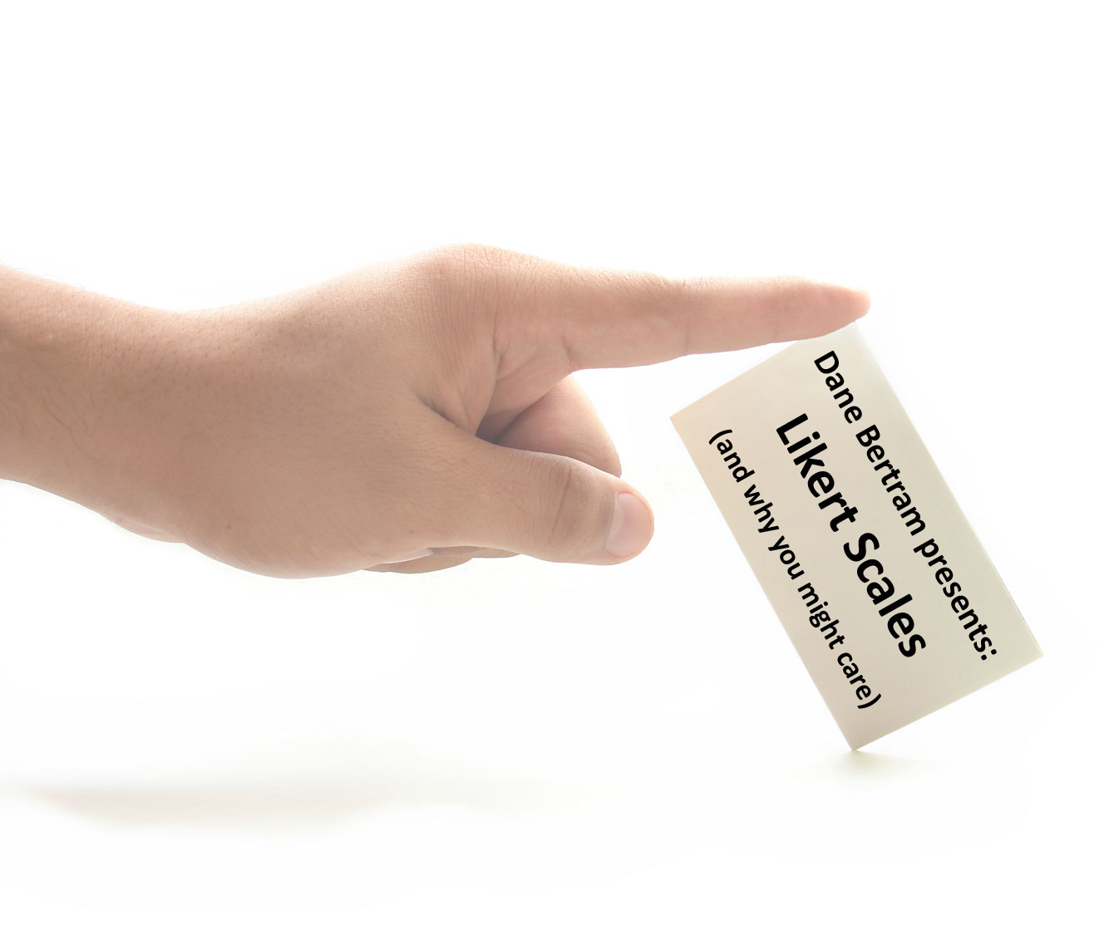
Overview
Basics
Analysis Methods
Worked Example
Strengths
Weaknesses
Notes:
Basics - definition, sample, origin, variations
Analysis methods - individual responses vs. summed responses, descriptive stats and Mann-Whitney U test
Worked example - example question, raw data, and analysis
Strengths
Weaknesses

Slide 3

Basics

Slide 4
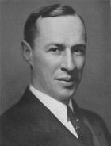
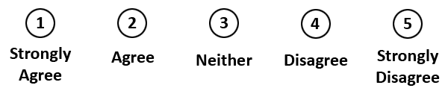
Likert Scale \lick-urt\, n.
Who?
  Dr. Rensis Likert
What?
  Psychometric response scale
When?
  1932
Where?
  Questionnaires
Why?
  Obtain preference or degree of agreement
Notes:
Who - Dr. Rensis Likert (sociologist at U of Michigan)
What - psychometric response scale (measurement of psychological vars such as attitudes, abilities, personality traits, etc.)
- non-comparative scale
- each item is scaled independently from the others (ex. How do you feel about X?)
- comparative scaling -> items are compared with each other (ex. Do you prefer X or Y?)
- unidimensional scale (only measures a single underlying trait)
- ordinal scale (ordered categories, but magnitude of difference between each might be different)
When - 1932 - “A Technique for the Measurement of Attitudes” in the Archives of Psychology
Where - wherever participant attitudes are valuable (requirements gathering, evaluation, etc.)
Why - obtain participants preferences or degree of agreement
- means of measuring psychological attitudes in a “scientific” way like grams or degrees Celsius

Slide 5
Sample Likert Scale Question
Please indicate how much you agree or disagree with each of the following statements:
 | Strongly disagree | Somewhat disagree | Neither agree nor disagree | Somewhat agree | Strongly agree
1. The “U of C • This is now” website is easy to use | 1 | 2 | 3 | 4 | 5
2. The “My U of C” website is easy to use. | 1 | 2 | 3 | 4 | 5
3. The “Peoplesoft Student Center” website is easy to use. | 1 | 2 | 3 | 4 | 5
Notes:
5-point scale is most common
Some advocate use of 7 and 9-point scales for additional granularity (tapers off above 9 or 11 points)
4 or other even-numbered point scales produce ipsative (forced choice) measure with no neutral option
Each level is assigned a numeric value (coding), usually starting with 1 and incrementing by 1
Many variations:
agreement (above)
frequency: always -> occasionally -> never
quality: poor -> average -> excellent
easy of use: frustrating -> satisfying, difficult -> easy, impossible -> easy
Ben Shneiderman (Designing the User Interface) -> many HCI-specific examples

Slide 6
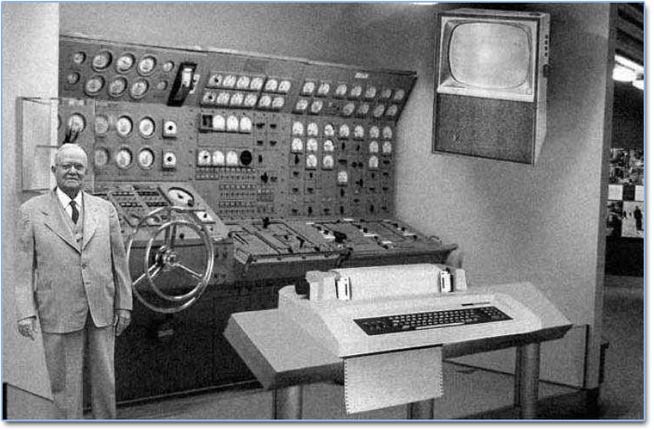
Analysis Methods

Slide 7
Analysis Methods
Individual questions (ordinal data)
  Descriptive statistics
    Median
    Mode
    Range
    Inter-quartile range
    Not mean or standard deviation
  Non-parametric tests
    Mann-Whitney U test
    Wilcoxon signed-rank test
    Kruskal-Wallis test
Notes:
Individual questions or “items” are ordinal data
- ordered categories, but participants might not perceive the difference between adjacent levels to be equal
Many do treat responses as interval data, but this is dangerous
- interval data has ordered categories, but no absolute zero point
- numbers assigned to categories indicate magnitude of difference between them
- differences between pairs of measurements can be meaningfully compared
Descriptive stats
- median -> middle number in sorted data
- mode -> most frequent number in data
- range -> diff between largest and smallest value in data
- inter-quartile range -> diff between Q3 and Q1; the middle 50% of data
Q1 cuts off lowest 25% of data = median of lower 50%
Q2 = median of all data
Q3 cuts off highest 25% of data = median of upper 50%
- not mean or standard deviation
- “The average of ‘fair’ and ‘good’ is not ‘fair-and-a-half’” – Susan Jamieson paraphrasing Kuzon Jr et al.
Non-parametric tests (underlying pop. does not have a pre-defined distribution)

Slide 8
Analysis Methods Cont’d
Summed responses (interval data)
  Restrictions
    All questions use same Likert scale
    Defendable approximation to an interval scale
  Parametric tests
    Analysis of variance (ANOVA)
Reduced to nominal levels of agree vs. disagree:
  Chi-square test
  Cochran Q test
  McNemar test
Notes:
Groups of related items sometimes have their responses summed and then analyzed
- ie. “summative scales”
Restrictions:
- must use same Likert scale
- defendable approx. to interval scale
- coding indicates magnitude of diff between items, but there’s no absolute zero
- all items measure a single latent variable
- var that is not directly observed, but inferred from other vars that are observed/measured directly
Parametric tests (underlying pop. has a pre-defined distribution such as a normal distribution)

Slide 9

Worked Example

Slide 10
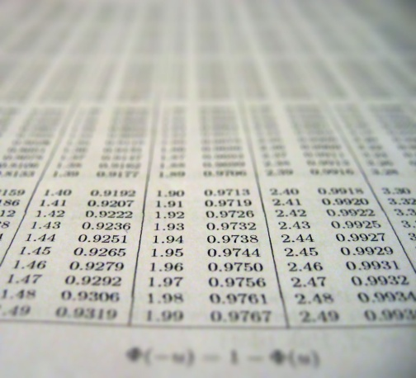
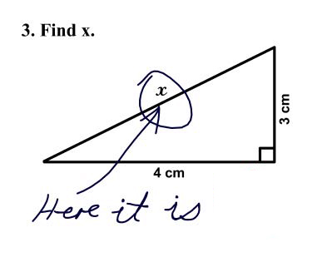

Worked Example
Raw data
Descriptive statistics
Mann-Whitney U test
Please indicate how much you agree or disagree with each of the following statements:
 | Strongly disagree | Somewhat disagree | Neither agree nor disagree | Somewhat agree | Strongly agree
1. The “U of C • This is now” website is easy to use | 1 | 2 | 3 | 4 | 5
2. The “My U of C” website is easy to use. | 1 | 2 | 3 | 4 | 5
3. The “Peoplesoft Student Center” website is easy to use. | 1 | 2 | 3 | 4 | 5
Notes:
Mann-Whitney U test for Q1: The “U of C • This is now” website is easy to use

Slide 11
Raw Data
Participant ID | Category | Q1. U of C | Q2. My U of C | Q3. Peoplesoft
1 | MSc | 4 | 4 | 3
2 |  | 3 | 4 | 3
3 |  | 4 | 3 | 2
4 |  | 2 | 3 | 4
5 |  | 5 | 3 | 3
6 |  | 4 | 2 | 2
7 |  | 3 | 3 | 3
8 |  | 4 | 4 | 4
9 | PhD | 3 | 4 | 3
10 |  | 2 | 5 | 2
11 |  | 2 | 4 | 2
12 |  | 4 | 1 | 3
13 |  | 1 | 3 | 2
14 |  | 2 | 2 | 3
15 |  | 4 | 3 | 3
16 |  | 1 | 1 | 2
Table 1. Raw Data

Slide 12
Descriptive Statistics
 | Median | Mode | Range | Inter-quartile Range
Q1. U of C | 3 | 4 | 4 | 2
Q2. My U of C | 3 | 3 | 4 | 1.25
Q3. Peoplesoft | 3 | 3 | 2 | 1
Table 2. Descriptive Statistics 1A
 | Median |  | Mode |  | Range |  | Inter-quartile Range
 | MSc | PhD | MSc | PhD | MSc | PhD | MSc | PhD
Q1. U of C | 4 | 2 | 4 | 2 | 3 | 3 | 1 | 1.5
Q2. My U of C | 3 | 3 | 3 | 4 | 2 | 4 | 1 | 2.25
Q3. Peoplesoft | 3 | 2.5 | 3 | 3 | 2 | 1 | 0.5 | 1
Table 3. Descriptive Statistics 1B
Notes:
Table 2 -> stats for all responses together
Table 3 -> stats broken down by participant categories

Slide 13
Descriptive Statistics Cont’d
 |  | Strongly disagree | Somewhat disagree | Neither agree nor disagree | Somewhat agree | Strongly agree
Q1. U of C | # | 2 | 4 | 3 | 6 | 1
 | % | 13% | 25% | 19% | 38% | 6%
Q2. My U of C | # | 2 | 2 | 6 | 5 | 1
 | % | 13% | 13% | 38% | 31% | 6%
Q3. Peoplesoft | # | 0 | 6 | 8 | 2 | 0
 | % | 0% | 38% | 50% | 13% | 0%
Table 4. Descriptive Statistics 2A
 |  | Strongly disagree |  | Somewhat disagree |  | Neither agree nor disagree |  | Somewhat agree |  | Strongly agree
 |  | MSc | PhD | MSc | PhD | MSc | PhD | MSc | PhD | MSc | PhD
Q1. U of C | # | 0 | 2 | 1 | 3 | 2 | 1 | 4 | 2 | 1 | 0
 | % | 0% | 25% | 13% | 38% | 25% | 13% | 50% | 25% | 13% | 0%
Q2. My U of C | # | 0 | 2 | 1 | 1 | 4 | 2 | 3 | 2 | 0 | 1
 | % | 0% | 25% | 13% | 13% | 50% | 25% | 38% | 25% | 0% | 13%
Q3. Peoplesoft | # | 0 | 0 | 1 | 4 | 4 | 4 | 2 | 0 | 0 | 0
 | % | 0% | 0% | 25% | 50% | 50% | 50% | 25% | 0% | 0% | 0%
Table 5. Descriptive Statistics 2B
Notes:
Table 4 -> aggregate responses for each Likert scale level (# and %)
Table 5 -> again, broken down by participant categories

Slide 14
Mann-Whitney U test
Requirements:
  Non-parametric test
  Two samples must be statistically independent
  Observations must be on an ordinal scale
Null hypothesis:
  Equal probability that an observation from one sample will exceed an observation from the other sample
Notes:
AKA:
Mann-Whitney-Wilcoxon
Wilcoxon rank-sum test
Wilcoxon-Mann-Whitney test
Non-parametric (underlying pop. does not have a pre-defined distribution)
Statistically independent (occurrence of one event makes it neither more nor less probable that the other event occurs)
Null hypothesis: the two samples come from same pop

Slide 15
Step 1: Calculate U statistic
Tie
Tie
Tie
Tie
Rank-ordered: | 1 | 1 | 2 | 2 | 2 | 2 | 3 | 3 | 3 | 4 | 4 | 4 | 4 | 4 | 4 | 5
Origin sample: | P | P | M | P | P | P | M | P | M | M | P | M | P | M | M | M
Combine observations from both samples
Write down observations in rank-order
Label which sample each observation came from
  Alternate between samples when repeated values appear in both

Slide 16
Step 1: Calculate U statistic
Tie
Rank-ordered: | 1 | 1 | 2 | 2 | 2 | 2 | 3 | 3 | 3 | 4 | 4 | 4 | 4 | 4 | 4 | 5
Origin sample: | P | P | M | P | P | P | M | P | M | M | P | M | P | M | M | M
Count: |  |  | 0.5 |  | + 1 | + 1 |  | + 1 |  |  | + 1 |  | + 1 |  |  | = | 5.5
Rank-ordered: | 1 | 1 | 2 | 2 | 2 | 2 | 3 | 3 | 3 | 4 | 4 | 4 | 4 | 4 | 4 | 5
Origin sample: | P | P | M | P | P | P | M | P | M | M | P | M | P | M | M | M
Count = |  |  | 0.5 |  | + 1 | + 1 |  | + 1 |  |  | + 1 |  | + 1 |  |  |  | = 5.5
}
For each observation from sample 1 (MSc students):
  Move left-to-right
  Count 1 for each observation from sample 2 (PhD students) occurring after it in the list
  When there is a tie, count 0.5
Add all these counts together to form U_{MSc}
Count for first MSc response:

Slide 17
Step 1: Calculate U statistic
Count for second MSc response:
Tie
Rank-ordered: | 1 | 1 | 2 | 2 | 2 | 2 | 3 | 3 | 3 | 4 | 4 | 4 | 4 | 4 | 4 | 5
Origin sample: | P | P | M | P | P | P | M | P | M | M | P | M | P | M | M | M
Count = |  |  | 0.5 |  | + 1 | + 1 |  | + 1 |  |  | + 1 |  | + 1 |  |  |  | = 5.5
Rank-ordered: | 1 | 1 | 2 | 2 | 2 | 2 | 3 | 3 | 3 | 4 | 4 | 4 | 4 | 4 | 4 | 5
Origin sample: | P | P | M | P | P | P | M | P | M | M | P | M | P | M | M | M
Count: |  |  |  |  |  |  | 0.5 |  |  |  | + 1 |  | + 1 |  |  | = | 2.5
}
Count for third MSc response:
Rank-ordered: | 1 | 1 | 2 | 2 | 2 | 2 | 3 | 3 | 3 | 4 | 4 | 4 | 4 | 4 | 4 | 5
Origin sample: | P | P | M | P | P | P | M | P | M | M | P | M | P | M | M | M
Count: |  |  |  |  |  |  |  |  |  |  | 1 |  | + 1 |  |  | = | 2
Rank-ordered: | 1 | 1 | 2 | 2 | 2 | 2 | 3 | 3 | 3 | 4 | 4 | 4 | 4 | 4 | 4 | 5
Origin sample: | P | P | M | P | P | P | M | P | M | M | P | M | P | M | M | M
Count = |  |  | 0.5 |  | + 1 | + 1 |  | + 1 |  |  | + 1 |  | + 1 |  |  |  | = 5.5

Slide 18
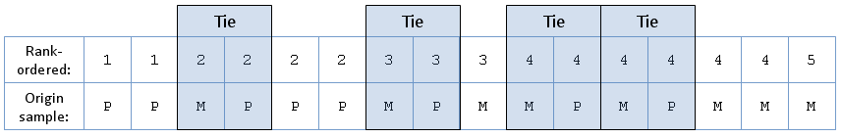
Step 1: Calculate U statistic
Sum these counts together:
  U_{MSc} = 5.5 + 2.5 + 2 + 1.5 + 0.5 + 0 + 0 + 0
  = 12
Similarly, calculate U_{PhD}:
  U_{Phd} = 8 + 8 + 7.5 + 7 + 7 + 6.5 + 4.5 + 3.5
  = 52
Sanity check:
  U₁ + U₂ = (# of observations in S₁) x (# of observations in S₂)
Notes:
Sanity check works because in the most extreme case,
all values from one sample would come before the values
from the other sample. Thus, moving left-to-right, each
of the counts would be either 8 or 0 in the example above

Slide 19
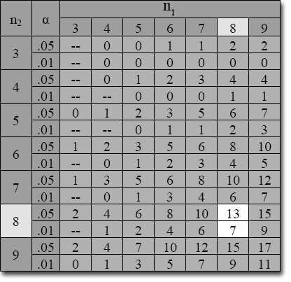
Step 2: Critical values table
Table 6. Mann-Whitney U Distribution Critical Values
Use the lower of the two U stats (U_{MSc} = 12) with:
  n₁ = # of observations in S₁
  n₂ = # of observations in S₂
  α = level of significance
If below table value:
  Reject null hypothesis
  Samples are significantly
  different at the α level
Notes:
n1 and n2 both = 8 in this case
Alpha = .05
We reject the null hypothesis at the .05 level and state
that the MSc and PhD samples are significantly different
in their opinion of the main U of C website.

Slide 20

Why does it not suck?
Simple to construct
Generally a highly reliable scale
Easy to read and complete for participants
Fun for the whole family!

Slide 21
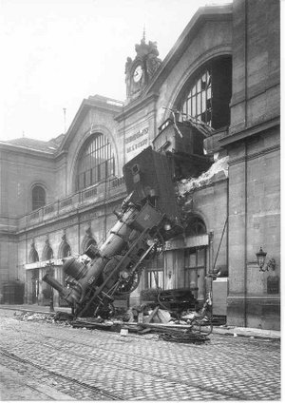
Ok then, what does suck?
Central tendency bias
  “Fence riding”
Acquiescense bias
  Try to “please” you
Social desirability bias
  Portray themselves favourably
Lack of reproducibility
Difficult to demonstrate validity
  Did you measure what you set out to measure?
Notes:
Central tendency bias – participants avoid extreme response categories
Acquiescense bias – participants agree with statements as present in order to “please” experimenter
Social desirability bias – portray themselves (or their org) in a more socially favourable light rather than being honest
Reproducibility -> everyone has their own opinions
Validity -> measuring what you set out to measure?

Slide 22
Questions?

