Slide 1
Medication management tools for the home based elderly
Nicole Percival

Slide 2

Medication & The Elderly

Slide 3
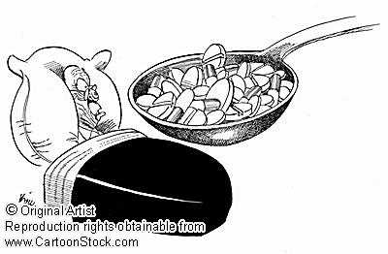
Medication Management Problems
Factors influencing medication compliance
Reasons for non-adherence
Consequences of medication mismanagement

Slide 4

Medication Management Tools –
Considerations

Slide 5
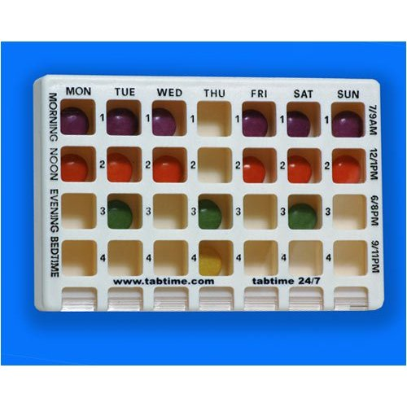
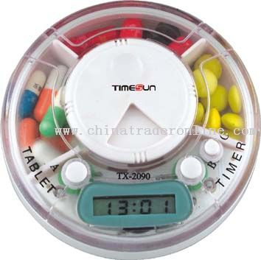
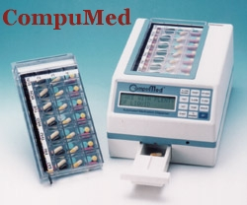
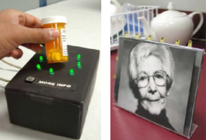
Medication Management Tools – Existing Technology

Slide 6

Conclusion

Slide 7
References
Agarawala, A., Greenberg, S., & Ho, G. (2004). The context-aware pill bottle and medication monitor. Video proceedings and proceedings supplement of the UBICOMP 2004 conference.
Beolchi, L. (2003). Telemedicine Glossary: Glossary of concepts, Technologies, Standards and Users, 5th ed., European Commission, Brussels.
Blonde, L. (2000). Removing polytherapy as a barrier to adherence. Managed care, compliance and persistence with medication therapy, 9 (9), 1-
Corlett, A. J. (1996). Aids to compliance with medication. British Medical Journal, 313, 926-29.
Coughlin, J. F., Pope, J. E., & Leedle Jr., B. R. (2006). Old age, new technology, and future innovations in disease management and home health care. Home health care management and practice, 18 (3), 196-207.
Dresden, D. (2004). Packages they’ll like. Pharmacy Week, 18 (14), www.pharmacyweek.com
Hornick, T. R., Higgins, P. A., Stollings, C., Wetzel, L., Barzilai, K., & Wolpaw, D. (2006). Initial evaluation of a computer-based medication management tool in a geriatric clinic. The American journal of geriatric pharmacology, 4 (1), 62-69.
Jadad, A. R., & Delamothe, T. (2003). From electronic gadgets to better health: Where is the knowledge? British Medical Journal, 327 (7410), 300-
Kerns, B., Atkinson, W., & Niewenhous, S. S. (2008). Improvement in the management of oral medications: Collaborative approaches. Home health care management practice, 20, 141-46.
Koong, K. S., Koong, L. Y., Liu, L. C., & Yu, M. (2005). An examination of selected drug availability at online pharmacies. International Journal of Elecronic Healthvare, 1 (3), 291-302.
MacLaughlin, E. J., Raehl, C. L., Treadway, A. K., Sterling, T. L., Zoller, D. P., & Bond, C. A. (2005). Assessing medication adherence in the elderly: Which tools to use in clinical practice. Drugs Aging, 22 (3), 231-55.
Metaxiotis, K. (2005). E-health versus KM-based health: a dilemma in researchers’ minds. International Journal of Electronic Healthcare, 1 (3), 303-15.

Slide 8
References
Mitchell, J., Matthews, H., Hunt, L., Cobb, K., & Watson, R. (2001). Mismanaging prescription medications among rural elders: The effects of socioeconomic status, health status, and medication profile indicators. The Gerontologist, 41 (3),
Mulvenna, M. D., Nugent, C. D., Wallace, J. G., & Martin, S. (2006). Representation of user contexts in smart home monitoring. International Conference on Aging, Disability and Independence, Saint Petersburg, USA, University of Florida, 1-5 February, 256.
Nugent, C., Finlay, D., Davies, R., Mulvenna, M., Wallace, J. , Paggetti, C., Tamburini, E., & Black, N. (2007). The next generation of mobile medication management solutions. International Journal of Electronic Healthcare, 3 (1), 7-31.
Rivers, P. H. (1992). Compliance aids – do they work? Drugs and Aging, 2, 103-11.
Schilit, B. N., Adams, N., Gold, R., Tso, M. M., & Want, R. (1994). Context-aware computing applications, IEEE Workshop on Mobile Computing Systems and Applications.
Smith, D. (1989). Compliance packaging: A patient education tool. American pharmacy, NS29 (2),
Szeto, A. Y. J., & Giles, J. A. (1997). Improving oral medication compliance with an electronic aid, IEEE Engineering in Medicine and Biology Magazine, 16 (3), 48-54.
Wendt, D. A. (1998). Evaluation of medication management interventions for the elderly. Home Healthcare News, 16 (9), 613-17.
Wiebe, C. (1999). Following orders: New solutions to the age-old problem of patient noncompliance with prescription drug orders. American medical news, www,ama-assn.org.amednews/
Wickramasinghe, N. S., Fadlalla, A. M. A., Geisler, E., & Schaffer, J. L. (2005). A framework for assessing e-health preparedness. International Journal of Electronic Healthcare, 1 (3), 316-34.
Winland-Brown, J. E., & Valiante, J. (2000). Effectiveness of different medication management approaches on elder’s medication adherence. Outcomes Management for Nursing Practice, 4 (4), 172 – 75.

