Slide 1
HOW TO PRESENT
SAUL GREENBERG
UNIVERSITY OF
CALGARY
Image from:
Notes:
The first two slides are fakes. I go in pretending I am bubbling, unprepared, last minute, etc.
Then have blue screen of death and panic.
Then recover by pulling out my memory stick and borrowing another student’s computer
Prep:
Check audio, projector
Seating (rearrange_
Put out handouts
Greet people
To have:
-notes
-handouts
-backup
-computer
-speakers on reserve if needed (cable?)

Slide 2
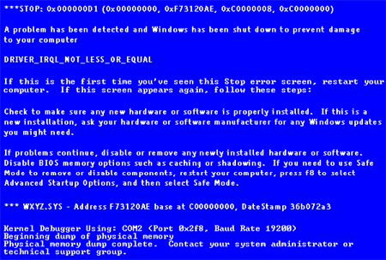


Slide 3
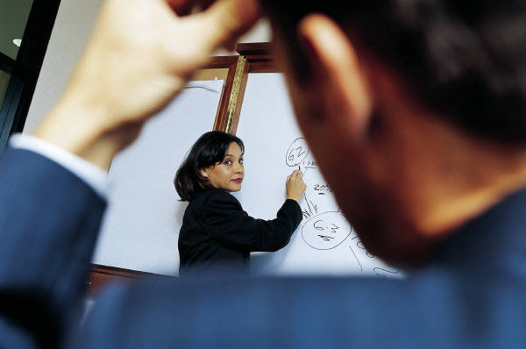
How to Present
Saul Greenberg
University of Calgary
Image from:
Notes:
First things first:
-never check your presentation with your luggage
-check out media long before the talk starts
-make sure all audience can see projected image
walk around
2 projectors
wall vs. screen
-focus
-know equipment: switches, bulbs
-light and glare: media tradeoff
-backup media should always be available
This slide: intro slide
introduce self, where from, and topic

Slide 4
The Message
Prepare yourself
Typical presentations
Style
know your message
know your audience & venue
practice, practice, practice
top-down structure
keep it simple
use media effectively
stay in control
use body language
let your enthusiasm show!
Notes:
I always write out what the goal of the talk is, that is, the main message that I want people to remember from the presentation
The entire talk should be crafted to deliver this message

Slide 5
Outline
Why present?
Presentations you may give
Structure
Style and tips
Use of media
Handling questions
Notes:
To deliver this message, I will first ….
The outline provides a road map, and should relate back to the message

Slide 6
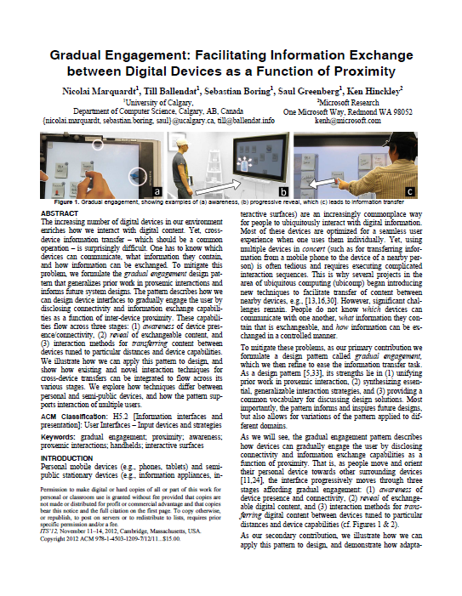
motivation
Why present?
Science includes the dissemination of knowledge
Notes:
Dissemination:
-papers
-presentations
-posters
-demonstrations
-videos
-www
-system / software releases …

Slide 7

motivation
Why present?
Audiences are opportunities
  get them interested in your work
  associate your “face” with the work
  provide discussion / feedback
The downside:
  risky!
Notes:
Dissemination:
Audience:
-is this the audience I want e.g., good conference? A write only paper?
-are there people I want to hear me in this audience?
-will the work be remembered afterwards
surprises, skits, this intro!!!
Risks:
-people remember bombs and bad talks
-hard to recover
-risk worth it: eg, live demo implies faith in the software
-possible to produce a paper which sounds ok in writing but may seem stupifying or trivial as a presentation

Slide 8

Presentations you may give
Research papers
  seminar/conferences, workshops
Surveys / topic introductions
  tutorials/conferences/class
Discussions / points of view
  seminars, workshops
  panels
Defense of known subject matter
  thesis, proposals
Notes:
Your minimum presentations:
-You are required to give at least one departmental seminar to your peers (other grads) and faculty
-You should try to publish and present at least one paper and/or outside presentation
-You have to give a Thesis Oral, where orals are public.

Slide 9
Presentations you may give
Audiences
  topic specialists
  area specialists
  computer scientists
  scientists
  academics
  public
experts
lay
Notes:
Audience:
-your talk must be prepare at the right level for your audience.
-A great talk for one audience may bomb with another.
-the audience determines the amount of detail you can get into

Slide 10
Presentations you may give
As room size increase, so does:
  formality
  inability of audience to cope with detail
2500+
large halls
60
large meeting rooms
30
seminar rooms
10
breakout rooms
Notes:
Larger audience:
-broader interests
-less overall knowledge of your area
-less able to cope with detail
Exception: thesis oral
-small but formal

Slide 11
Structure
The Opening: 1 1-2 minutes
  Introduce yourself and co-authors
  Tell them what you are going to tell them
  Define the problem
  Provide a road map (outline)
Notes:
Give the chair notes to introduce you, and discuss it with them
so you get a good intro!

Slide 12
Structure
The Opening: 2 ~5 minutes
  Tell them why they should listen
  Motivate the audience
    define the problem in greater detail
    emphasize goal and contributions
  Background / terminology
    relate to earlier work
    avoid or explain jargon
Notes:
Example:
-Apply theoretical aspects to real world problems and applications
- how it fits in
why it is useful
-Gives background to understand your talk
-Avoid or explain jargon / acronyms

Slide 13
Structure
The Body
  Tell them
  Describe what you did, and how you did it
  Explain its significance
Notes:
-Avoid excessive details:
Refer to paper for details
-Significance
Tell audience why they where there

Slide 14
Structure
Conclusions 2-3 minutes
  Tell them what you told them
  Summarize purpose and main point(s)
  Discuss current work/open problems
  Indicate your talk is over
Notes:
-Mention gaps that weren’t covered in the talk or the paper (avoids awkward questions)
-Be open and honest
increases credibility

Slide 15
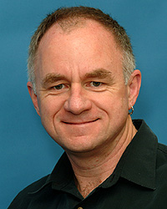
Style and Tips
I can’t overemphasize the importance of being clear in your own mind what you want the audience to get from your presentation.
Only then can you really concentrate on doing a good job of getting it across.
Bruce MacDonald
Notes:
Your message should permeate your talk
-the intro, the contributions, the conclusions
-all points should re-enforce it
-it should be the single thing the audience takes away with them

Slide 16
Know your
Message !
Bruce MacDonald
Notes:
Your message should permeate your talk
-the intro, the contributions, the conclusions
-all points should re-enforce it
-it should be the single thing the audience takes away with them

Slide 17

Style and Tips
Don’t get bogged down in details
  will lose people and never get them back
  main point forgotten by audience
  fit details to your audience
Keep it simple
Notes:
Details:
-You know too much, and can get bogged down / over-run time
-Shorter talks are harder!
-Decide what you want to include and leave out while still communicating the main message is hard work
Audience
-Different audiences require different styles / terminology / detail

Slide 18

Style and Tips
Good body language
  be enthusiastic
  maintain eye contact
  speak clearly and audibly
  don’t read
Use your voice and body
Notes:
‘Sell’ your ideas.
Much of message comes from body language and voice
Scripts: reading from them puts people to sleep.

Slide 19

Style and Tips
Timing
  adjust content to fit
  don’t rush
Watch the time
Notes:
Time:
Conferences - strict time
people hate missing coffee breaks / lunch
you may loose your question period
avoid going faster: trim instead

Slide 20

Style and Tips
Prepare, practice, revise, practice
  get talk to match slides
  know your notes, but don’t rely on them
  get feedback
    friendly but critical audience
Practice, practice, practice
Notes:
Practice is the most important single thing you can do to improve your presentation!!!

Slide 21
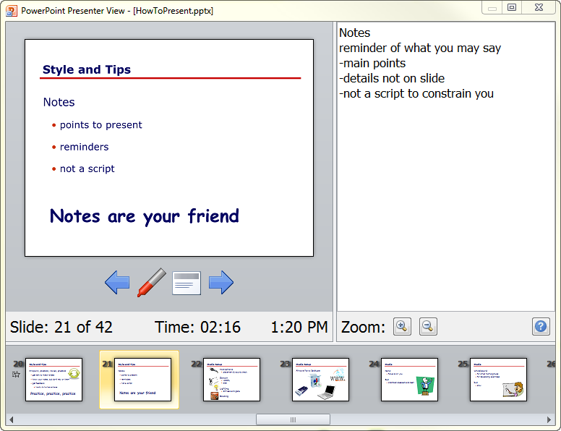
Style and Tips
Notes:
Notes
reminder of what you may say
-main points
-details not on slide
-not a script to constrain you

Slide 22


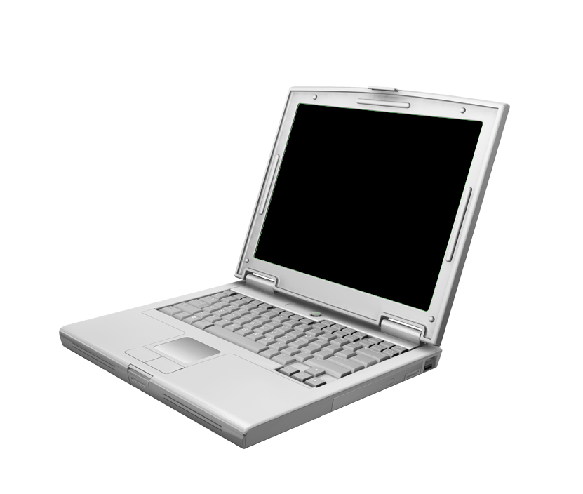

Media Setup
Always have backups
Notes:
Expect everything to work, but prepare for failure
May have 2nd lower quality version, but still works (eg overheads)

Slide 23



Media Setup
Microphone
  placement & sound check
Screen
  visibility
  size
  lighting
Seating
Notes:
Microphone:
-placed too high, breathing
-too low, bad audio / feedback
-keep mouth by mike
-watch out for wires
-know where the switch is
Screen and lighting
- Can people easily read smallest text from the back?
Seating
-rearrange if needed
- Get people to sit near front (handouts)?

Slide 24

Media
None
  focus is on you
But
  practiced speakers are best
Notes:
Avoid no media unless you are skilled

Slide 25

Media
Whiteboard
  for small rooms/groups
  for developing examples
but
  slow
Notes:
Whiteboard:
-can use with other media
eg for recording static list of points during presentation
-electronic whiteboards atop e.g. powerpoint

Slide 26

Media
Slide deck
  the norm
  text / images / videos
  static and dynamic content
but
  less text per slide
  expect poor lighting
Notes:
Computers:
-excellent for multimedia
-unreliable, hard to set up, projector problems, power issues, resolution dilemmas, projector brightness, audio jacks, small screens…
-expect them to fail
-maximize font size / images / contrast due to poor lighting

Slide 27
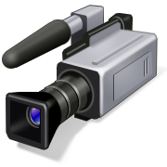
Media
Video and demos
  showing vs explaining
  tells the story
but
  don’t let them take over
Notes:
Videos
-great, but don’t let them take over
Demos
-they see it, they believe it
-risky, but well worth it
-have backup (video) just in case!

Slide 28
Text description
Proxemic Media Player (2010)
A video media player
senses
  distance and orientation of a person
reacts by
  turning itself on
  progressive detail
  interaction techniques tuned to distance
Notes:
Illustrating a system by text
-textual descriptions of visual material hard to understand

Slide 29
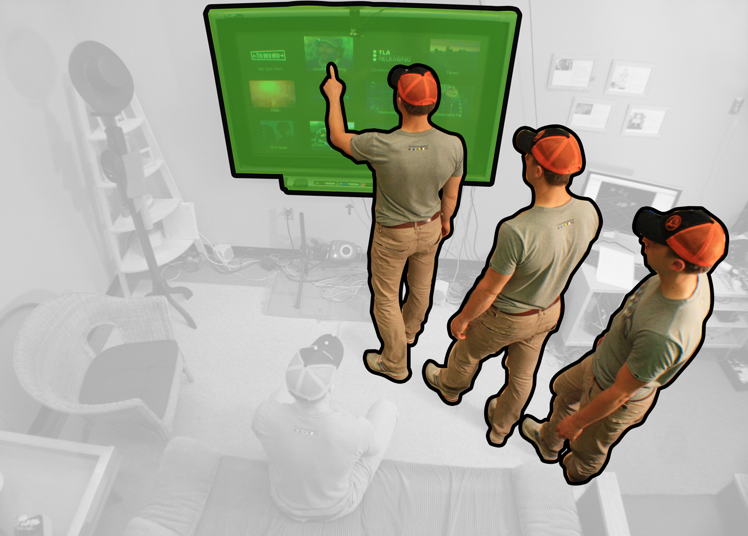
Picture
Proxemic Media Player
Notes:
Illustrating a system by image
-weave a scenario around it so people can understand how the system works

Slide 30
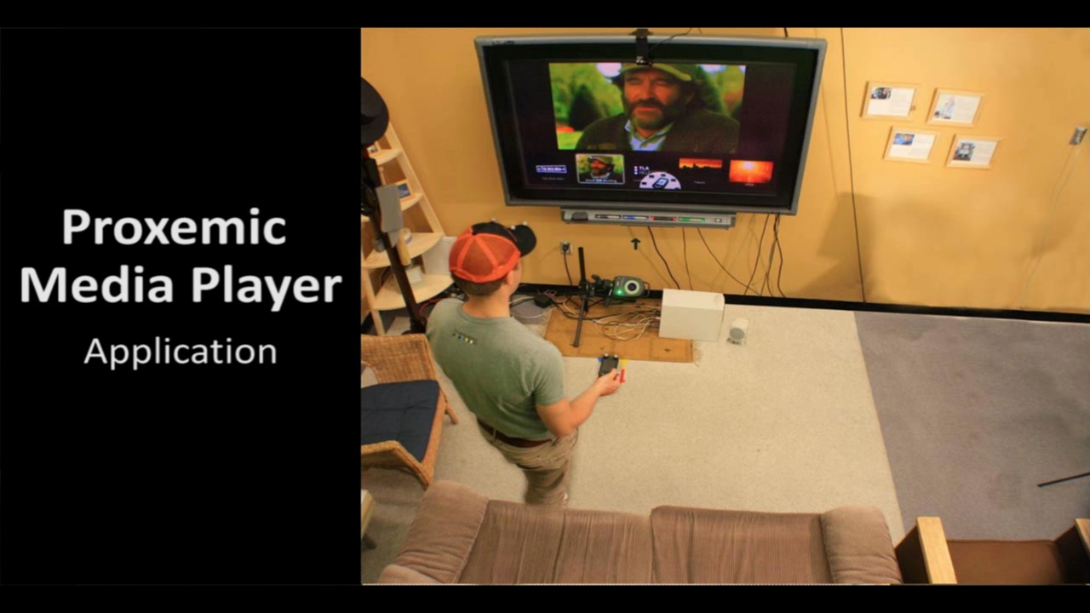
  reacts according to distance & orientation
  increase in detail & interactivity
Notes:
Illustrate a system by image and video
-use image as prelude to tell them what to watch for
-reduce the volume and talk over it if it’s a long video so it doesn’t take over

Slide 31
Too much detail; cluttered
Appearance of Media
None
  practiced speakers are best at this, because they are comfortable talking to the audience
Whiteboard
  this is best for small rooms, for group,s and for developing examples where the example unfolds over time
  its really too slow a medium, because it takes time to write things down!
  it also puts your back to the audience
Transparencies
  must be legible by people at back of your expected meeting room in bad lighting conditions (assume the worst!)
  of course, it should be typeset. Some good thing to remember are:
    large, variable width fonts
    uncluttered, with only a few easily remembered points on the slide that you can talk around
    white space used as hints
  don’t prepare too many, because people won’t remember. Around 1.5-2 minutes/overhead or more is a reasonable rule of thumb
  people remember visuals, so prefer pictures/tables over words if possible
Notes:
Example of different (bad) media use

Slide 32
Appearance of Media (16 point courier)
None
  practiced speakers are best at this
Whiteboard
  best for small rooms/groups
  best for developing examples
  very slow
Transparencies
  must be legible by all (assume the worst!)
  typeset
  don’t prepare too many
  prefer pictures/figures/tables over words

Slide 33
ALL CAPS
APPEARANCE OF MEDIA
NONE
  PRACTICED SPEAKERS ARE BEST AT THIS
WHITEBOARD:
  BEST FOR SMALL ROOMS/GROUPS
  BEST FOR DEVELOPING EXAMPLES
  VERY SLOW
TRANSPARENCIES
  TYPESET
  DON’T PREPARE TOO MANY
  PREFER PICTURES/FIGURES/TABLES OVER WORDS

Slide 34


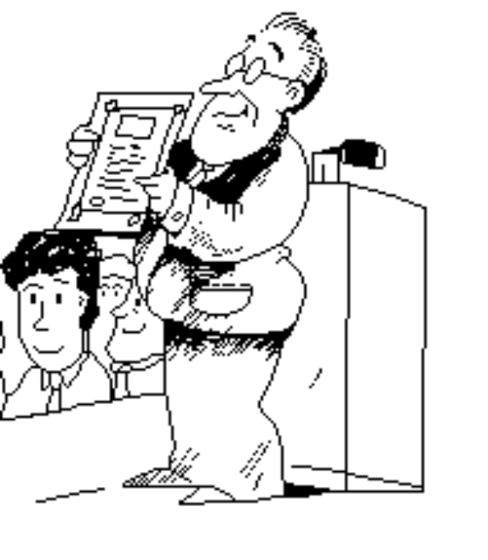
Fontitis, overdecorated
Appearance of Media
None
  practised speakers are best at this
Whiteboard:
  best for
    small rooms/groups
    developing examples
  very slow
Transparencies
  must be legible by all (assume the worst!)
  Typeset it
  don’t prepare too many
  prefer pictures/figures/tables over words

Slide 35

Bad colors, contrast…
Appearance of media
Transparencies
  must be legible by all (assume the worst!)
  typeset
  don’t prepare too many
  prefer pictures/figures/tables over words
Computers
  less text / slide
  expect poor lighting
  best for animations and demonstrations
Notes:
Your screen may give far better contrast than the screen in the hall!!!

Slide 36

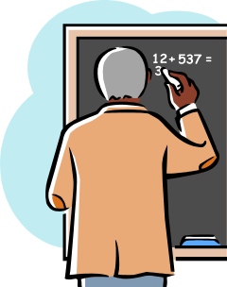

Gratuitous animations (not visible in handouts)
Appearance of Media
None
  practiced speakers are best at this
Whiteboard
  best for small groups
  best for developing examples
  very slow
Transparencies
  typeset
  don’t prepare too many
  prefer pictures/figures/tables over words

Slide 37
Alignment & white space
Appearance of Media
None
practiced speakers are best at this
Whiteboard
best for small groups
best for developing examples
very slow
Transparencies
typeset
don’t prepare too many
prefer pictures/figures/tables over words

Slide 38

About right
Appearance of Media
None
  practiced speakers are best at this
Whiteboard
  best for small groups
  best for developing examples
  very slow
Transparencies
  typeset
  don’t prepare too many
  prefer pictures/figures/tables over words

Slide 39

Question/Discussion
Anticipate questions ahead of time
  dry runs help
Turn “bad” questions into good ones
  always repeat the question
Maintain control
  guide discussion
  limit time on minor/irrelevant
Notes:
Always repeat question
Bad questions
- can’t hear it, rambly, vague, multiple questions, unclear
transform it into a better question you can answer
Control: don’t get left out of the loop
-many prima donnas out there who want their minute of fame

Slide 40
The Thesis Oral Presentation
Why?
  a warm-up period for you and the examiners
  reminds examiners what they have read
What?
  objective of your work
  very brief overview/motivation/history
  highlights of your methodology/results
  main contributions
  future directions
To prepare
  mock defense
Notes:
Ask your advisor about what should be in it.

Slide 41
Summary
Prepare yourself
Typical presentations
Style
know your message
know your audience & venue
practice, practice, practice
top-down structure
keep it simple
use media effectively
stay in control
use body language
let your enthusiasm show!
Notes:
I always write out what the goal of the talk is, that is, the main message that I want people to remember from the presentation
The entire talk should be crafted to deliver this message
… and it should end with the same message

Slide 42
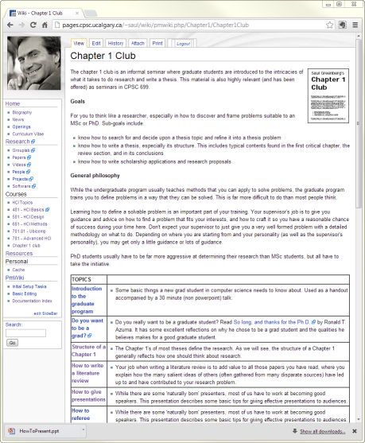
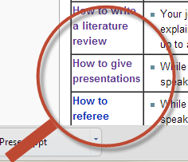
For more informaton
google
  Saul Greenberg
  Chapter 1 Club
Notes:
For all this material and more…

Slide 43



Permissions
You are free:
  to Share — to copy, distribute and transmit the work
  to Remix — to adapt the work
Under the following conditions:
Attribution — You must attribute the work in the manner specified by the author (but not in any way that suggests that they endorse you or your use of the work) by citing:
  “from presentations accompanying the book ‘Sketching User Experiences, the Workbook’, by S. Greenberg, S. Carpendale, N. Marquardt and B. Buxton”
Noncommercial — You may not use this work for commercial purposes, except to assist one’s own teaching and training within commercial organizations.
Share Alike — If you alter, transform, or build upon this work, you may distribute the resulting work only under the same or similar license to this one.
With the understanding that:
Not all material have transferable rights — materials from other sources which are included here are cited
Waiver — Any of the above conditions can be waived if you get permission from the copyright holder.
Public Domain — Where the work or any of its elements is in the public domain under applicable law, that status is in no way affected by the license.
Other Rights — In no way are any of the following rights affected by the license:
  Your fair dealing or fair use rights, or other applicable copyright exceptions and limitations;
  The author's moral rights;
  Rights other persons may have either in the work itself or in how the work is used, such as publicity or privacy rights.
Notice — For any reuse or distribution, you must make clear to others the license terms of this work. The best way to do this is with a link to this web page.

