Slide 1
2 Programming
Peeking into Computer Science

Slide 2
Objectives
At the end of this section, you will be able to:
Understand the concept of variables
Create properties and local variables in Alice

Slide 3
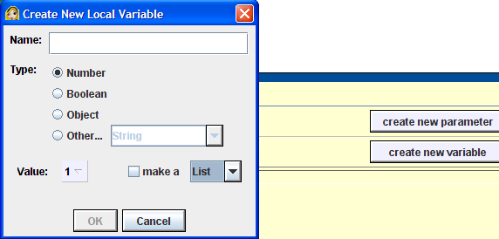
JT’s Extra: Variables
Are used by a program to temporarily store information.
Many types of information can be stored by a variable.
  For this class you will be mostly concerned with: numbers, Booleans (true or false), string (series of characters).
(Lists will also be covered this term).

Slide 4
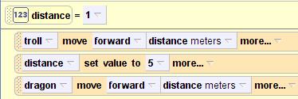
JT’s Extra: Example Use Of A Variable
Example 3: variables
Distance is a variable with an initial value of 1.
The no. of meters forward that the troll moves is determined by the current value stored in distance (1).
Variable distance now stores the number 5.
The no. of meters forward that the dragon moves is determined by the current value stored in distance (which is now 5).

Slide 5
JT’s Extra: Variable Naming Conventions
Should be meaningful
  E.g., ‘x’, ‘y’ (bad) vs. ‘age’, ‘distance’ (better)
Variable names should generally be all lower case.
For variable names composed of multiple words separate each word by capitalizing the first letter of each word (save for the first word) or by using an underscore. (Be consistent!)
  netIncome
  gross_pay
  (Avoid using spaces).
Notes:
Another example that shows the effect of user input is tutorial 3-3.
5

Slide 6
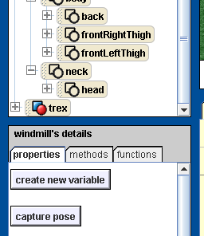
Property Variables
Properties of an object:

Slide 7
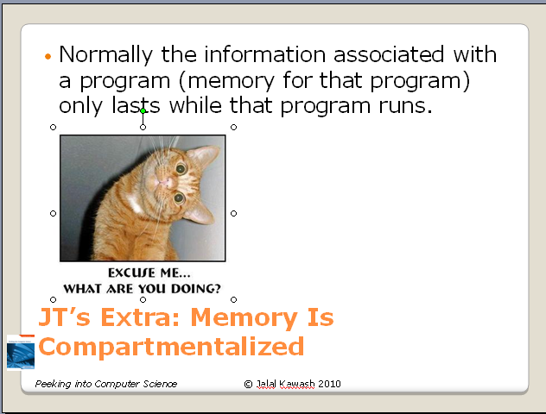
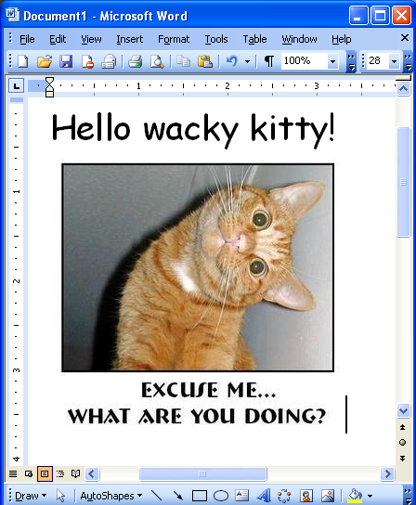
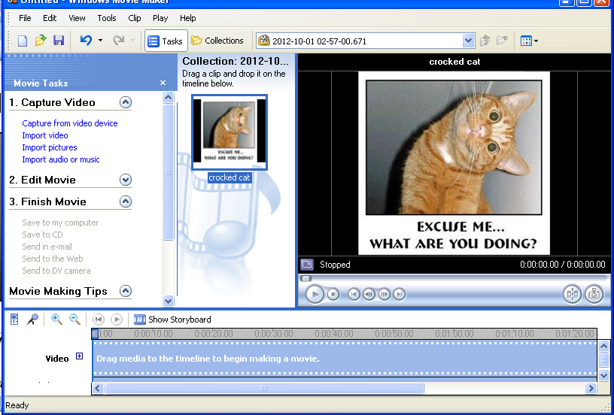
JT’s Extra: Memory Is Compartmentalized
Image in PowerPoint
While the program runs the text and image can be accessed elsewhere
Word
Movie maker
Normally the information associated with a program (memory for that program) only lasts while that program runs.

Slide 8
JT’s Extra: Memory Is Compartmentalized
The program (PowerPoint) ends and it’s data is no longer accessible (localized to the program unless copied)
Word
Movie maker
Normally the information associated with a program (memory for that program) only lasts while that program runs.

Slide 9
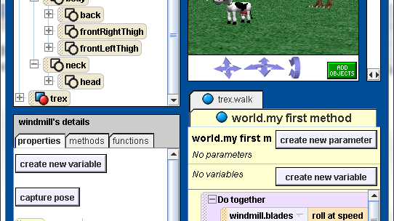
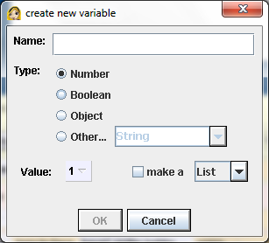
Local Variables
Local to methods
  Do not exist outside the method in which they are contained

Slide 10
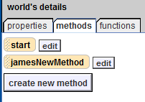
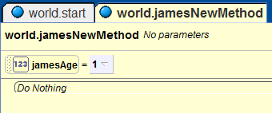
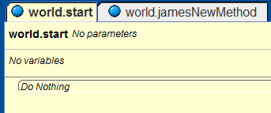
JT’s Extra: Local Variables
Methods of the example program: ‘start’, ‘jamesNewMethod’
Local variable of ‘jamesNewMethod’: ‘jamesAge’
Local variable ‘jamesAge’ not in the ‘start’ method

Slide 11
JT’s Extra: World Level Variables
As the name implies they can be accessed anywhere in the world.
In practice it means that these variables can be used in any method of that world.

Slide 12
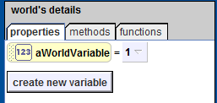
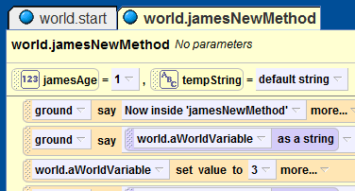
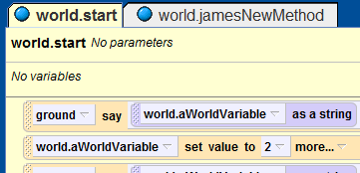
JT’s Extra: World Level Variables
Example 4: Local vs. World variables, string conversion
World-level variables: properties of the world
World level variable can be directly accessed in the methods.

Slide 13
JT’s Extra: String Conversion
An object can only display string information when it ‘says’ or ‘thinks’ something.
Numeric information must be converted to a string before it can be displayed:
  World->functions->”what as string”

Slide 14
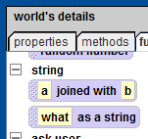
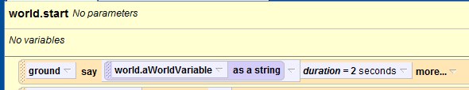
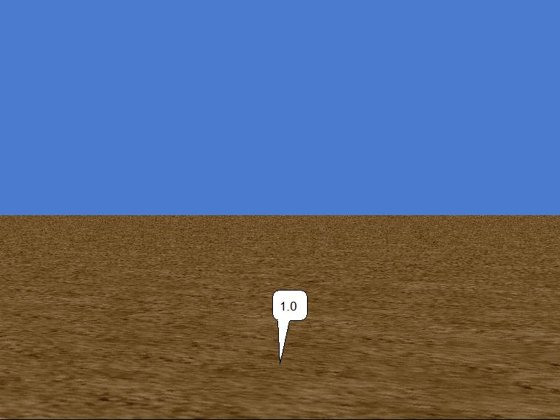
JT’s Extra: String Conversion (2)

Slide 15
JT’s Extra: Captioning Output
Sometimes when many variables are being displayed (say/think) it’s hard to track the information.
Captioned or labeling which variable is being displayed can be useful.
    World->functions->”joined with”
    (You join the caption with the display of the variable’s contents).
Net income $
75,000
Labeling output
Contents of variable

Slide 16
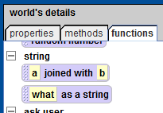
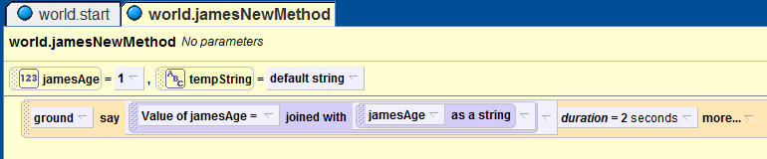
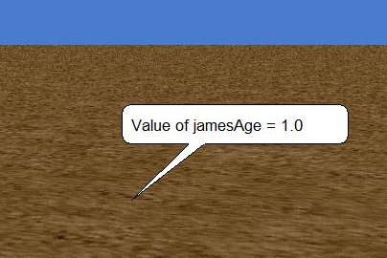
JT’s Extra: Captioning Output (2)

Slide 17
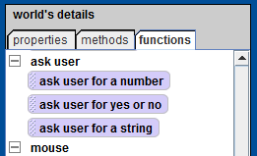

JT’ Extra: Getting User Input
Example 5: captioning output (applying ‘join’), getting user input
Getting user input: functions of class world
Drag the appropriate function when setting the value of variables
Source of information for the variable is the user.

Slide 18

Assignment Statement & User Input

Slide 19
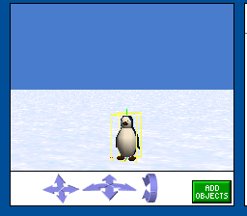
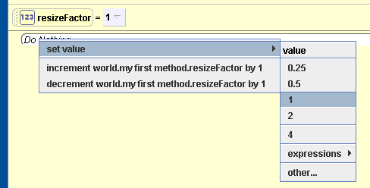
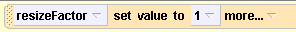
Assignment Statement

Slide 20
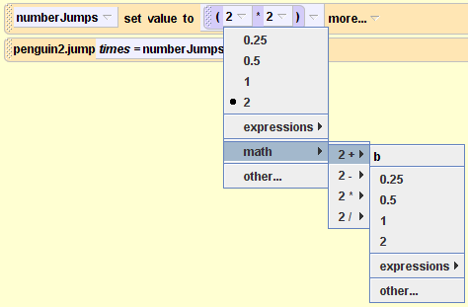
JT’s Extra: Mathematical Expressions
Most any arbitrary mathematical expression can be created in Alice.
Expressions are created graphically.
Example:

Slide 21
JT’s Extra: Common Mathematical Operations
Mathematical operation | Symbol used in Alice
Addition | +
Subtraction | -
Multiplication | *
Division | /

Slide 22
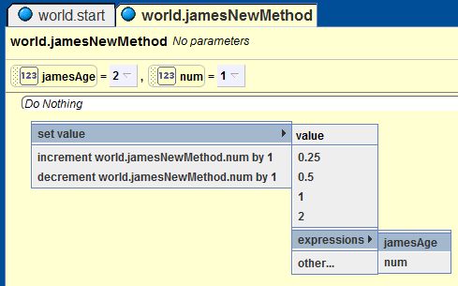
JT’s Extra: Copying From a Variable Is An Expression
Example:
We want to add the expression: num = jamesAge
Set the variable ‘num’ to the current value of the variable ‘jamesAge’
Num=
Yields the expression:
Num = jamesAge

Slide 23
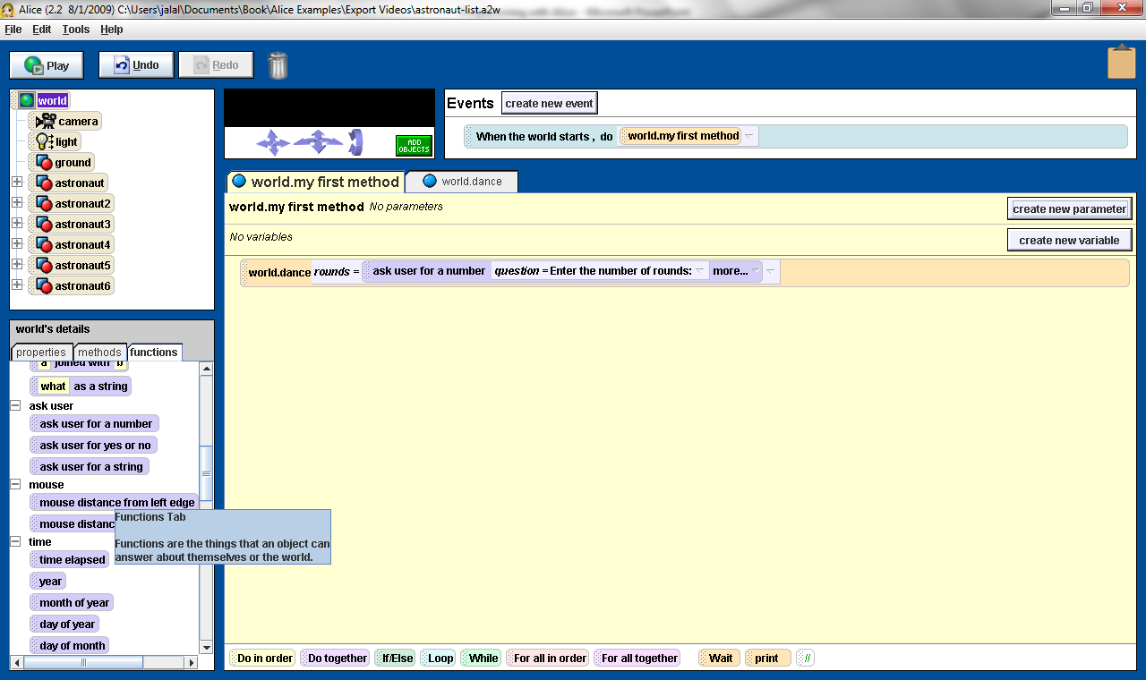
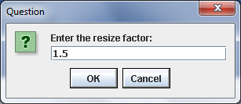
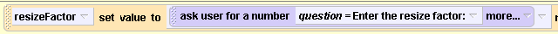
User Input
Drag and drop ask user for a number function to replace the value 1

Slide 24
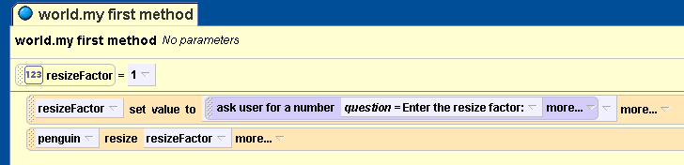
The Complete Program

Slide 25
Methods and Functions
Defining Behaviour

Slide 26
Objectives
At the end of this section, you will be able to:
Use methods and parameters
Understand and use functions
Create methods and functions

Slide 27

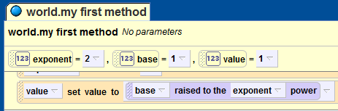
JT’s Extra: Parameters
Parameters is information that is passed into a function or a method.
Example: exponent function of world (base, exponent)
  Based raised to the power of the exponent.
  Based and exponent is information passed to the exponent function.
Parameters to the function

Slide 28

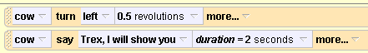
Methods
A method is defined inside an object
It has a name
And zero or more parameters
A method is called within an object:

Slide 29
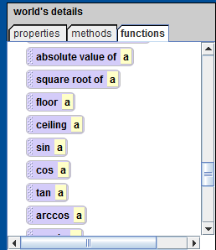
JT’s Extra: Function Definition
A function definition indicates what a function will do when it is run.
Examples (functions of class world which have already been defined by the creators of Alice).
Execute some instructions and return a value

Slide 30
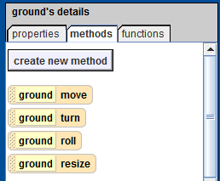
JT’s Method Definition
A method definition indicates what a method will do when it is run.
Examples (methods of class world which have already been defined by the creators of Alice).
Methods act on or do something to the object that it belongs to.

Slide 31
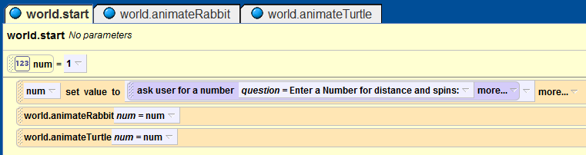
JT’s Extra: Method Call
Example 6: method definitions
When a method is actually run.
This is the one special method that automatically executes when the program is run.

Slide 32
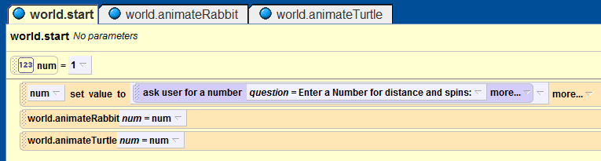
JT’s Extra: Method Definitions And Calls
Defines the instructions that will execute when the start method executes

Slide 33
JT’s Extra: Method Definitions And Calls
Method call: runs the animateRabbitMethod
Method call: runs the animateTurtleMethod

Slide 34
JT’s Extra: Method Parameters
Method parameters: the number entered by the user will be passed into each method.

Slide 35
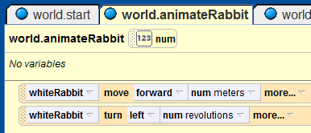
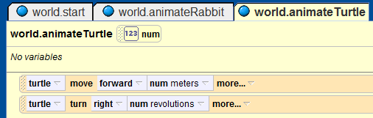
JT’s Extra: Method Definitions
Method parameter: the number passed in determines the distance moved and the number of rotations.

Slide 36
JT’s Extra: Good Style (Creating Your Own Methods)
Each method should have one well defined task. If it doesn’t then it may be a sign that it should be decomposed into multiple sub-methods.
    Clear method: A method that converts lower case input to capitals.
    Ambiguous method: A method that prompts for a string and then converts that string to upper case.

Slide 37
JT’s Extra: Good Style (Creating Your Own Methods): 2
(Related to the previous point). methods should have a self descriptive name: the name of the method should provide a clear indication to the reader what task is performed by the method.
    Good: isNum, isUpper, toUpper
    Bad: doIt, go
Try to avoid writing methods that are longer than one screen in size.
    Tracing methods that span multiple screens is more difficult.

Slide 38
JT’s Extra: Good Style (Creating Your Own Methods): 3
The conventions for naming variables should also be applied in the naming of methods.
  Lower case characters only.
  With methods that are named using multiple words capitalize the first letter of each word but the first (most common approach) or use the underscore (less common).

Slide 39
Parameters
Parameters of a method are like local variables in the method
The difference is that a value must be assigned to parameters when a method is called

Slide 40
JT’s Extra: Parameters
Also you can think of parameters as a mechanism for communicating information into a method.
Start method
Num = A value from the user
Pass value entered by user into ‘move’
Knight’s move method

Slide 41
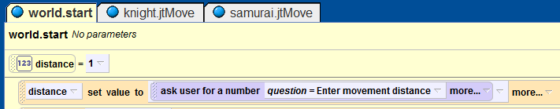

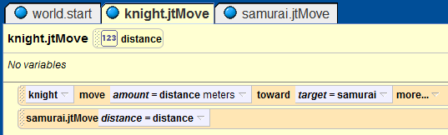
JT’s Extra: Parameter Passing
Example 7: Parameters
Get value for distance from user in ‘start’ method
Pass the distance into the move method as a parameter
Now ‘distance’ can be used in the ‘move’ method

Slide 42
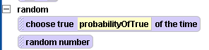
Functions
Functions are methods that return values
Mathematically, f(n) = 2n
f(5) returns 10

Slide 43
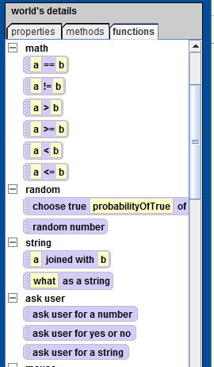
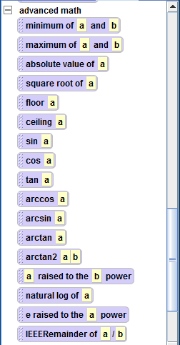
JT’s Extra: Useful Functions Of Class World

Slide 44
Do in order and Do together
Sequential and parallel execution

Slide 45
Objectives
At the end of this section, you will be able to:
Understand the difference between sequential and parallel execution
Make use of the Do in order and do together statements
Draw flowcharts for story lines with parallel and sequential actions

Slide 46

Sequential and Parallel Execution
This we have created is sequential
Straight-line code
Finish one instruction before starting
the next

Slide 47
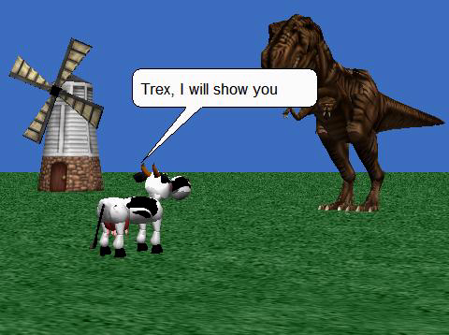
Parallel Execution
Two methods executed at the same time
  In parallel, or concurrently
The windmill blades roll concurrently with the rest of the movie actions
Cow turns her head while Trex was running

Slide 48
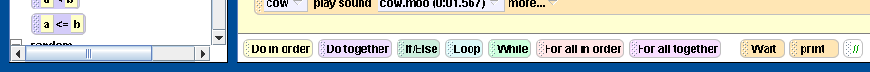
Do in order
Default mode of execution
Can group statements in a Do in order statement

Slide 49
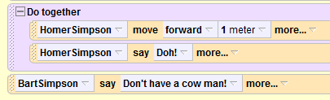
Do together
Example 8: simultaneous actions
Can group statements in a Do together statement to run concurrently

Slide 50
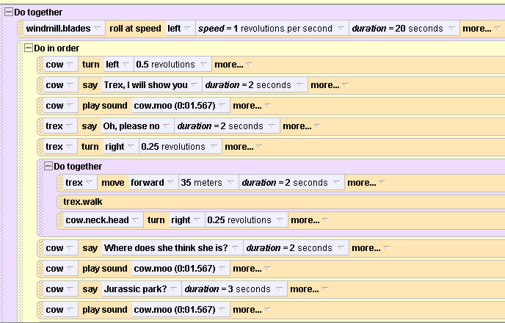
Intertwining in order and together

Slide 51
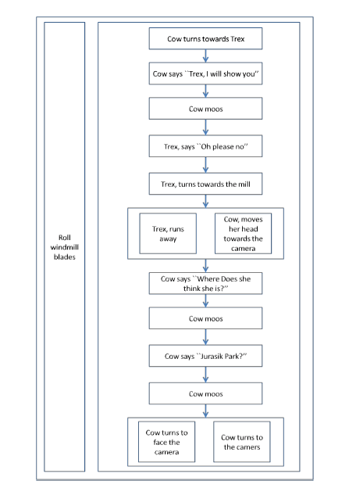
Flowcharts for Story Lines

Slide 52
Flowcharts for Story Lines

Slide 53
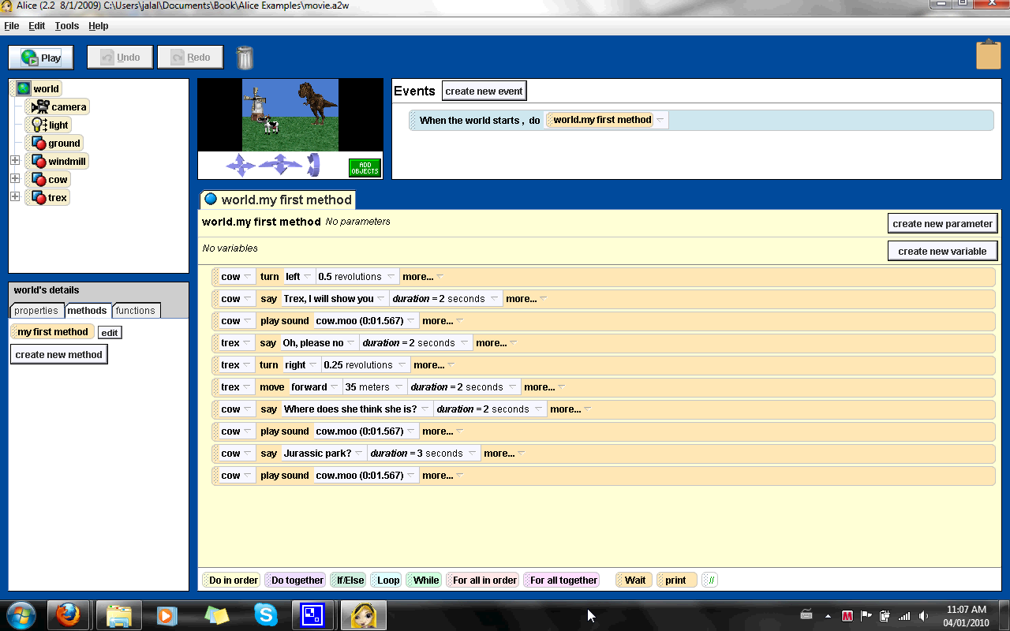
Do together and in order movie

Slide 54
JT’s Extra: Flowcharts
It’s a graphical notation that’s used to specify how a computer program will execute.
Symbols:
  Terminal (for the start and end of the program).
  Processing (for a step in the program)
Arrows are used to connect the symbols (show the order and direction of execution).
Start/end
Processing
Start
Instruction
End

Slide 55
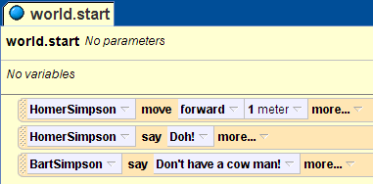
JT’s Extra: Example Program: Flowchart
Start/end
Homer: move forward 1 meter
Homer: “Doh!”
Bart: “Don’t have a cow man!”
End

Slide 56
JT’s Extra: Flowchart (Do-Together)
Start/end
Encompasses all the instructions that execute at the same time (encompassed by the ‘do together’ container)
Homer: move forward 1 meter
Homer: “Doh!”
Bart: “Don’t have a cow man!”
End

Slide 57
JT’s Extra: Program Documentation
English statements inserted into a computer program.
They are not written in a programming language.
They are for the reader of the program and won’t be executed by the computer.
It describes ‘what’ the program does (but not ‘how’ it does it.
  Correct: the program sorts contacts into alphabetical order
  Incorrect: the program uses the quicksort algorithm.

Slide 58

JT’s Extra: Creating Program Documentation
Create comments for the documentation graphically.

Slide 59
JT’s Extra: What Should Be In The Program Documentation
What does the program do e.g., tax program.
What are it’s capabilities e.g., it calculates personal or small business tax.
What are it’s limitations e.g., it only follows Canadian tax laws and cannot be used in the US. In Canada it doesn’t calculate taxes for organizations with a yearly gross earnings over $1 billion.
Author
What is the version of the program

Slide 60
JT’s Extra: What Should Be In The Program Documentation (2)
If you don’t use numbers for the different versions of your program then consider using dates (tie this with program features i.e., list the features of version ‘x’ of the program).
  How does the program work.
  This is often a description in English (or another high-level) language that describes the way in which the program operates.
  The purpose of this description is to help the reader quickly understand how the program works.
  Typically used to describe things that are not immediately self evident from the program code.
For an example of a completely documented program see “The Simpsons” example program.

