Slide 1
5 Event Handling
Interactive Programming

Slide 2
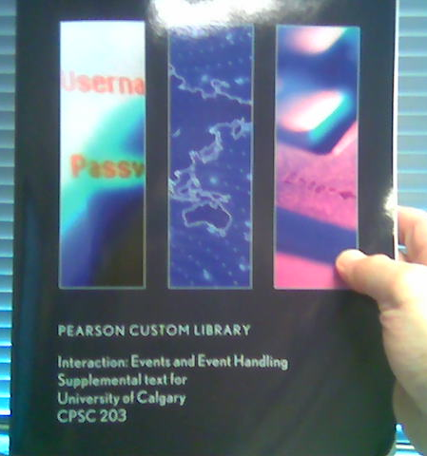
Suggested Reading
Interaction: Events and Event Handling, Supplemental Text for CPSC 203
Distributed this term with new textbook copies
If you bought a used copy, then read the lab manual:
JT’s examples:
http://pages.cpsc.ucalgary.ca/~kawash/peeking/labManual.html
http://pages.cpsc.ucalgary.ca/~tamj/203/extras/alice/examples_part5.htm

Slide 3
Objectives
By the end of the section, the student will:
Understand events and event handling
Create and use 9 events and even handlers in Alice
Start working on interactive games

Slide 4
Interactive Programming
Programs seen so far do not interact with the user
Interactive programs: react to user events
  Such as: moving the mouse, clicking, or pressing a key on the keyboard
Interactive games are one example

Slide 5
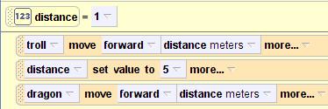
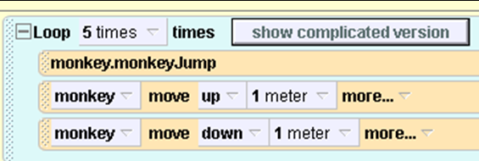
JT (Until Now): Program control is largely determined by the program through a series of sequential statements.
Simple program: pure linear sequence
Program with loops: not purely linear but the timing of execution can be directly predicted

Slide 6

JT: Traditional Software
The user can only interact with the program at places that are specified by the program (e.g., when an input statement is encountered).
Examples

Slide 7
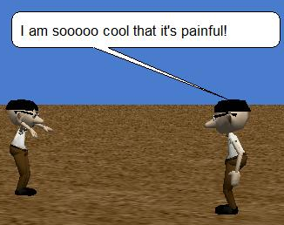
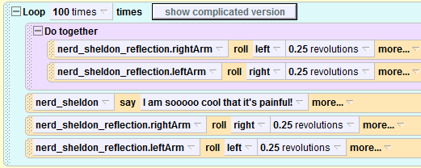
Example 14
Program control can also be sequential
JT: Event-Driven Software

Slide 8

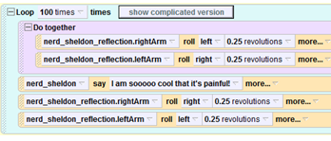

JT: Event-Driven Software Can Include Code That Occurs Only When Event Occurs
Regular code instructions
Event: When???
Always runs when program runs
Only runs when event occurs as program is running

Slide 9
Event Types
When the world starts
When a key is typed
When the mouse is clicked
Let the mouse move an object
Let the arrow keys move an object
Let the mouse move the camera
Let the mouse orient the camera
While something is true
When a variable changes

Slide 10
Event Handling
When an event takes place, a method is executed
JT: Recall this example
Method ‘startOfTheWorld’ is an example of an event handler

Slide 11
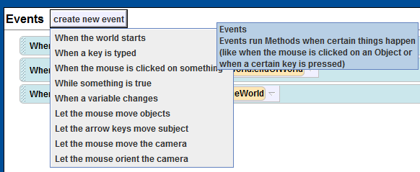
JT: Steps For Creating An Event Handler
Identify the event

Slide 12
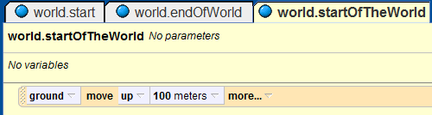
JT: Steps For Creating An Event Handler
Create a handler for it (define a method that runs when the event occurs)

Slide 13

JT: Steps For Creating An Event Handler
Register the handler for this event

Slide 14
When an event happens
Wait until an event happens
Every time it happens, a handler is performed
E.g. when a mouse is clicked

Slide 15
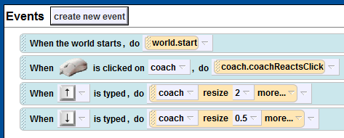
JT: Specific Events May Be Tied To Handlers
Example 15: (up/down) arrows

Slide 16
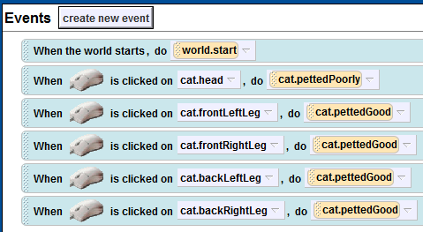
JT: Events Specific To Objects, Random Reactions
Example 16
Example 16:
Hates head petting
Likes body petting

Slide 17
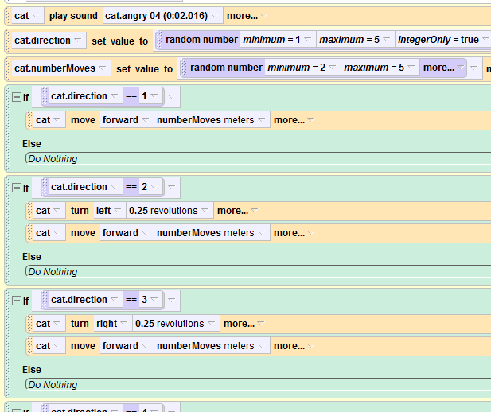
JT: Method “catPettedPoorly”
Play angry cat sound
Cat’s random reactions to event

Slide 18
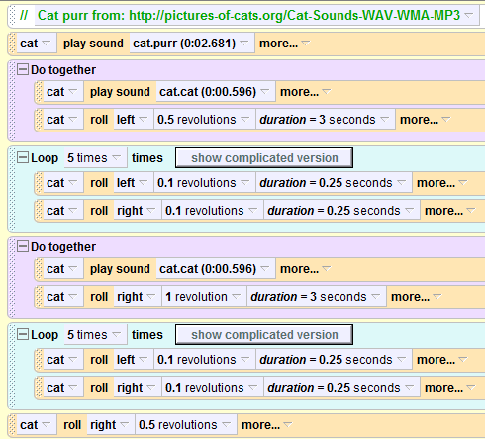
JT: Method “catPettedGood”
Sounds of contented cat
Cat’s happy reactions

Slide 19
When the world starts
When the world starts, “world.my first method” is executed
You can change it

Slide 20
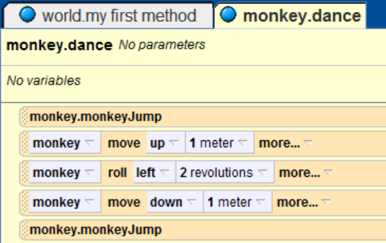
When the world starts
In a world with an monkey object
Create a simple method of monkey, dance:

Slide 21
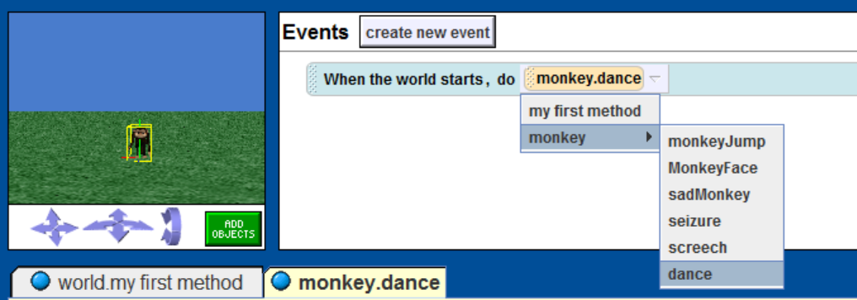
When the world starts
Register the new method for the event
When the world starts, monkey.dance will be executed instead of world.my first method

Slide 22
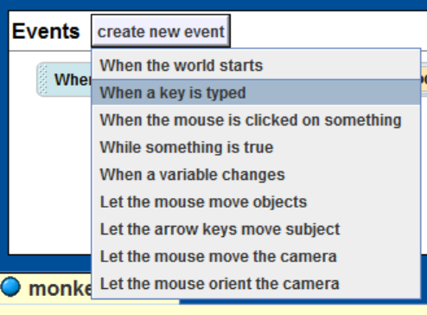
When a key is typed
Create a new event

Slide 23
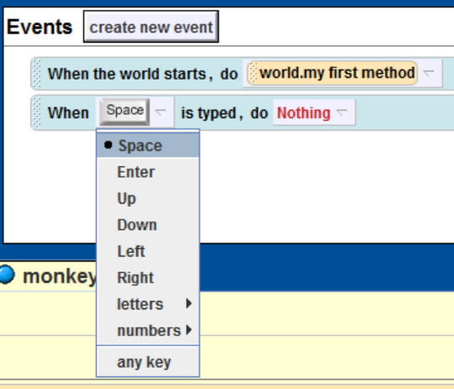
When a key is typed
Choose the key to be typed

Slide 24
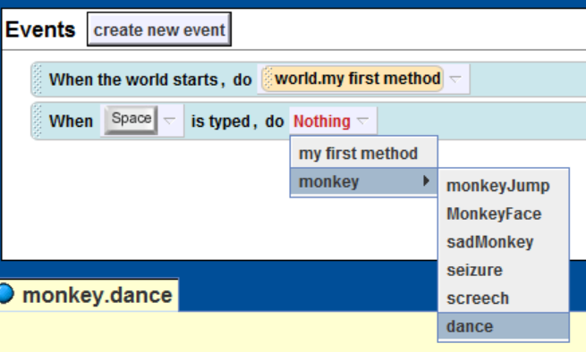
When a key is typed
Choose handler method

Slide 25
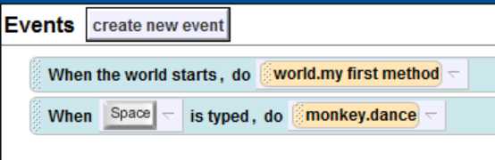
When a key is typed
Every time the space key is typed, the monkey dances

Slide 26
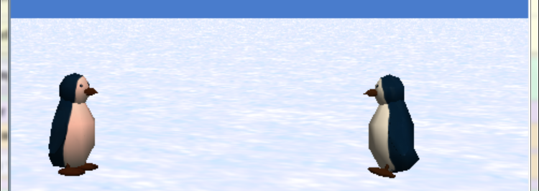
Example
A world with two penguins facing each other

Slide 27
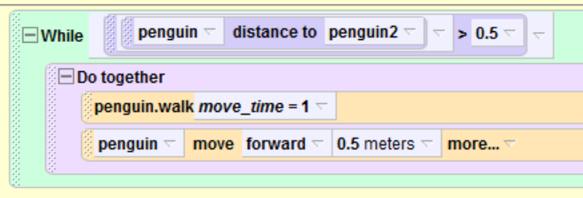
Example
White penguin moves towards pink penguin until too close

Slide 28
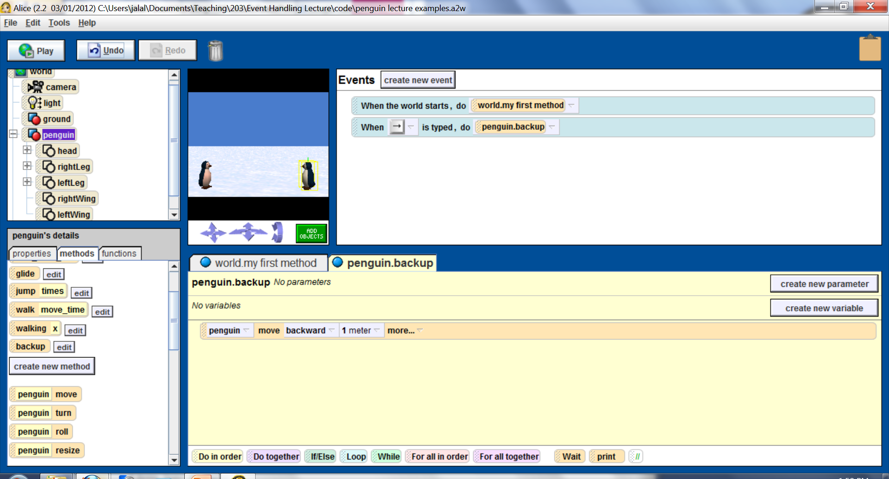
Example
Holding the white penguin back: event and its handler

Slide 29
Exercise
Create an Alice world and add one object to it
Write handlers so that:
UP arrow key: moves the object up ½ meters
DOWN arrow key: moves the object down ½ meters
LEFT arrow key: moves the object left ½ meters
RIGHT arrow key: moves the object right ½ meters

Slide 30
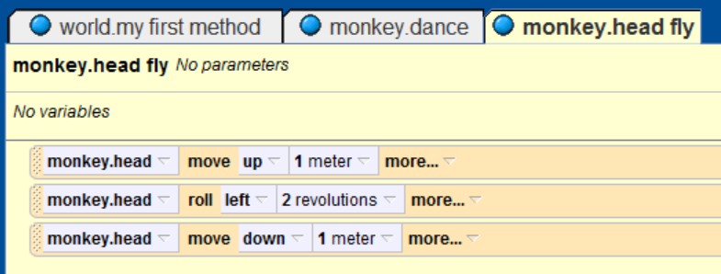
When the mouse is clicked
Create a method for monkey, head fly:

Slide 31
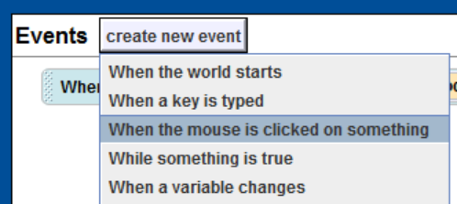
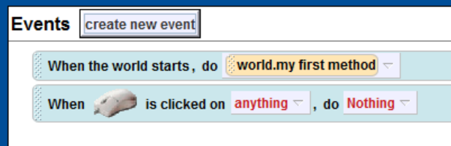
When the mouse is clicked
Register the handler

Slide 32
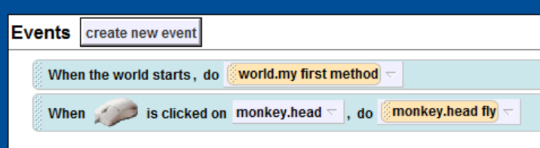
When the mouse is clicked
Register the handler

Slide 33
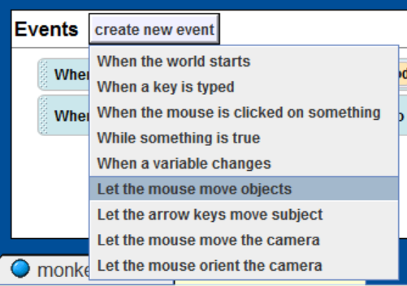
Let the mouse move an object
Create a new event

Slide 34
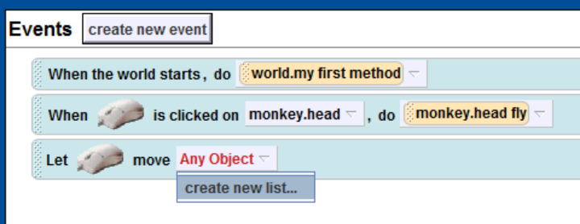
Let the mouse move an object
This event works on lists
Create a new list

Slide 35
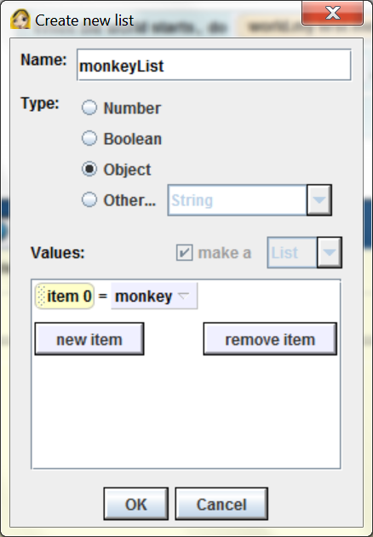
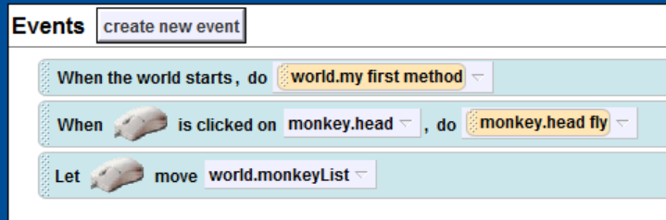
Let the mouse move an object
This event works on lists
Create a new list
Click on the monkey to drag it

Slide 36
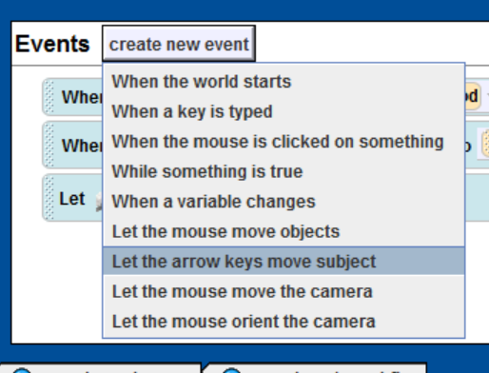
Let the arrow keys move an object
Create a new event

Slide 37
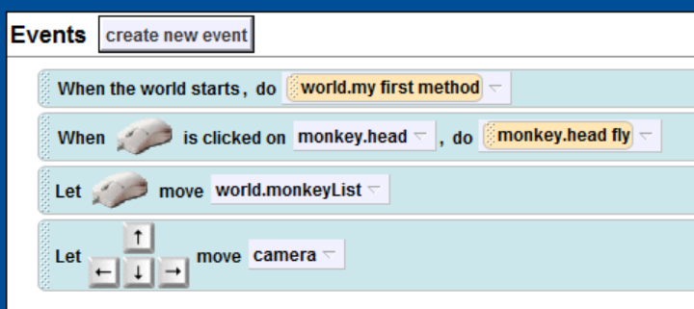
Let the arrow keys move an object
Create a new event

Slide 38
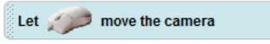
Let the mouse move the camera
This event allows you to drag the mouse and move the camera

Slide 39
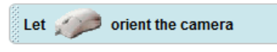
Let the mouse orient the camera
Similar to moving the camera, except it only moves the camera left or right (orientation)

Slide 40
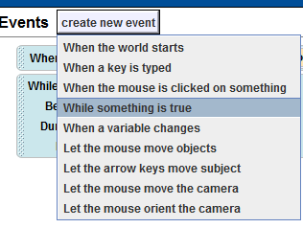
While and events
As long as something is true, perform the handler action
This action is performed repeatedly, until the while condition becomes false

Slide 41
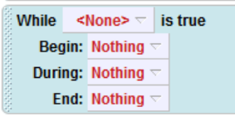
While something is true
While a condition is true do the following
Up to three actions are performed: When the while condition becomes true, while the condition is true, and when it becomes false.

Slide 42
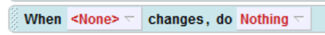
When a variable changes

Slide 43

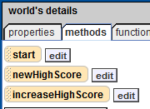
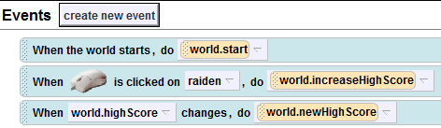
JT: Event For Changing Variables
Example 17
Important variable
Define key methods
Register methods

Slide 44
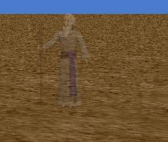
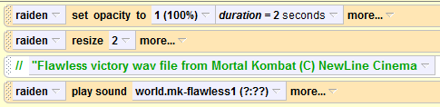
JT: Event For Changing Variables

