Slide 1
3 Database Queries
Peeking into Computer Science

Slide 2
Reading Assignment
Mandatory: Chapter 4 – Sections 4.6 & 4.7

Slide 3
Example Access DB
Can be found on:
http://pages.cpsc.ucalgary.ca/~kawash/peeking.html
Includes all examples in the book
  Numbered by exercise numbers

Slide 4
Structured Query Language

Slide 5
Objectives
By the end of this section, you will be able to:
Name the two parts of SQL
Understand the function of each part
Formulate basic DDL & DML statements in SQL

Slide 6






JT’s Extra: Purpose
Sale $$$
Sale $$$
Database: Customer information
To store & retrieve information
Notes:
6

Slide 7
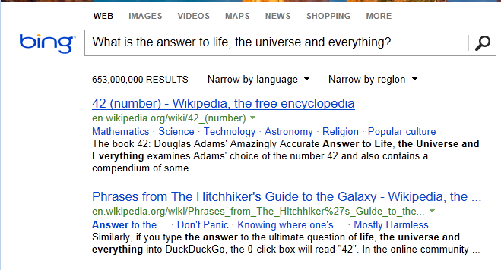
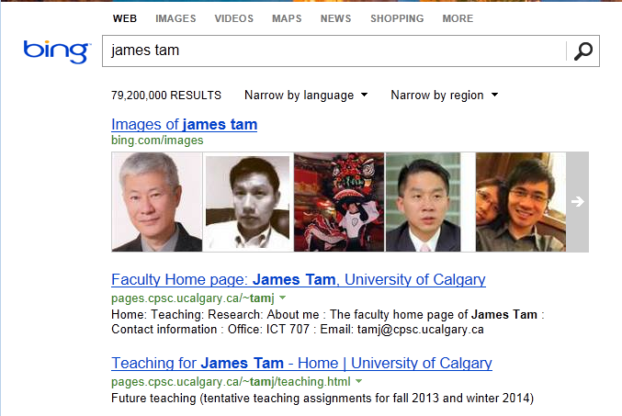
JT’s Extra: Queries
Queries are questions ‘asked’ of/to the database in order to retrieve information.

Slide 8
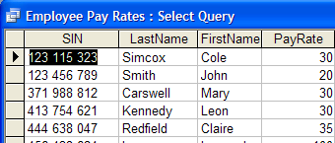
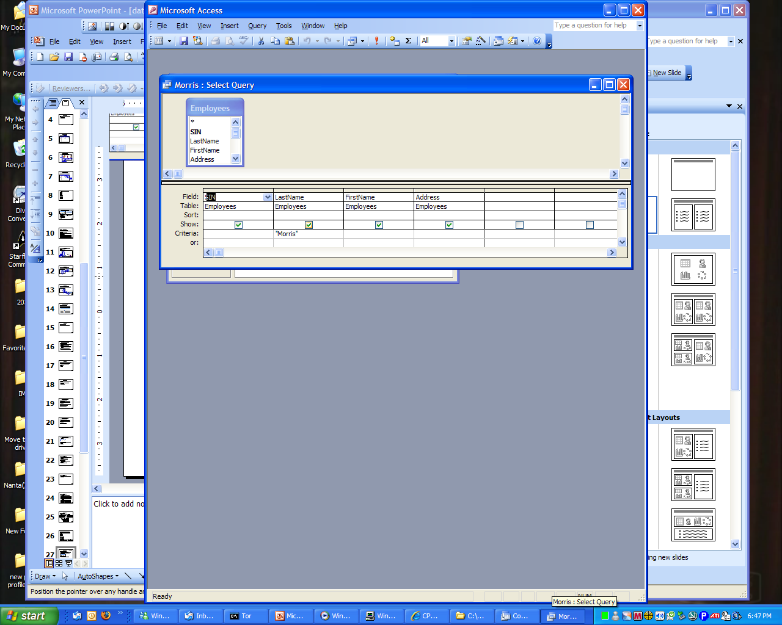
JT’s Extra: Retrieving Data Via Queries
Query
Data retrieval occurs through the use of ‘queries’:
  A query is a question asked of the data in the database.
  Typically worded to show only the parts of the database for which the answer to the question is true.
  Example 1: What is the SIN, name and pay rate of every employee in the Employees Table:
  Example 2: What employees have the last name of Morris?
Notes:
8

Slide 9
Structured Query Language
SQL
Programming language, specialized for databases
Data Definition Language (DDL)
  Defining the structure of the DB
Data Manipulation Language (DML)
  Manipulating the contents of the DB
JT’s Extra: SQL = Structured Query Language
JT’s Extra: Creating the data (table)
What fields?
What will each field store?
JT’s Extra: Modifying the data (table)
Insertions
Deletions

Slide 10
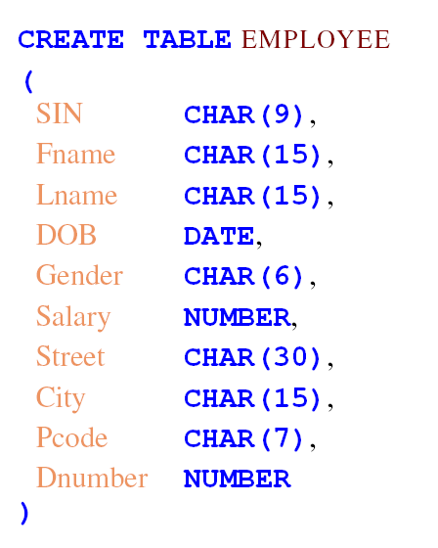
DDL

Slide 11
DDL
DROP TABLE EMPLOYEE

Slide 12
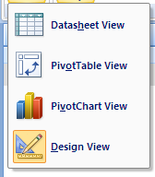
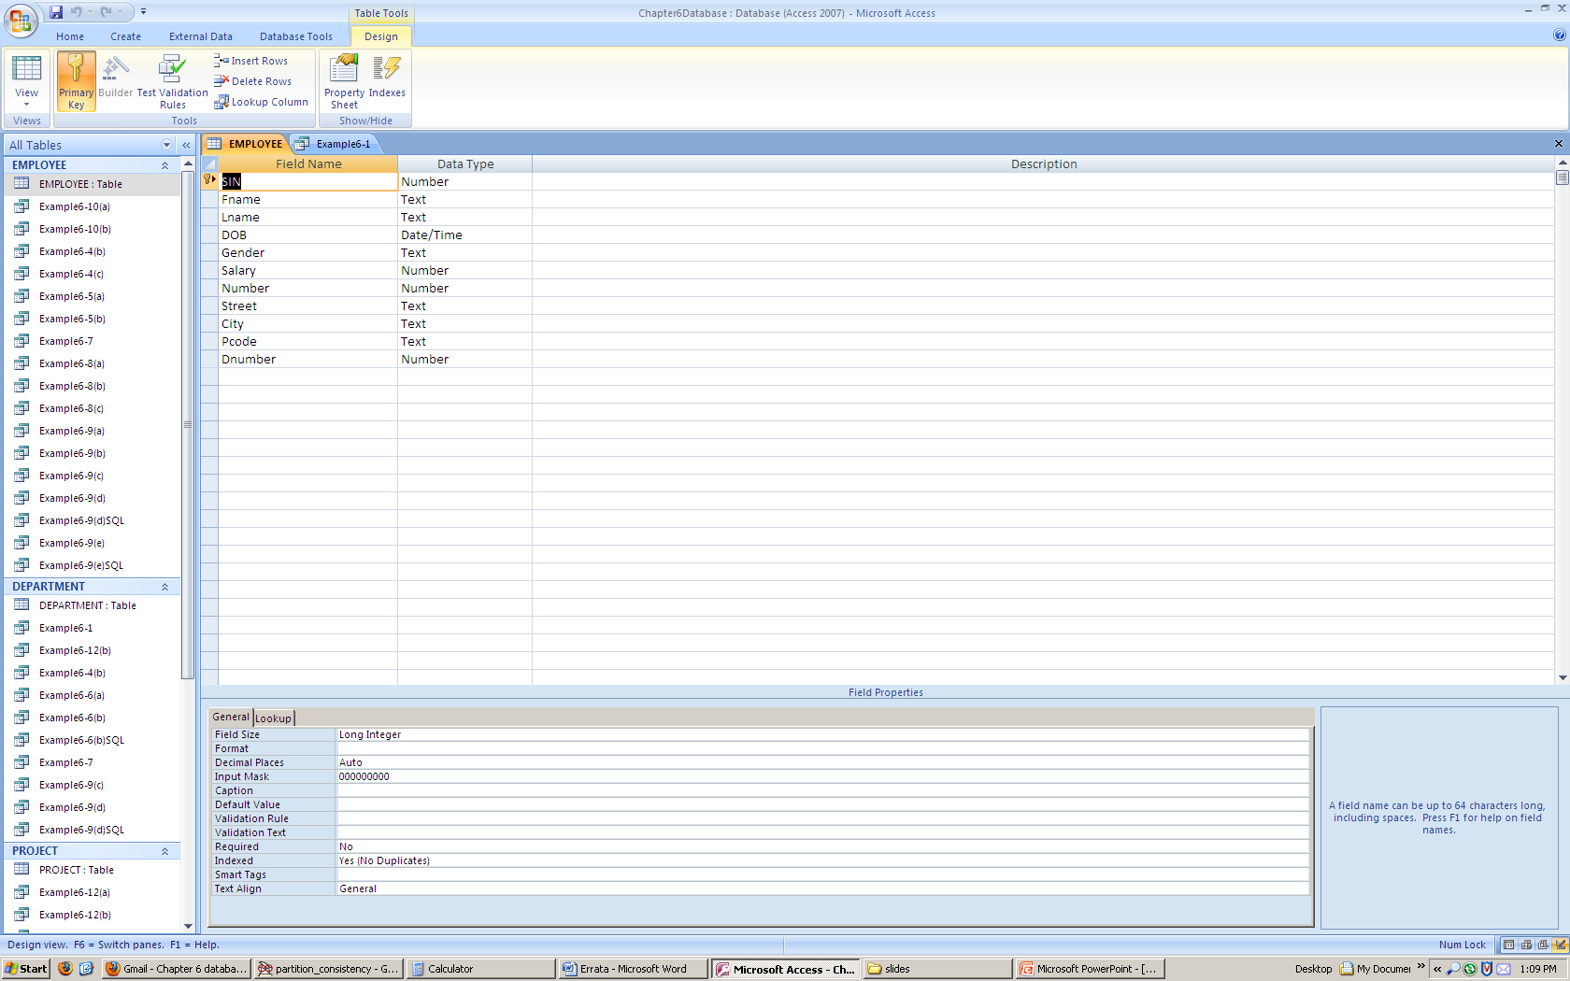
Access Table Creation

Slide 13
JT’s Extra: DML General Structure
Recall: Data manipulation language modifies the tables
General format:
<Action> into/from <Table name>
Example:
Insert into Employees {some values}
Delete from Employees {conditions for deletion }
Notes:
13

Slide 14
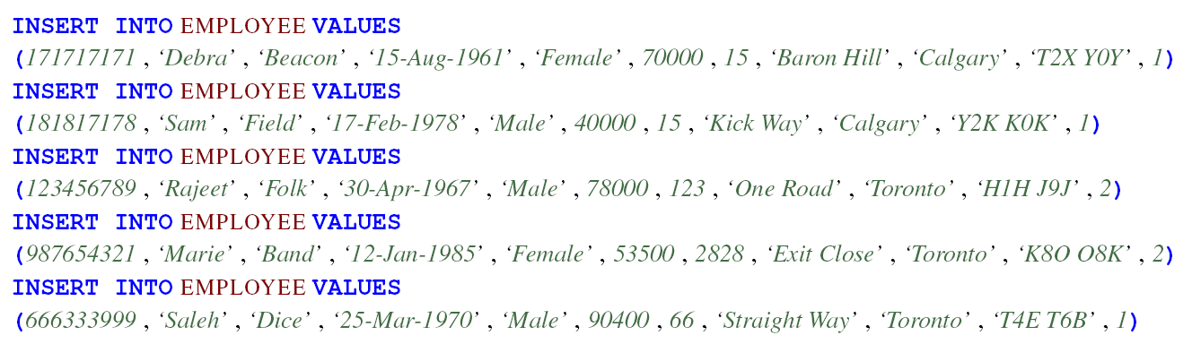
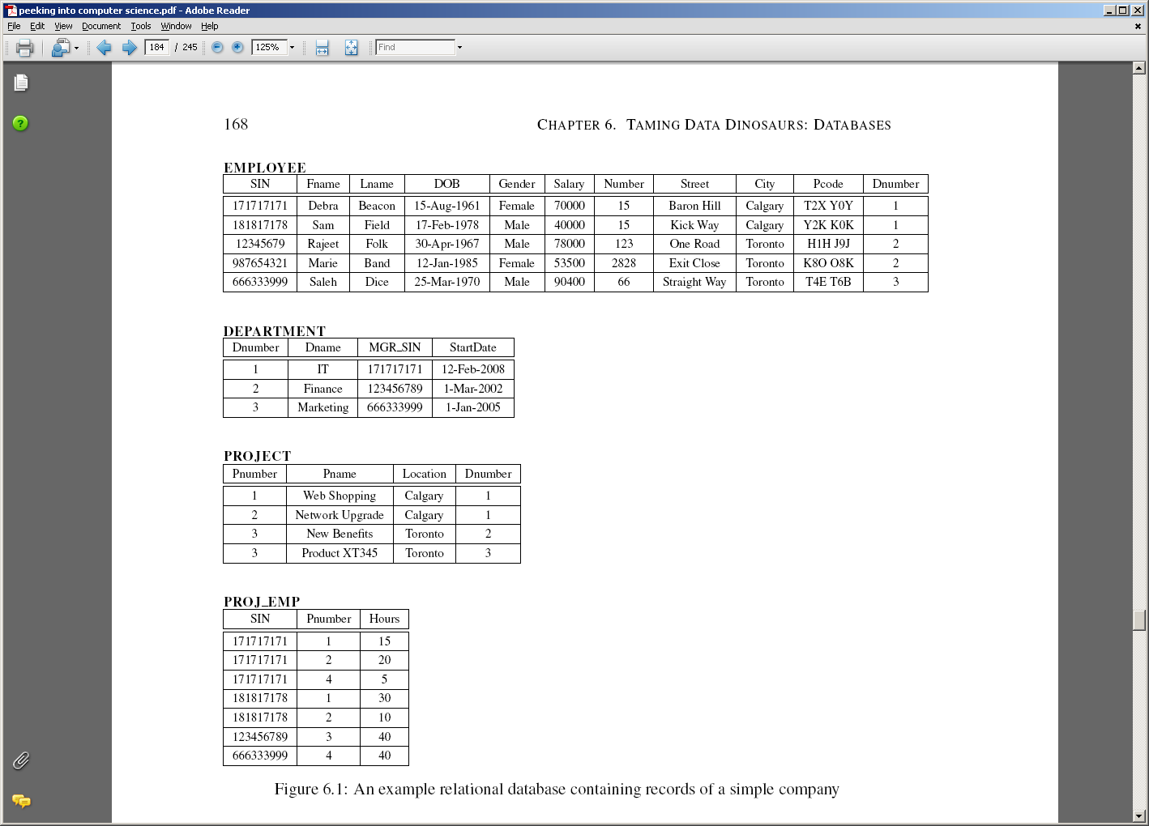
DML - Insertion

Slide 15
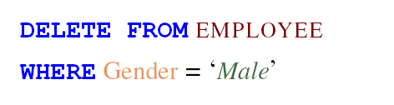
DML - Deletion

Slide 16
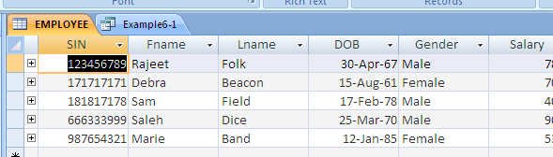
Access Insertion and Deletion

Slide 17
SQL Queries
Questioning the database

Slide 18
Objectives
By the end of this section, you will be able to:
Know the basic parts of speech in SQL
Formulate SQL queries
Use set operations in SQL queries
Use complex logic in SQL queries

Slide 19
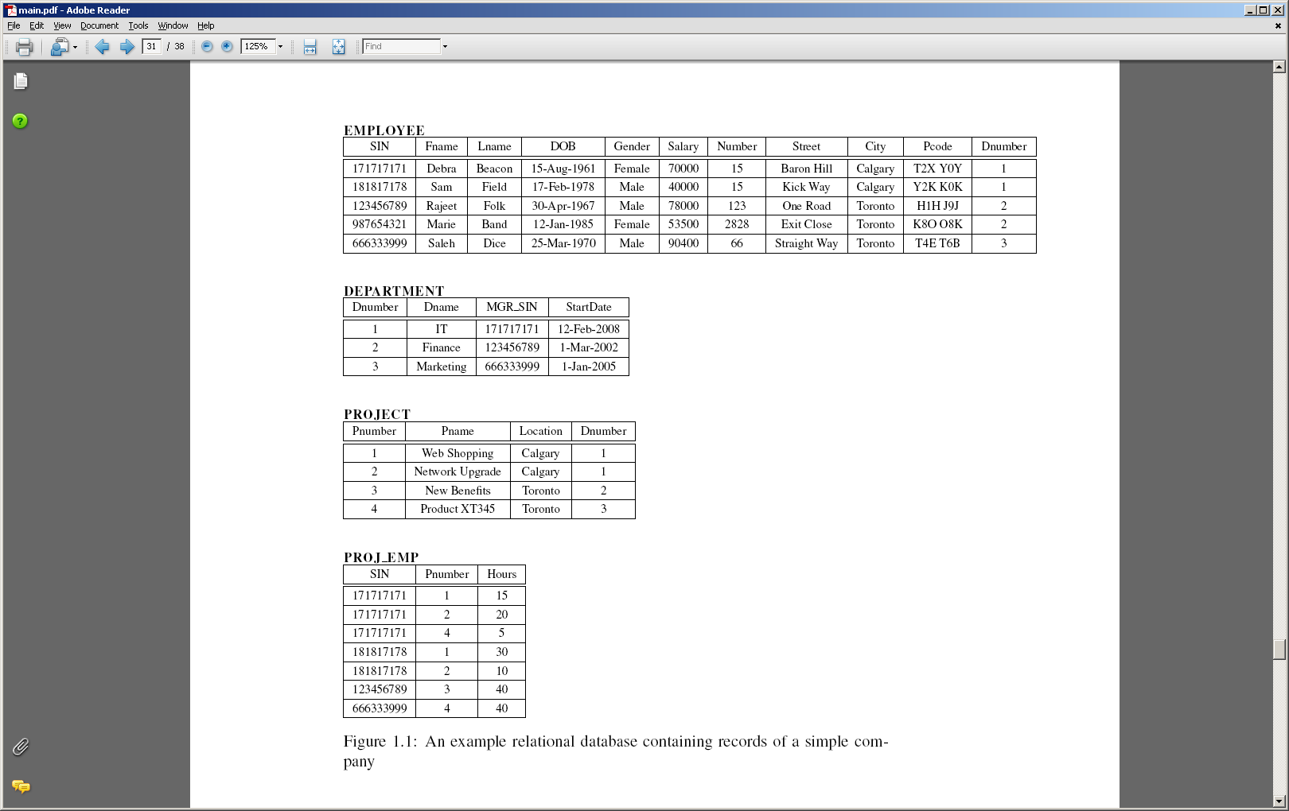
Example Database

Slide 20
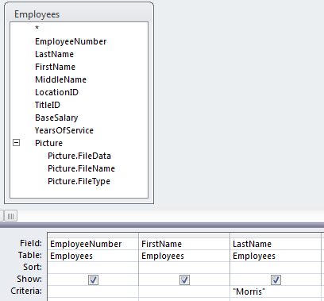
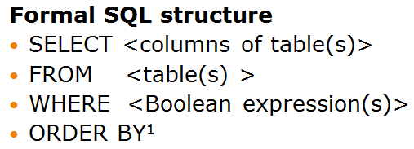
Queries
Ways of submitting questions to the DB:
Query By Example (QBE)
  JT: In Access it’s graphical
Using SQL
  Text

Slide 21





JT’s Extra: My $0.02 On Forming Queries Using SQL
Writing SQL queries can be complex
SQL queries are powerful (i.e., unusual searches can show useful information)
SQL!!!
SQL!!!
SQL!!!
SQL is commonly used (standard)

Slide 22
JT’s Extra: Basic Format Of SQL Queries
Informal English description
Given some condition(s) is/are met what rows and columns of what tables will appear.
Example:
If last name is “Morris” show the employee number, first name and last name from the employees table.

Slide 23
JT’s Extra: Basic Format Of SQL Queries (2)
Specifying the query in the form of QBE (Query by example) in MS-Access

Slide 24
JT’s Extra: Basic Format Of SQL Queries (3)
Formal SQL structure
SELECT <columns of table(s)>
FROM <table(s) >
WHERE <Boolean expression(s)>
ORDER BY¹
1 Optional section: used to format or rank query results

Slide 25
JT’s Extra: Example SQL Query
SELECT
  Employees.EmployeeNumber,
  Employees.FirstName,
  Employees.LastName
FROM EMPLOYEES
WHERE
  EMPLOYEES.LastName="Morris";

Slide 26
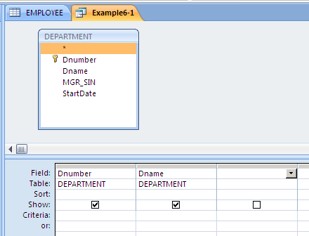
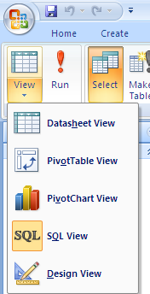
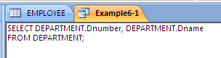
QBE – Projection

Slide 27
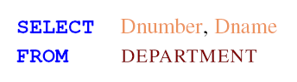
SQL - Projection
X
X

Slide 28
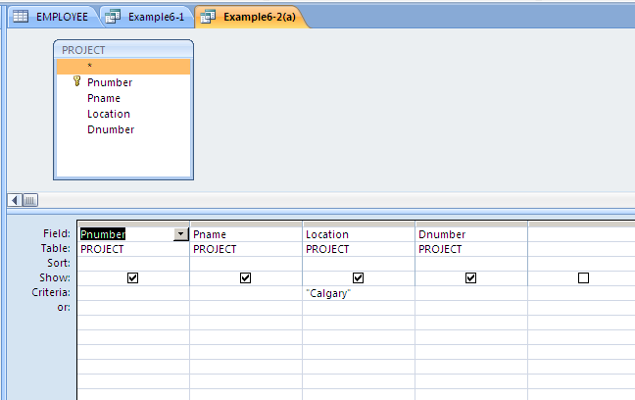
QBE - Selection

Slide 29
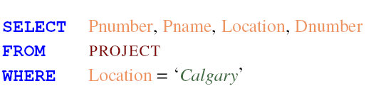
SQL - Selection

Slide 30


JT’s Extra: Wildcards
Poker is the wildcard in card game
It can be substituted for any other card
In the example it can take the place of: Ace, King, Queen, Jack or Ten to give you a “Royal Flush”

Slide 31
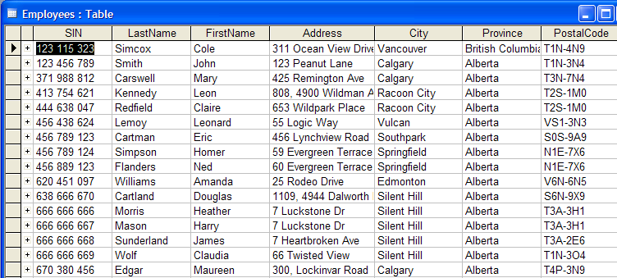
JT’s Extra: Using The Wildcard In Queries
The ‘wildcard’ character can stand for any number of characters in the position that it’s placed:
  Example queries that follow will be from the Employees table:
Notes:
31

Slide 32
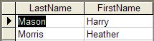
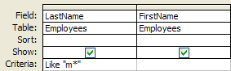
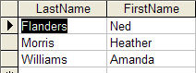
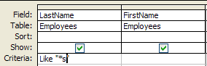
JT’s Extra: Using The Wildcard In Queries (Access)
Examples:
  Which employees have a last name that begins with ‘m’?
  Which employees have a last name ends with ‘s’?
Notes:
32

Slide 33
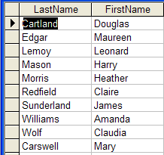

  Which employees have the letter ‘a’ anywhere in their first name?
JT’s Extra: Using The Wildcard In Queries (Access: 2)

Slide 34
Wild Cards
*

Slide 35
EMPLOYEES (TABLE/SET)
* 456 789 123, Cartman Eric, Southpark
* 456 789 124, Simpson Homer, Springfield
* 666 666 666, Morris Heather, Silent Hill
* 666 666 667, Mason Harry, Silent Hill
* 670 380 456, Edgar Maureen, Calgary
Departments (TABLE/SET)
* 1, Human Resources
* 2, Marketing
* 3, Finance
* 4, Management Information Systems
TimeBilled (TABLE/SET)
* 8, 456 789 123, 2, 10/1/2007, 80
* 9, 456 789 124, 2, 10/1,2007, 60
* 14, 666 666 666, 3, 10/1/2007, 50
* 15, 666 666 667, 3, 10/1/2007, 50
* 18, 670 380 456, 4, 10/1/2007, 40
JT’s Extra: As mentioned each table can be viewed as a set of information.
Notes:
35

Slide 36
JT’s Extra: Set Operations On Databases
UNION
INTERSECT
MINUS

Slide 37
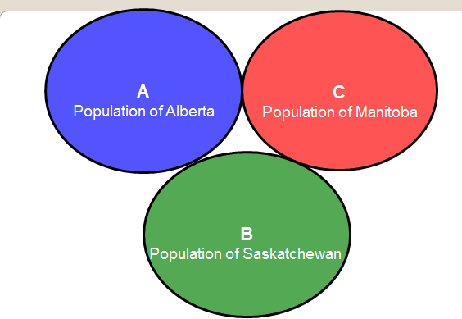
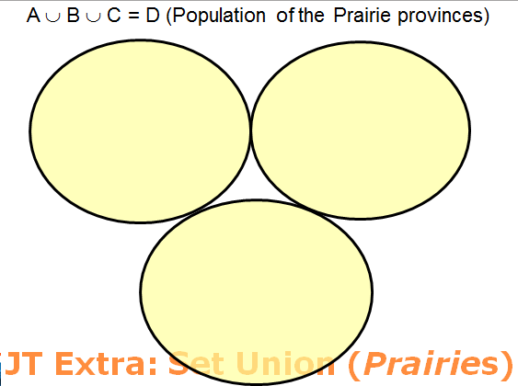
JT’s Extra: Union (Logical “OR”)

Slide 38
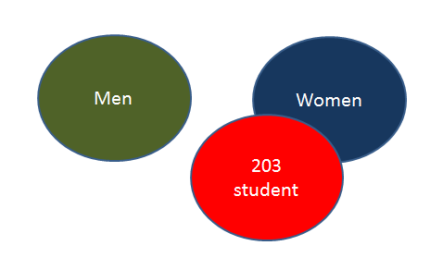
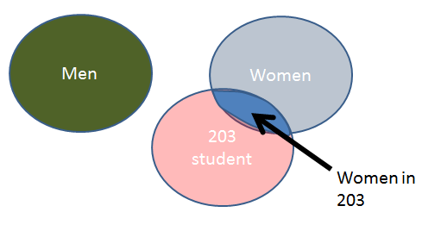
JT’s Extra: Intersection (Logical “AND”)
(203 student) AND (Women)

Slide 39
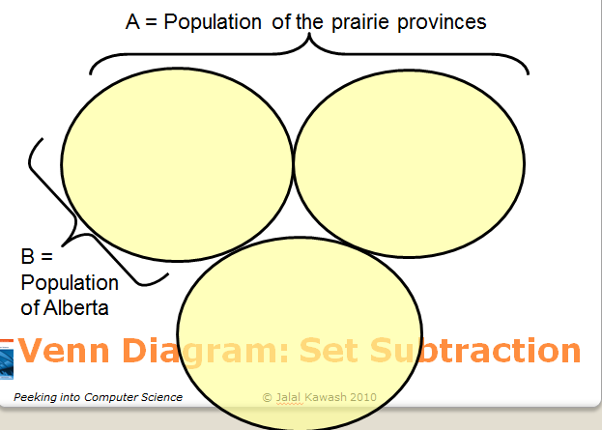
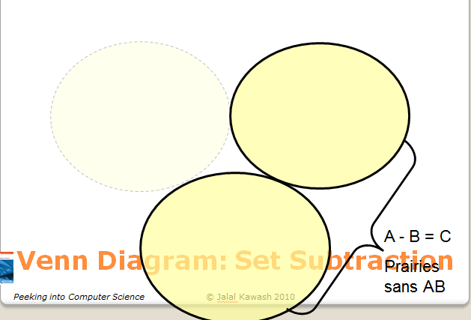
JT’s Extra: Subtraction “Minus”

Slide 40
JT’s Extra: Forming SQL Queries Using The Set Operations
Format:
  <SQL Query 1>
  <SQL Query 2>
SET OPERATION

Slide 41
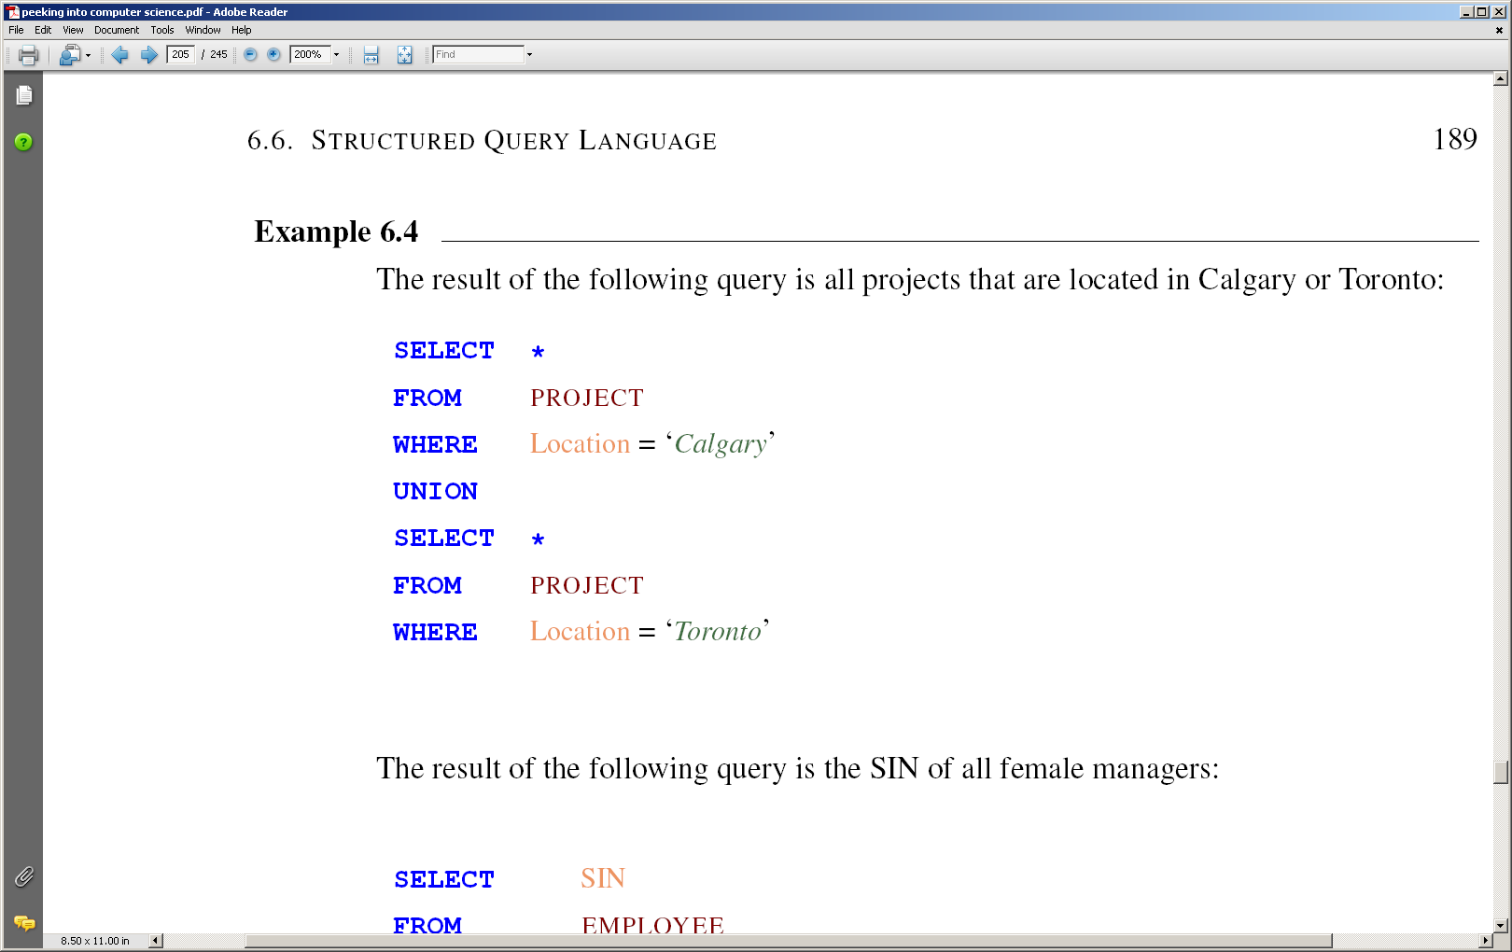
SQL – Set Operations

Slide 42
SQL – Set Operations

Slide 43
SQL – Set Operations

Slide 44
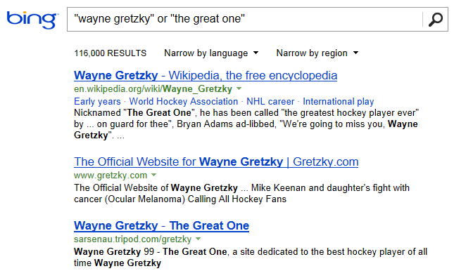
JT’s Extra: Union Is Similar To Logical “OR” For Web Searches

Slide 45
JT’s Extra (From Textbook): Union
JT: Both show results up
(Dept. 1 employees with income over $80k)

Slide 46
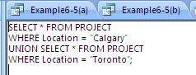
Union in Access
Cannot be done in design view, only in SQL view

Slide 47
JT’s Extra (From Textbook): Intersect
JT: show query results that meets both criteria (Female employees that live in Calgary)

Slide 48
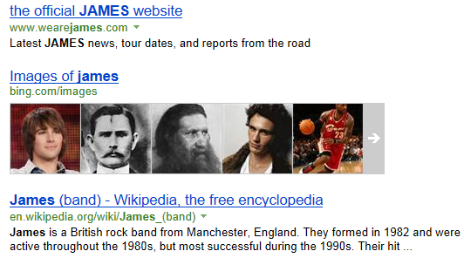
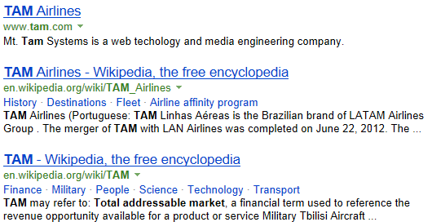
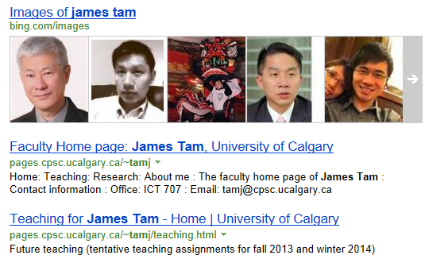
JT’s Extra: Intersection Is Similar To Logical “AND” For Web Searches
Websites containing ‘James’
Websites containing ‘Tam’
Websites containing
‘James’ AND ‘Tam’
FYI: Search engine input: james tam (defaults to ‘AND’)

Slide 49
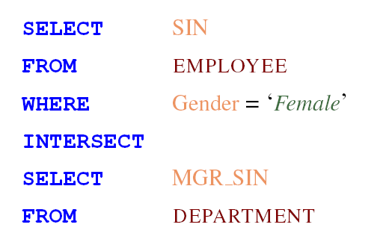
SQL – Set Operations

Slide 50
JT’s Extra (From Textbook): Minus
Gender = “Male”
S1 = SIN of all male employees
MINUS
S2 = SIN of all employees that are managers

Slide 51
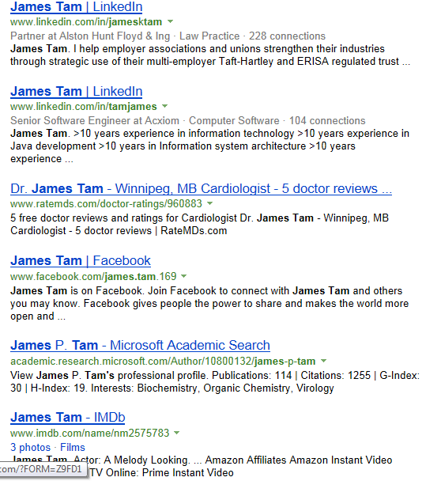
JT’s Extra: Minus Is Similar To “Subtract” For Web Searches
Websites containing
‘James’ AND ‘Tam’
Subtract all pages that contain ‘ucalgary’
=
FYI: Search engine input: james tam -ucalgary

Slide 52
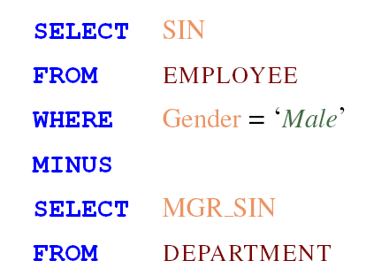
SQL – Set Operations

Slide 53
INTERSECT and MINUS in Access
No direct support
Can use IN for intersect
Can use NOT IN for Minus

Slide 54
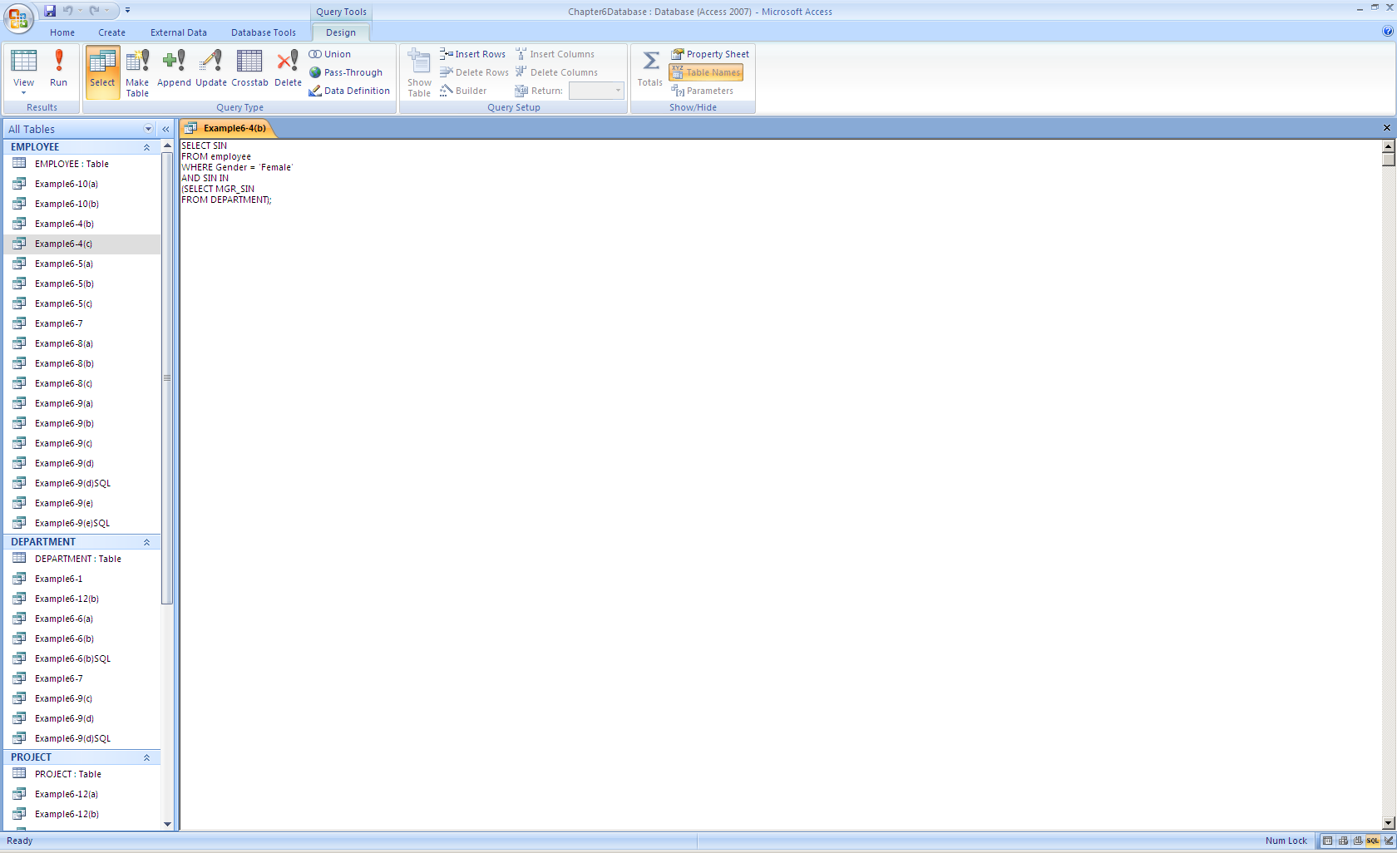
INTERSECT in Access

Slide 55
How IN Works
Result
171717171

Slide 56
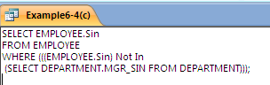








MINUS in Access
JT: Effect of query

Slide 57
Comparison Operators
Equals =
Not equal !=
Greater >
Greater or equal >=
Less than <
Less than or equal <=

Slide 58
Boolean Operators
AND
OR
NOT

Slide 59
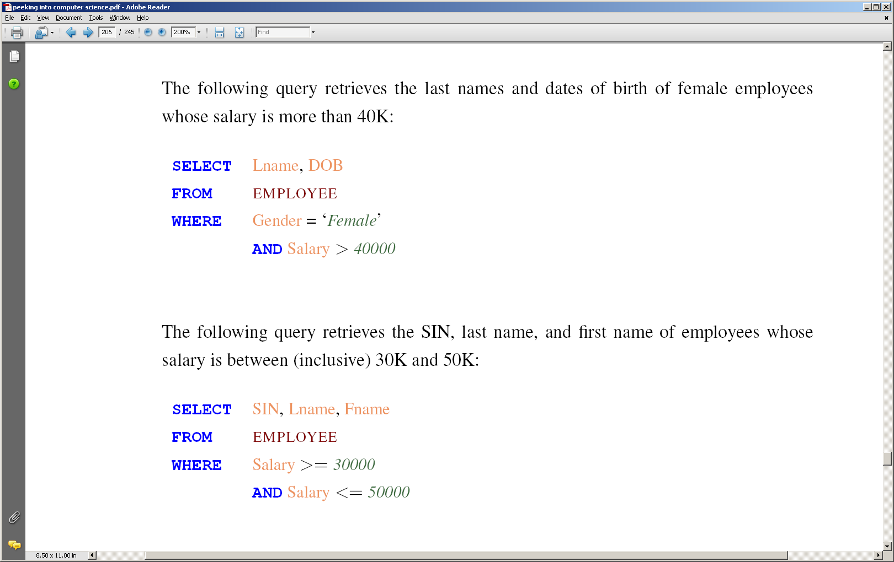
SQL – Example Query

Slide 60
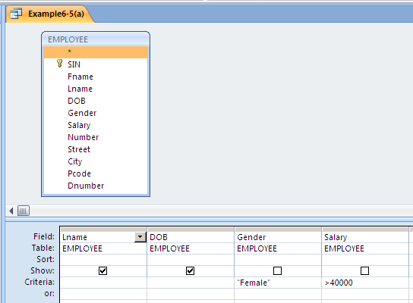
QBE – Example Query

Slide 61
QBE – Example Query
JT: cross column = “AND”

Slide 62
SQL – Example Query

Slide 63
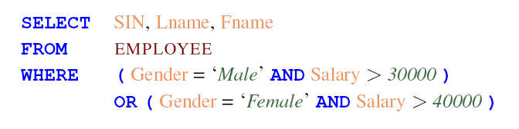
SQL – Example Query

Slide 64
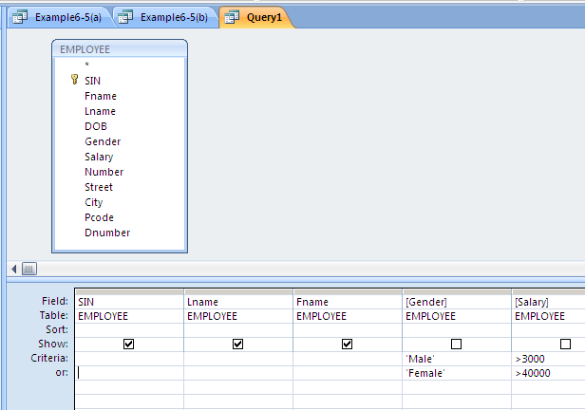
QBE – Example Query
JT: >30000

Slide 65
QBE – Example Query
JT: >30000
JT: cross row = “OR”

Slide 66
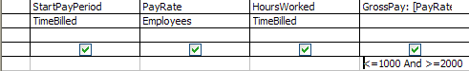
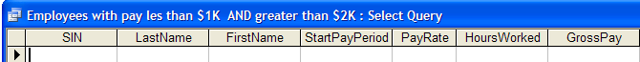
JT’s Extra: Empty Queries (Contradiction)
Query
Result of the (empty) query
Wav file from “The Simpson” © Fox
Take care not to specify queries that can never be true! (Logic: contradiction)
This will result in an “Empty Query”, a query that yields no results.
  Example: Which employees have a gross pay lower than $1,000 AND higher than $2,000 (inclusive for both) on one of their time cards?
Notes:
66

Slide 67
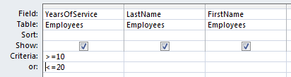

JT’s Extra: Queries Resulting From A Tautology
Query
SQL
SELECT Employees.YearsOfService, Employees.LastName, Employees.FirstName
FROM Employees
WHERE (((Employees.YearsOfService)>=10)) OR (((Employees.YearsOfService)<=20));
Query result
In a similar fashion take care not to specify queries that are always true. (Tautology)
Notes:
67

