Slide 1
Introduction to VBA (Visual Basic For Applications) Programming
Origins of VBA
Creating and running a VBA program
Variables & constants
Interactive programs
Formatting documents
Debugger basics
Security
Introduction to program documentation

Slide 2

B.A.S.I.C.
Beginner’s All-Purpose Symbolic Instruction Code (BASIC)
  From: www.acm.org (original full article: http://time.com/69316/basic/)
A widely used programming language
It was relatively simple to learn (statements were “English-like” e.g., “if-then”)
Widely popular and it was commonly packaged with new computers in the 1970’s and 1980’s
(A then relatively unknown company: Microsoft got it’s initial cash inflows and reputation producing several versions of the language)
B.G.

Slide 3
Visual Basic
A newer programming language developed by Microsoft
It was designed to make it easy to add practical and useful features to computer programs e.g., programmers could add a graphic user interface, database storage of information etc.
Also it can take advantage of the built in capabilities of the various versions of the Windows operating system
  Why write a feature of a program yourself when it already “comes with the computer”
For more information:
  http://msdn.microsoft.com/en-us/library/2x7h1hfk.aspx

Slide 4
Visual Basic For Applications (VBA)
Shares a common core with Visual Basic.
However VBA programs aren’t written in isolation (creating a program just for it’s own sake).
  Most programs are written to be standalone: a computer game can be run without (say) running a web browser or MS-Office.
VB = Visual Basic, VBA = Visual Basic for Applications
Each VBA program must be associated with a ‘host’ application (usually it’s Microsoft office document such as MS-Word but other applications can also be augmented by VBA programs).
  The host application is enhanced or supplemented by the VBA program
  “Why doesn’t this stupid word processor have this feature??!!”
    - Now you can add that feature yourself using VBA

Slide 5
Visual Basic For Applications (VBA): 2
Important! Because every VBA program must be run within the context of host application when you are learning to write your programs do not open up an important MS-Word document and run your programs.
  The host program often needs an Word document in order to run certain capabilities.
  VBA programs often change documents (formatting, style, text).
  Therefore use only small ‘test’ MS-Word documents when running your VBA programs otherwise your information may be lost or corrupted.

Slide 6
Macros
Macro: a sequence of keystrokes or mouse selections (instructions to the computer) that can be repeated over and over
  MS-Office can be augmented by writing Macros (essentially computer programs) that will run either for multiple documents or only for a particular document.
  In this class we will focus solely on MS-Word macro programming
VBA (as guessed) is an example of a macro programming language e.g., you can write a program that includes a series of formatting and other commands that you frequently carry out in Word documents
Write the commands once in the form of a program and just re-run this program instead of re-entering each command

Slide 7
Writing Macros
It is not assumed that you have any prior experience writing computer programs (macro language or something else).
Consequently early examples and concepts will be quite rudimentary i.e., “we will go slow”
  The effect is that you may find that the capabilities of the early examples will duplicate familiar capabilities already built into MS-Word
    Why are we writing a macro program for this feature?
    Makes it easier to understand (you know the expected result).
    Keeps the example simpler.
Later examples will eventually demonstrate the ‘power’ of macros
  You can do things that would be impossible (or at least difficult) with the default capabilities built into MS-Word

Slide 8
Can You Complete The Following Tasks?
Open a MS-Word document and replace every instance of one phrase e.g., tamj@ucalgary.ca with another tamj@cpsc.ucalgary.ca
Open every document in a folder and perform the same search and replace operation:
  2 documents?
  10 documents?
  100 documents?
  All the documents in a particular folder?
  What if you just wanted to open the word documents a particular word or phrase in the name e.g., “assignments_2014”?
This is an example where writing a macro once is a more efficient approach
  One answer to the question: “Why are we learning this???”

Slide 9
Advanced Use Of Macros
Although it’s beyond the scope of this class the following example is introduced now to make you aware of the power of VBA and macro languages.
  It can actually be used to perform real tasks.
You can use a macro to take advantage of the capabilities of each MS-Office application:
  Establishing references to applications to ‘link’ them
  Take the output from one application and making it the input of another.

Slide 10
Advanced Use Of Macros (2)
Example: macros can automate the following task
  Store data in MS-Access
  Store the query results in MS-Excel and perform calculations on the data
  Use the formatting capabilities of MS-Word to produce reports
  MS-Outlook can email the final documents

Slide 11
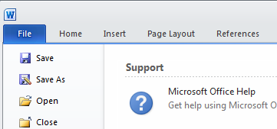
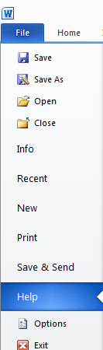
Viewing The ‘Developer’ Ribbon (MS-Word 2010)
The macro programming capability comes built-in to the MS-Office suite.
  You simply have to enable that functionality
Steps
  Select the ‘File’ ribbon
  Select ‘options’

Slide 12
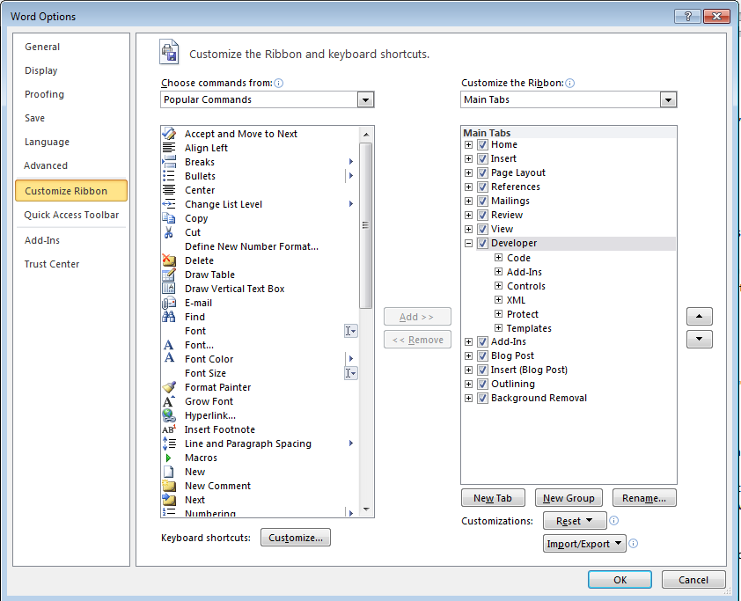
Viewing The ‘Developer’ Ribbon (MS-Word 2010): 2
3A) Select “customize the ribbon”
3B) Check the ‘Developers’ box

Slide 13

Viewing The ‘Developer’ Ribbon (MS-Word 2010): 3
This should add a new ribbon “Developer”

Slide 14
Macros And Computer Security
Computer viruses are simply malicious computer programs.
Macros can be a useful mechanism for reducing repetition or adding new capabilities to MS-Office.
But as is the case when writing a computer program malicious code can also be written with a macro and the virus can be activated by just opening the MS-office document that contains the macro.
Just because you are writing macro programs does not mean that you shouldn’t take macro security seriously!

Slide 15
Examples Macros Viruses
“Melissa”: Information about an old but ‘successful’ Macro Virus
  http://www.cnn.com/TECH/computing/9903/29/melissa.02.idg/index.html?_s=PM:TECH
  http://www.symantec.com/press/1999/n990329.html
  http://support.microsoft.com/kb/224567
Macro viruses aren’t just “ancient history”, take the potential threat seriously!
    http://www.symantec.com/avcenter/macro.html
    http://www.microsoft.com/security/portal/threat/encyclopedia/search.aspx?query=Virus
    http://ca.norton.com/search?site=nrtn_en_CA&client=norton&q=macro+virus

Slide 16
Enabling Macros To Run
If you can' t run macros in MS-office (you see odd error messages) then examine the "Trust Center“ settings in Word
  Select the ‘File’ ribbon
  Select ‘options’

Slide 17
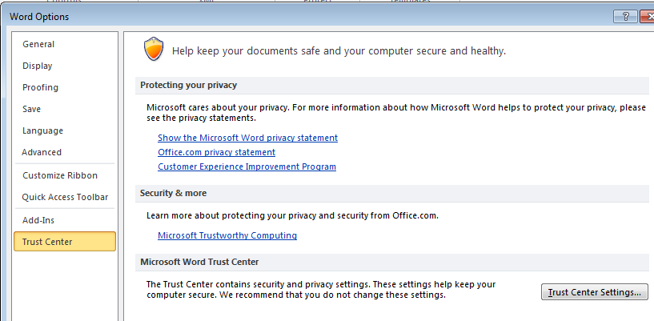
Enabling Macros To Run (2)
3A) Select “Trust Center”
3B) Select “Trust Center Settings”

Slide 18
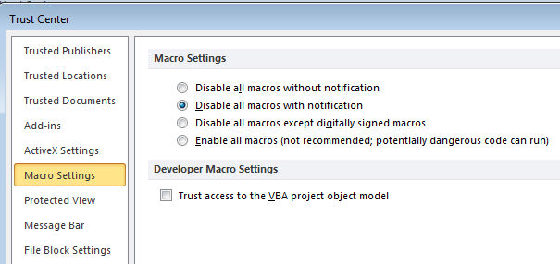
Enabling Macros To Run (3)
4A) Select “Macro Settings”
4B) Select “Disable all macros with notification”
More secure
Less
secure
5) Exit MS-Word (close ALL documents)

Slide 19
Enabling Macros To Run (4)
This should be the default setting for MS-Word (“disable macros with notification”) but these steps will allow you to use machines set differently

Slide 20
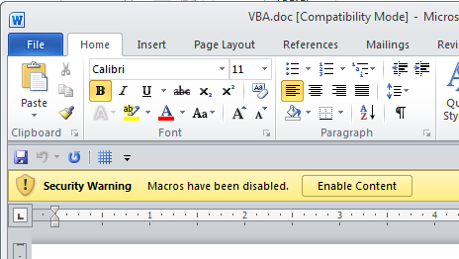
Effect: Opening Word Documents
Using this setting will disable all macros by default (safer approach) but you can still enable the macros as the document is opened.
JT’s caution
You should not casually select this option for all MS-Word documents
It’s recommended that you ONLY do it for ones you have created.

Slide 21
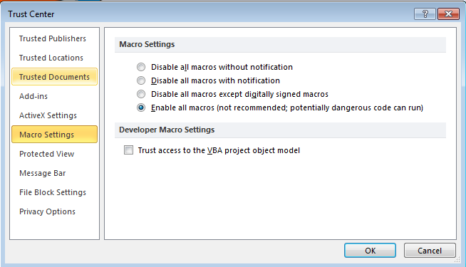


Macro Security
DO NOT take the ‘easy’ way out
More secure
NO!
Less
secure
For more information:
http://www.office.microsoft.com/en-us/help/enable-or-disable-macros-in-office-documents-HA010031071.aspx

Slide 22
Creating Macros
Record the macro automatically: keystrokes and mouse selections will be stored as part of the macro
Manually enter the Macro (type it in yourself into the VBA editor)

Slide 23
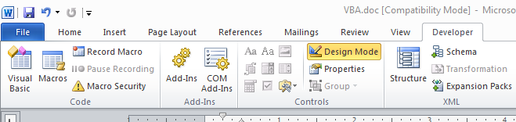
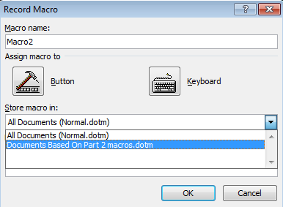
Recording Macros
Developer ribbon
  “Record Macro”
  Recording details
What to name the macro
Where to store the macro

Slide 24
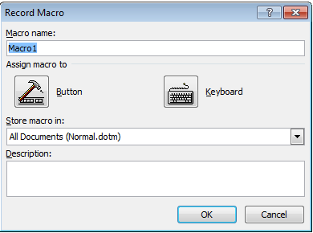
Naming The Macro: Conventions
Part of your assignment marks will be awarded according to how well your programs conform to stylistic conventions such as naming conventions employed.
  Macros should be given a good self-explanatory name e.g., ‘formatting_resume_headings’
  Additional details can be provided under ‘description’ (more later)
Language requirements:
    Must start with an alphabetic letter, after than any combination of letters and numbers may be used
    Maximum length of 80 characters
    It cannot contain spaces, punctuation or special characters such as # or !
      ‘resume headings’ (Not Allowed: space character)
      ‘macros!’ (Not Allowed: special character)
    Can contain underscores (separate long names)

Slide 25
Where To Store

Slide 26
Side Note: Template Documents
Can be used to customize MS-Word settings e.g., creating formatting styles
You can have the customizations will apply each time that you open MS-Word.
If you want different customizations to apply under different circumstances then you can create template documents.

Slide 27
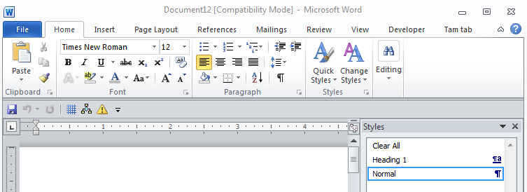
Side Note: Template Documents (2)
Example: default formatting styles

Slide 28
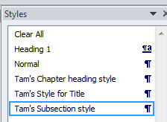
Side Note: Template Documents (3)
Example: you can create custom formatting styles

Slide 29
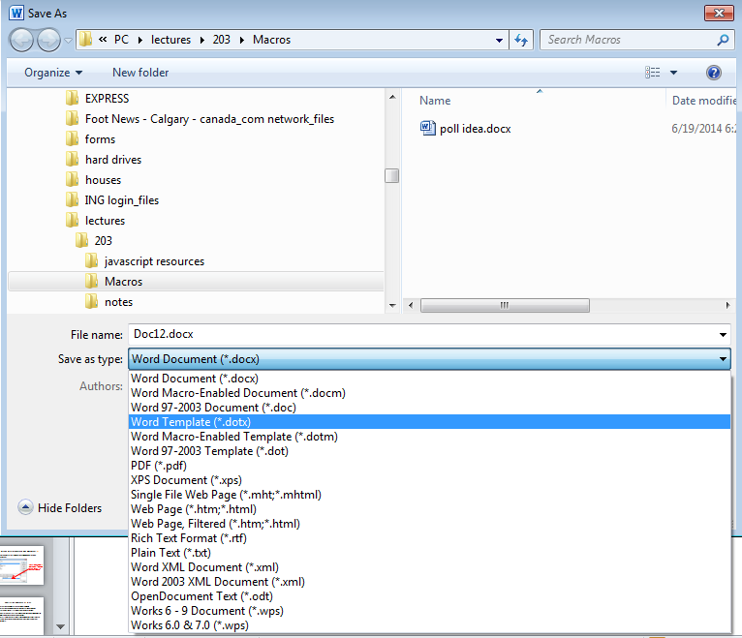
Side Note: Template Documents (4)
You have these customizations available only under certain situations by creating a template document (‘.dotx’)

Slide 30
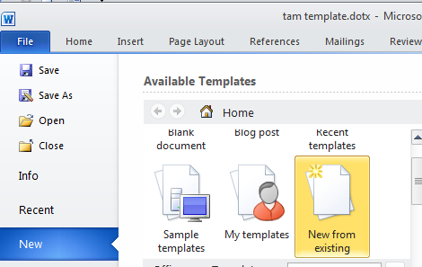
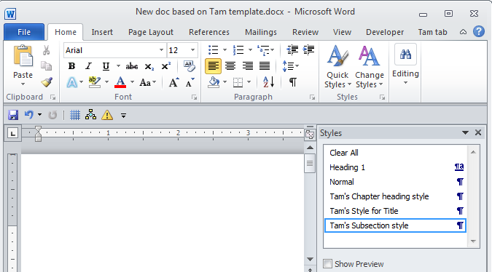
Side Note: Template Documents (5)
All documents created using this template will have access to the customizations.

Slide 31
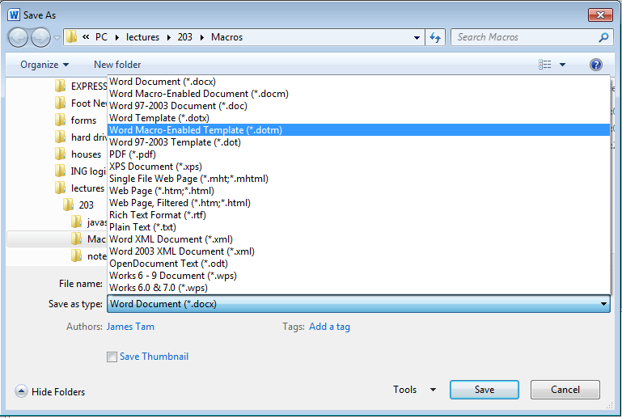
Document Templates & Macros
You can also create templates that not only include formatting customizations but also include macros that you create.
In the latter case: The template must be saved as a macro-enabled template rather than a regular template (‘.dotm’)

Slide 32
Storage Locations For Macros
All templates: all MS-Word documents can access the macro
  Located in the ‘normal.dotm’ document
User created template: only MS-Word documents based on that template can access the macro
  Creating your own ‘.dotm’ template document
One document: the macro instructions can only be accessed in the one document
  Creating a macro enabled document ‘.docm’

Slide 33
#1 Making Macros Available In All Documents
This is the default option for saving macros
(Note: this is the most convenient approach if you work on the same computer.
  This approach is not recommended if you work on multiple machines (e.g., 203 lab and computer(s) at home) because transferring your work will take more work.
  If you do employ this approach on your own computer then you will probably want to delete all your macros associated with the ‘normal’ template after you finish with this course (details on ‘deleting macros’ coming up).
  For these reasons this approach is NOT recommended for this course.

Slide 34
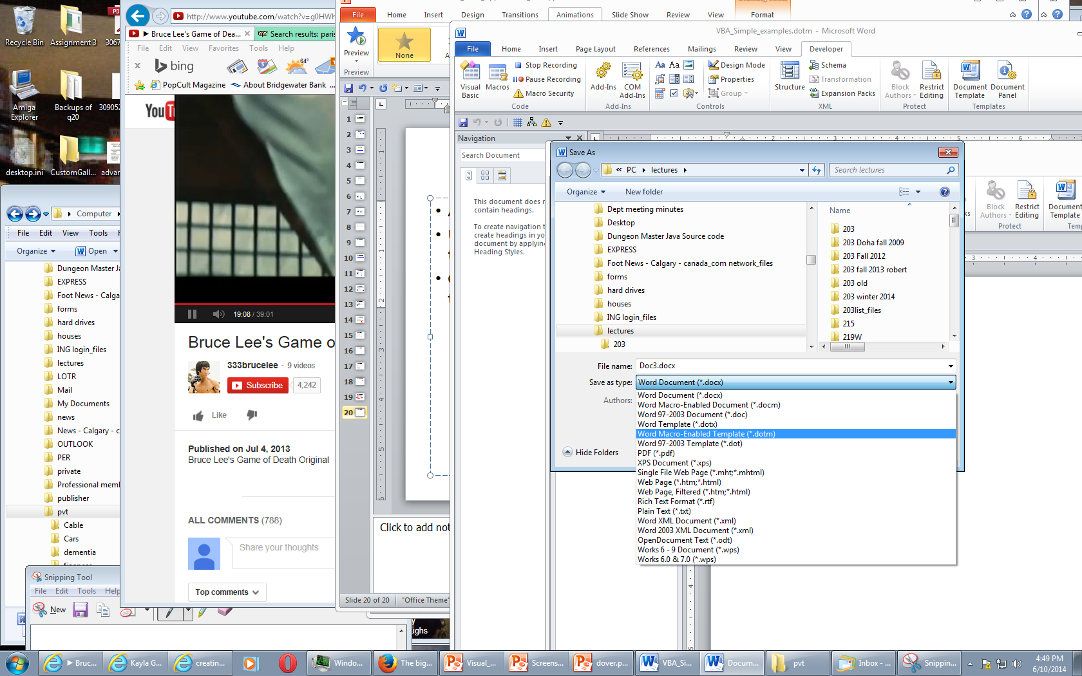
#2: Making Macros Specific To One Template
In ‘real life’ your organization may be creating so many macros in documents that some macros will only be used by some users.
Macros can be organized into different template ‘doc-dotm’ documents (m = macro enabled document)
Steps:
  Create a new macro-enabled template

Slide 35
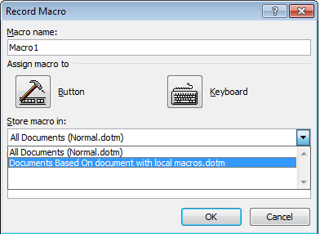
#2: Making Macros Specific To One Template (2)
After creating a new template you can now make your new macros specific to that new template:
You can transfer your work from one computer to another by transferring the template document (the recommended approach for this class)

Slide 36
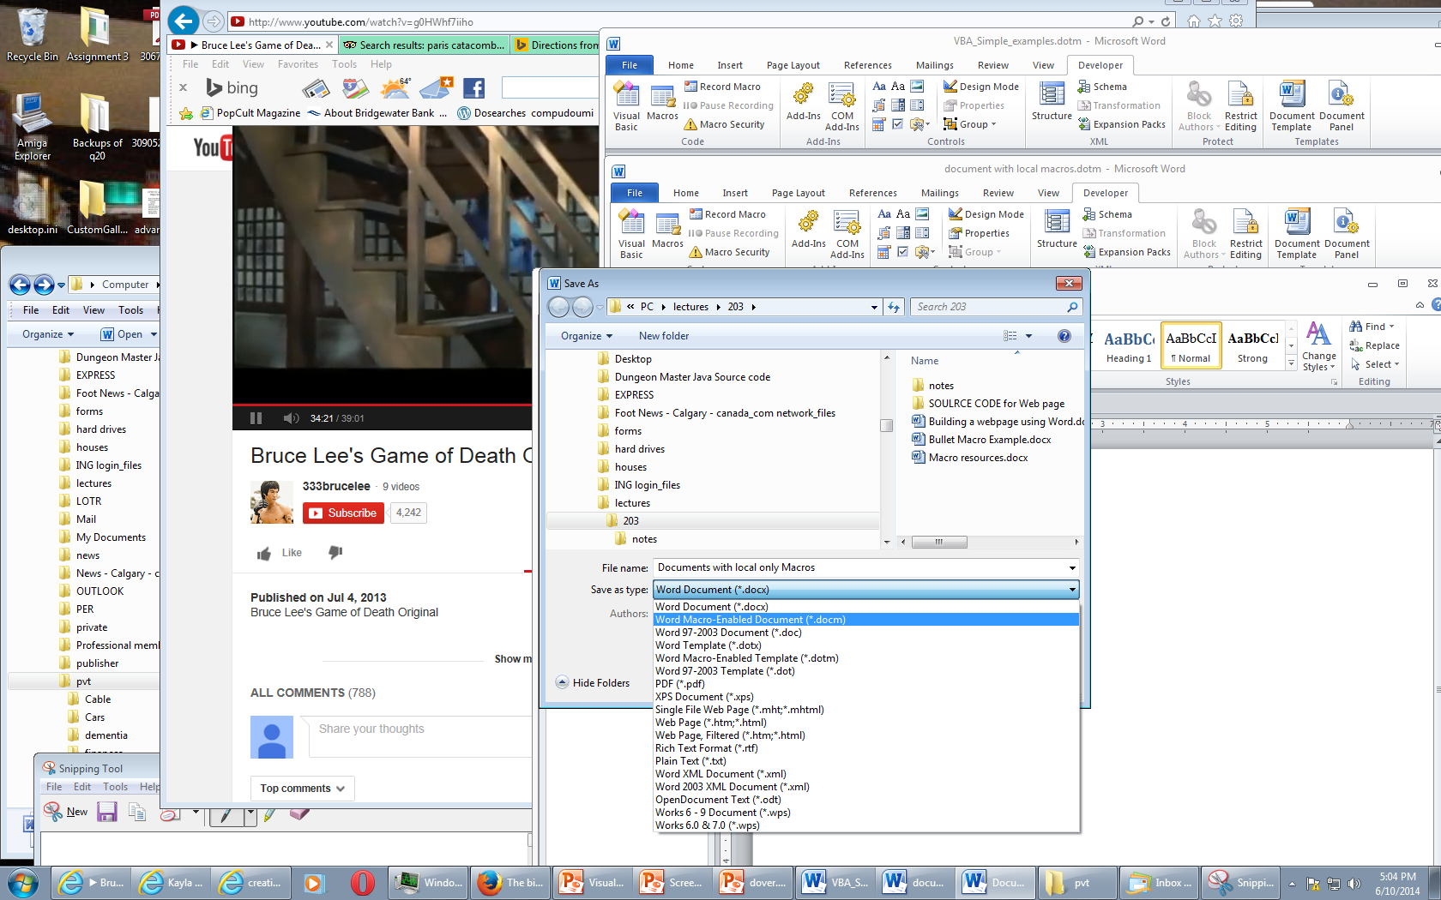
#3: Making Macros Specific To One Document
Save the document as one that has macros-enabled via “save as” rather than just “save”

Slide 37
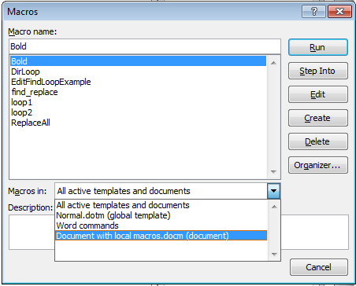
#3: Making Macros Specific To One Document (2)
Recorded macros can be made available in only this one document
This is the name of the document “Document with local macros.docm”

Slide 38
Contrasting Approach #2 & #3
#2 Creating a new macro-enabled template
#3 Creating a new document with macros enabled in it
Both seem similar (creating a file using MS-Word)
The difference is that the second approach only allows macros to work in one MS-Word document.
The first approach creates a template with macros that can work in all MS-Word documents that are based on that template.
One of way of transferring macros between machines is to transfer the macro-enabled document or macro-enabled template.

Slide 39
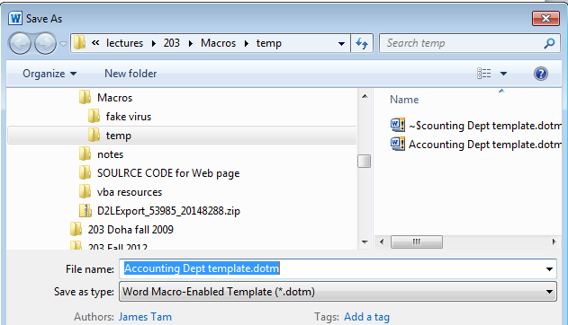
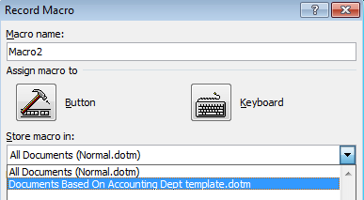
Saving Macros
Simple recap: If you don’t know where to save your macros:
  Start by creating a new macro enabled template
Save all your macros to this template (‘.dotm’)

Slide 40
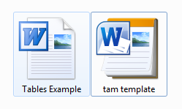
Transferring Your Macros (This Class)
If you created a macro-enabled template then transfer the template document (again file name suffix “.dotm”)
If you create a macro-enabled MS-Word document (file name suffix “.docm”) then transfer the Word document itself.

Slide 41
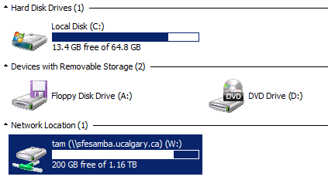
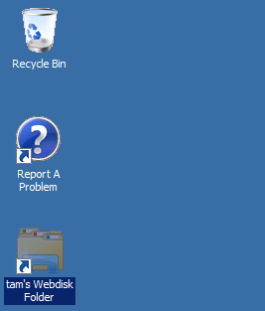
Transferring Your Macros (This Class): 2
In the 203 computer lab
Save the template document or macro enabled word document to your portable USB flash drive
OR
Save the template document on your web disk drive
  To download files stored on web disk onto another computer: https://webdisk.ucalgary.ca/

Slide 42
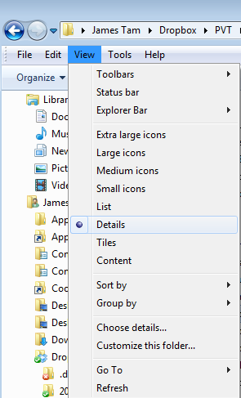

Viewing File Information
View details: select ‘view’ in a folder
Effect

Slide 43
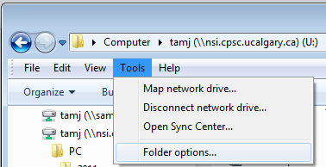
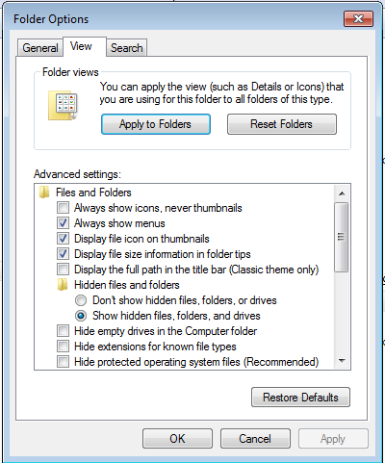

View File Suffixes
In a folder select: Tools->Folder options
Under the ‘view’ tab uncheck ‘Hide extensions for known file types’
Effect

Slide 44
The First Simple Macro
With word processing there’s sometimes a need to apply multiple formatting styles (bold, italics, underline) to high-lighted text
Manually applying the required formatting to each block of text can be tedious
  Recall: Macros can be used to automate or shorten some tasks
This first example macro program will be used to show:
  How to create a VBA macro for MS-Word
  How to automate a task using a macro

Slide 45
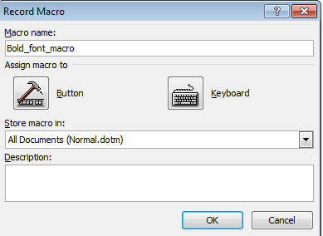
Recording A Simple Macro
(Of course a macro isn’t needed to use this formatting effect but it’s easiest to start with a simple example).
Bold face highlighted text.
  Select the developer tab and press record
  Give the macro a self explanatory name and press ‘OK’ (recording begins)

Slide 46
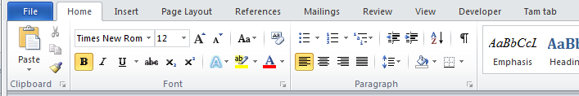
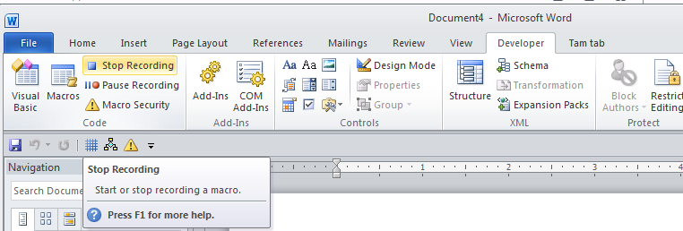
Recording A Macro (2)
Select whatever options you want to add to the recording of the macro
  In this case you would select bold font
  All commands have been entered so you can stop the recording

Slide 47
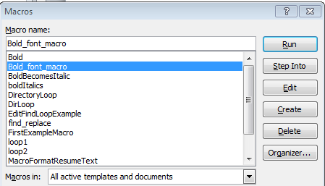
Running A Recorded Macro
Under the Developer ribbon select ‘macros’
Select the macro and then ‘run’ it

Slide 48
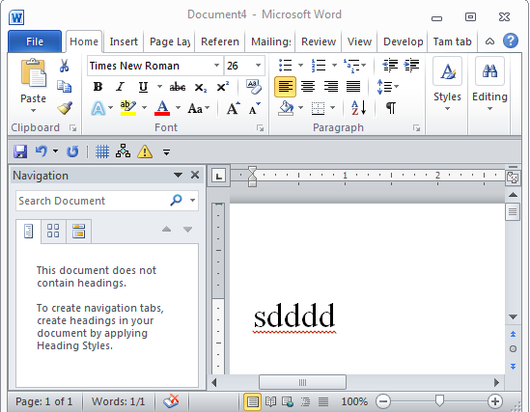
Running A Recorded Macro (2)
In this case nothing happened?
  This macro changes selected/highlighted text to bold
  You need to select some text before running the macro

Slide 49
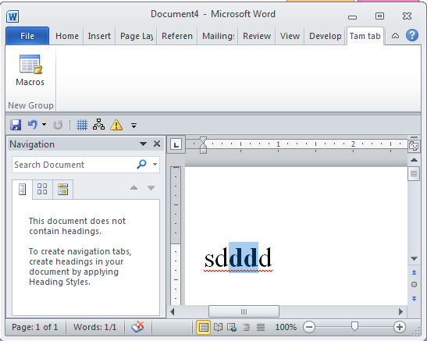
Running A Recorded Macro (3)
After selecting the text and running the macro again, whatever text was highlighted now becomes bold.

Slide 50
Recording Macros: Additional Comments
Don’t rely on creating all your macros by recording them.
Drawbacks:
  (Problem in terms of this class) to demonstrate your understanding of concepts you will be asked to manually write VBA code
    You won’t be adequately prepared if you rely on automatically recording your programs
  (Problem with doing this in real work) The automatically generated program code automatically is larger and more complicated than is necessary
    “Bloated” code
    Look under search terms such as +bloated "vba code" +recorded for examples of why automating recording VBA programs can be problematic.

Slide 51
Auto Generated VBA Program: 24 Lines
Sub heading()
With Selection.ParagraphFormat
.LeftIndent = InchesToPoints(0)
.RightIndent = InchesToPoints(0)
.SpaceBefore = 0
.SpaceBeforeAuto = False
.SpaceAfter = 6
.SpaceAfterAuto = False
.LineSpacingRule = wdLineSpaceSingle
.Alignment = wdAlignParagraphCenter
.WidowControl = True
.KeepWithNext = False
.KeepTogether = False
.PageBreakBefore = False
.NoLineNumber = False
.Hyphenation = True
.FirstLineIndent = InchesToPoints(0)
.OutlineLevel = wdOutlineLevelBodyText
.CharacterUnitLeftIndent = 0
.CharacterUnitRightIndent = 0
.CharacterUnitFirstLineIndent = 0
.LineUnitBefore = 0
.LineUnitAfter = 0
.MirrorIndents = False
.TextboxTightWrap = wdTightNone
End With
End Sub

Slide 52
VBA Statements Actually Needed: 1 Line
Sub headingManual()
Selection.ParagraphFormat.SpaceAfter = 6
End Sub

Slide 53
Recording Macros: Additional Comments
Benefits:
  You can use the macro code that is automatically generated in order to learn how to do manually.
  Sometimes this is very useful if you don’t know the wording of a command or how to access a property.
  Example (VBA program code for the previous example)
    Record the commands for the macro
    Then view the commands so you can learn how to do it manually
Sub AutoGeneratedFontChange()
Selection.Font.Bold = wdToggle
End Sub

Slide 54
Recording Macros
Bottom line: use it for learning “how to do” things
Don’t:
  Just use the auto-generated code to study for the exam without creating any code of your code
  Just hand in the auto-generated VBA code for your assignment
Use the auto-generated code to figure out how to “type the program from scratch” yourself (I will show how to do this shortly)

Slide 55
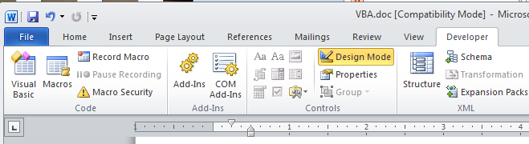
The Visual Basic Editor
You don’t need to familiarize yourself with every detail of the editor in order to create VBA programs.
Just a few key features should be sufficient
Starting the editor:
  Because VBA programs are associated with an office application open the editor from MS-Word
  Click the “Visual Basic” icon under “Developer”

Slide 56
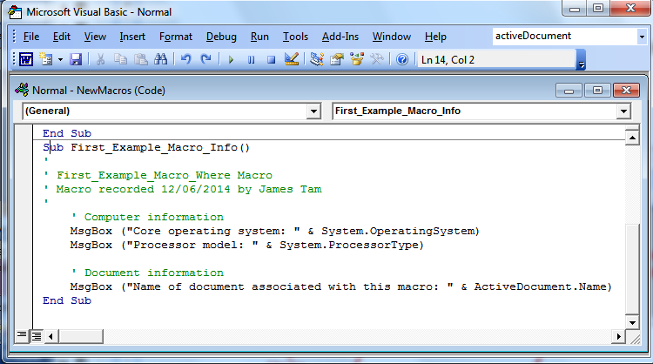
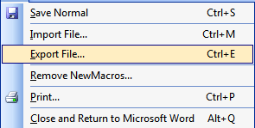
Overview Of The Important Parts Of The VBA Editor
Cut, copy, paste
Find, replace
Help lookup
Save
Program editor
Undo, redo
Export:
Useful for transferring or backing up your work
Run, pause, stop (VBA subroutine program)
Current location

Slide 57
VBA Examples: This Point Onwards
Unlike the previous example you will be manually typing in the program instructions yourself rather than automatically recording the program as a series of steps
Reminder: some of the early examples are meant only as a learning/teaching tool
  They show you how to write simple VBA programs
  So they won’t yet focus on “doing useful things” yet
Try typing them into the VBA editor or cutting and pasting them yourself
  It’s important to “try things out for yourself”
  With programming you learn by “doing yourself” rather than by watching someone else ‘do’

Slide 58
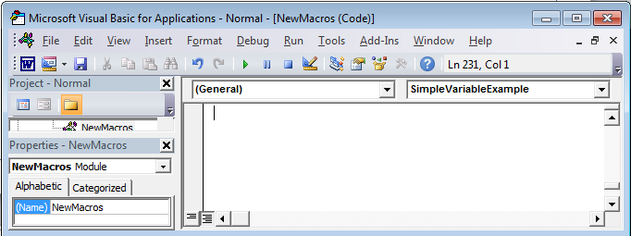
First VBA Example
Learning Objectives:
  Creating/running a VBA program
  Creating a Message Box “MsgBox”
Reminder steps (since this is your first example)
  Start up the application (MS-Word)
  Invoke the VBA editor: Developer->Visual Basic
  If successful you should see something similar to the image
Enter your program instructions here (program editor)

Slide 59
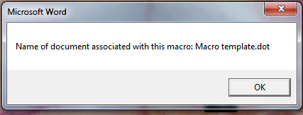
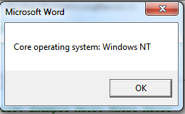
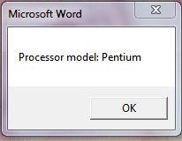
First VBA Example (2)
Type in or cut-and-paste the following example into the VBA editor (see last image for location of the editor, previous slide)
  This is NOT the same as pasting it directly into MS-Word.
  Word document containing the macro: first_example_macro_info.docm
Sub First_Example_Macro_Info()
'
' First_Example_Macro_Where Macro
' Macro recorded 12/06/2014 by James Tam
'
' Computer information
MsgBox ("Core operating system: " & System.OperatingSystem)
MsgBox ("Processor model: " & System.ProcessorType)
' Document information
MsgBox ("Name of document associated with this macro: " &
ActiveDocument.Name)
End Sub

Slide 60
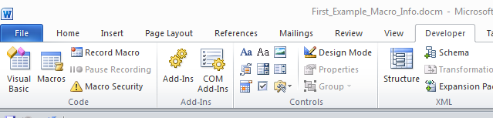
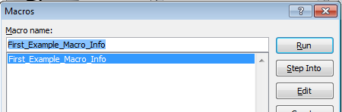
Reminder: Running Macros
(You must first have the ‘developer’ tab visible).
Developer->Macros
The single macro should be highlighted, then click ‘run’

Slide 61
Running VBA Programs You Have Entered
It can be done the same way as with auto-recorded programs

Slide 62
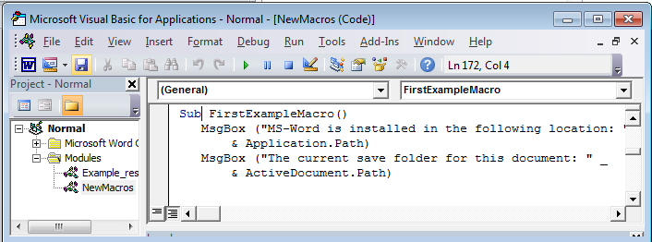
Running VBA Programs You Have Entered (2)
Or you can run the program right after you have entered it (in the editor).
Ensure correct program “sub” is to be executed (click there)
Press the ‘play/run’ button or “F5”

Slide 63
Message Box
(Details of the previous example)
Creates a popup window
Useful for testing
  Is my program working?
  Which part is running?
Also useful for displaying status messages about the current state of the program

Slide 64
Creating A Message Box
Ampersand ‘&’: connects strings (with quotes) and function return values (no quotes)
Format:
  MsgBox ("<Message to appear>")
Example:
  MsgBox ("Core operating system: " &
  System.OperatingSystem)
Quotes: literal string appears in message box
No quotes: the return result of function (this example) or contents of variable or constant (later examples)
Notes on ‘Format’:
Italicized: you have a choice for this part
Non-italicized: mandatory (enter it as-is)
Don’t type in the angled brackets (used to help you visually group)

Slide 65
Early Exam Information
You should know how a message box works and how to create one
Unless a function is extremely common or you are told otherwise you won’t have to memorize how a specific function operates e.g., System.OperatingSystem (too specific for the exam).
Alternatively you may be given a reminder in the exam itself that describes how to use a particular function.
  In this case you should then be able to write statements that employ that function.

Slide 66
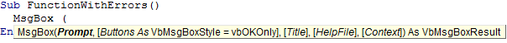
VBA Visual Aids: Function Arguments
As you type in the name of VB functions you will see visual hints about the arguments/inputs for the function.
  Enter the function name and then a space
Function arguments
(Bold): mandatory arguments

Slide 67
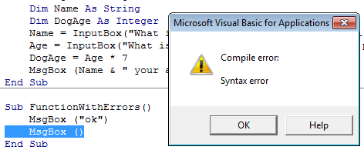

VBA Visual Aids: Error Information
Required argument missing
Part of program that contains errors (yellow highlight)
Specific statement/instruction causing the error (red font)

Slide 68
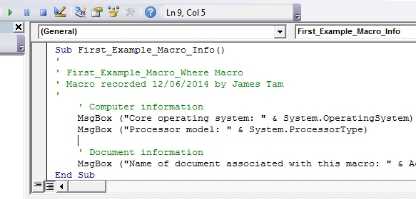
Viewing Macros
All macros that you have created can be viewed in the macro editor:
  Macros manually entered in the editor (Message Box example)
  Macros automatically recorded (previous example: changing font to bold)
Previous example: auto recorded

Slide 69
The ‘Sub’ Keyword
Sub stands for ‘subroutine’ or a portion of a VBA program Format:
  Sub <subroutine name>()
  <Instructions in the subroutine>
  End Sub
Example:
  Sub First_Example_Macro_Info()
  End Sub
All executable VBA program statements must be inside the subroutine
Header, start of subroutine:
Has word ‘Sub’
Name of subroutine
Set of brackets
Note: all lines in between are indented (4 spaces)
End of subroutine:
Has ‘End Sub’

Slide 70




Objects
You are of course familiar with objects in the everyday world.
  These are physical entities
Similar to everyday objects MS-Objects have properties and capabilities
  Properties: information that describe the object
    E.g., the name of a document, size of the document, date modified etc.
  Capabilities: actions that can be performed (sometimes referred to as ‘methods’ or ‘functions’)
    E.g., save, print, spell check etc.

Slide 71
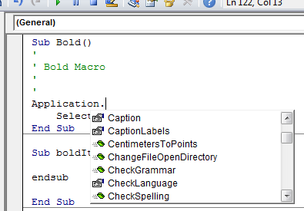
Common VBA Objects
Application: the MS-Office program running (for CPSC 203 it will always be MS-Word)
ActiveDocument
Selection
When enter one of these keywords in the editor followed by the ‘dot’ you can see more information.
Take advantage of the benefits:
The list of properties and methods is a useful reminder if you can’t remember the name
If you don’t see the pull down then this is clue that you entered the wrong name for the object

Slide 72
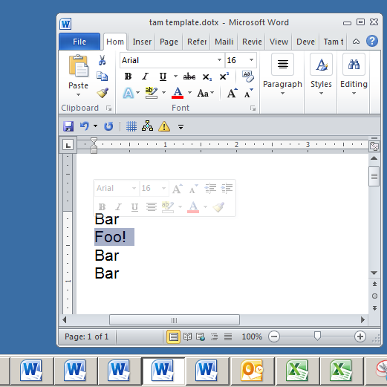
Example: What Are The Three Objects
Application:
  MS-Word
Current Document:
  “tamj template”
Selection
  “Foo!”

Slide 73
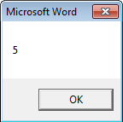
Using Pre-Built Capabilities/Properties Of Objects
Format:
  <Object name>.<method or attribute name>
Example:
  Sub ApplicationTest()
  MsgBox (Application.Windows.Count)
  End Sub
Application.Windows.Count
Property of Window:
Number
Accessing the Windows property of Word (the application)
Info about the windows currently opened
Object referred to: ‘Application’

Slide 74

Properties Vs. Methods/Functions
Recall
  Property: information about an object
  Method: capabilities of an object (possible actions)
Property: current cell
Using the ‘average()’ function

Slide 75

Properties Vs. Methods: Appearance
Methods
Property
Similar to functions in MS-Excel some object’s methods may require an argument or arguments
Examples
  ActiveDocument.CountNumberedItems
  ActiveDocument.Save
  ActiveDocument.SaveAs2(“<name>”)
No argument required
Argument: New name of document needed

Slide 76
More On Objects
This is only a very brief introduction on VBA objects
What you should now know
  The 3 common objects (application, active document, selection)
  Objects consist of attributes and methods and how to access/use them
As the need arises you will learn more about these objects (and perhaps others)

Slide 77

Built In Search/Help

Slide 78
Basic Mathematical Operators
Operation | Symbol used in VBA | Example
Addition | + | 2 + 2
Subtraction | - | 3 – 2
Multiplication | * | 10 * 10
Division | / | 81 / 9

Slide 79

Variables
Used to temporarily store information at location in memory
Variables must be declared (created) before they can be used.
Format for declaration:
  Dim <Variable name> as <Type of variable>
Example declaration:
  Dim BirthYear as Long
Image curtesy of James Tam

Slide 80
Some Types Of Variables
Type of information stored | VBA Name | Example variable declaration | Default Value
Whole numbers | Long | Dim LuckyNumber as Long | 0
Real numbers | Double | Dim MyWeight As Double | 0
Chararacters¹ | String² | Dim Name As String | Empty string
Date³ | Date | Dim BirthDate As Date | 00:00:00
1) Any visible character you can type and more e.g., ‘Enter’ key
2) Each string can contain up to a maximum of 2 billion characters
3) Format: Day/month/year

Slide 81
Examples Of Assigning Values To Variables
Note: some types of variables requires some mechanism to specify the type of information to be stored:
Strings: the start and end of the string must be marked with double quotes "
Date: the start and end of the string must be marked with the number sign #
Dim LuckyNumber As Long
LuckNumber = 888
Dim BirthDay As Date
BirthDay = #11/01/1977#
Dim MyName As String
MyName = "James"

Slide 82
Second VBA Example
Learning Objectives:
  Using variables
  Using mathematical operators

Slide 83



Second VBA Example (2)
  Word document containing the macro: secondExample.docm
  Sub FirstExample()
  Dim RealNumber As Double
  Dim WholeNumber As Integer
  RealNumber = 1 / 3
  MsgBox (RealNumber)
  WholeNumber = 5 / 10
  MsgBox (WholeNumber)
  WholeNumber = 6 / 10
  MsgBox (WholeNumber)
  End Sub
JT’s note: Anything over 0.5 is rounded up

Slide 84
Variable Naming Conventions
Language requirements:
  Rules built into the Visual Basic (recall VBA is essentially Visual Basic tied to an MS-Office Application) language.
  Somewhat analogous to the grammar of a ‘human’ language.
  If the rules are violated then the typical outcome is the program cannot execute.
Style requirements:
  Approaches for producing a well written program.
  (The real life analogy is that something written in a human language may follow the grammar but still be poorly written).
  If style requirements are not followed then the program can execute but there may be other problems (e.g., it is difficult to understand because it’s overly long and complex - more on this during the term).

Slide 85
Variable Naming Conventions (2)
Style requirement (all languages): The name should be meaningful.
Style requirement (from the Microsoft Developer Network¹):
  Choose easily readable identifier names
  Favor readability over brevity.
Examples
#1:
age (yes)
x, y (no)
HorizontalAlignment (yes)
AlignmentHorizontal (no)
CanScrollHorizontally (yes)
ScrollableX (no)
1 http://msdn.microsoft.com/en-us/library/ms229045.aspx

Slide 86
Variable Naming Conventions (3)
Style requirement: Variable names should generally be all lower case except perhaps for the first letter (see next point for the exception).
Style requirement: For names composed of multiple words separate each word by capitalizing the first letter of each word (save for the first word) or by using an underscore. (Either approach is acceptable but don’t mix and match.)
Avoid using keywords as names (next slide)
Examples
#3:
Age, height, weight (yes)
HEIGHT (no)
#4
firstName, last_name
(yes to either approach)

Slide 87
Some Common Visual Basic Keywords¹
And Boolean Call Case Catch Continue
Date Decimal Default Dim Do Double
Each Else End Erase Error Event
Exit False Finally For Friend Function
Get Global Handles If In Inherits
Integer Interface Is Let Lib Like
Long Loop Me Mod Module Next
Not Nothing Of On Operator Option
Optional Or Out Overrides Partial Private
Property Protected Public Resume Return Select
Set Shadows Short Single Static Step
Stop String Sub Then Throw To
True Try Using Variant When While
Widening With
1 The full list can be found on the MSDN http://msdn.microsoft.com/en-us/library/dd409611.aspx
Notes:
87

Slide 88
Variable Naming Conventions: Bottom Line
Both the language and style requirements should be followed when declaring your variables.

Slide 89


An Alternate To The MsgBox: The Status Bar
Finding the MsgBox popups too obtrusive?
You can display messages in a more subtle fashion by changing the title bar.
Before
After

Slide 90
Changing The Title Bar
Format:
  ActiveDocument.ActiveWindow.Caption =
  "<New text for the title bar>"
Word document containing the macro: firstTitlebarExample.docm
  Sub firstTitleBarExample()
  ActiveDocument.ActiveWindow.Caption = "A NEW TITLE!"
  End Sub

Slide 91

Comparison: Popups Vs. Status Messages
Popup dialogs:
  Often used for important messages that you don’t want the user to miss
  Overuse can simply result in the user “clicking past” the dialog without reading them
Status messages:
  More subtle presentation of information.
  Easy to miss.
  Multiple updates result in only the last change appearing to the user

Slide 92

Missing The Message
  Word document containing the macro: secondTitleBarExample.docm
  Sub secondTitleBarExample()
  Dim num1 As Integer
  Dim num2 As Integer
  num1 = 666
  num2 = 888
  ActiveDocument.ActiveWindow.Caption = num1
  ActiveDocument.ActiveWindow.Caption = num2
  End Sub

Slide 93

Getting User Input
A simple approach is to use an Input Box
Format:
  <Variable name> = InputBox(<"Prompt">, <"Title bar">)
Example:
  Name = InputBox("What is your name"), "Getting Personal")
Note: only the string for the prompt is mandatory.
If the title bar information is omitted then the default is the application name (“Microsoft Word”)

Slide 94



Third Example: InputBox
Learning: getting user input with an InputBox
Word document containing the macro: InputBox.docm
  Sub InputExample()
  Dim Age As Integer
  Dim Name As String
  Dim DogAge As Integer
  Name = InputBox("What is your name", "Getting personal: name")
  Age = InputBox("What is your age", "Getting even more personal: age")
  DogAge = Age * 7
  MsgBox (Name & " your age in dog years is " & DogAge)
  End Sub
  Note: there are two input boxes, one that prompts for the name and the other for the age. Each is given a self-descriptive name to distinguish them (an example of good programming style – more on this shortly)

Slide 95

The VBA Debugger
Debuggers can be used to help find errors in your program
Setting up breakpoints
  Points in the program that will ‘pause’ until you proceed to the next step
  Useful in different situations
    The program ‘crashes’ but you don’t know where it is occurring
      Pause before the crash
    An incorrect result is produced but where is the calculation wrong
Set up breakpoints
  Click in the left margin

Slide 96





The VBA Debugger (2)
Multiple breakpoints
Program pauses when breakpoints are reached
  The contents of variables can be displayed at that point in the program

Slide 97


How To Stop Step-By-Step Execution: Step Out
Suppose you have found and fixed the error and want execution to resume normally (without stopping at each break point)
You can “step out” of the breakpoints.
Example
Suppose execution reaches this point
Option 1: Continue debugging
Continue execution one ‘step’ at a time (program pauses at each breakpoint).
To resume execution as a breakpoint is reached select ‘play’ or press F5
Option 2: Stop debugging
Step out of debugging by pressing F8
Program executes without stopping

Slide 98
Break Points: Final Note
They only meant as a temporary mechanism for finding the errors in your program.
  (Having them ‘permanently’ included with the program would be a nuisance because it will pause at each break point).
Consequently break points are not saved either with: the document, template or the VBA program

Slide 99
Named Constants
They are similar to variables: a memory location that’s been given a name.
Unlike variables their contents cannot change.
The naming conventions for choosing variable names generally apply to constants but constants should be all UPPER CASE. (You can separate multiple words with an underscore).
  This isn’t a usual Visual Basic convention but since it’s very common with most other languages so you will be required to follow it for this class.
Example CONST PI = 3.14
  PI = Named constant, 3.14 = Unnamed constant
They are capitalized so the reader of the program can quickly distinguish them from variables.

Slide 100
Declaring Named Constants
1 The expression can be any mathematical operation but can’t be the result of a function call
Format:
  Const <Name of constant> = <Expression>¹
  JT: it’s preceded by the keyword ‘const’ to indicate that it is a constant
Example:
  Sub ConstantExample()
  Const PI = 3.14
  End Sub

Slide 101
Why Use Named Constants
No ☹
Yes ☺
They can make your programs easier to read and understand
Example:
  Income = 315 * 80
Vs.
  Income = WORKING_DAYS_PER_YEAR * DAILY_PAY

Slide 102
Predefined Constants: MS-Word
Microsoft uses their owning naming convention
Example: wdFormatOriginalFormatting

Slide 103

Predefined Constants
They are constants that are already defined by the language.
Similar to named constants that you create their use can make your program easier to read and understand.
Word document containing the macro: cutAndPaste.docm
  Learning concepts: Cutting and pasting text, using constants
Sub cutAndPaste()
Selection.Expand
Selection.Copy
Selection.MoveRight
Selection.PasteAndFormat
(wdFormatOriginalFormatting)
End Sub
A predefined constant
Another is “wdFormatPlainText”

Slide 104


Student Exercise (Early Review Example)
What would happen to the following document…
…if the following macro was executed?
Sub cutAndPaste()
Selection.Expand
Selection.Copy
Selection.MoveRight
Selection.PasteAndFormat (wdFormatPlainText)
End Sub
JT: This is a timed in class exercise (you get the answer in lecture so be sure to come to class)

Slide 105
Previous Example: For The Exam
Without any additional documentation or explanation you should know
The Selection Object:
  Expand()
  Copy() ‘ Also you should know Cut()
  MoveRight() ‘ Also you should know MoveLeft()
  PasteAndFormat() ‘ Also you should be familiar with predefined
  constants:
  wdFormatOriginalFormatting
  wdFormatPlainText

Slide 106

Closing Documents
Default action when closing a MS-Word document that has been modified
VBA code to close a document in this fashion:
  ActiveDocument.Close (wdPromptToSaveChanges)
Pre-defined constant

Slide 107
More Pre-Defined Constants: Closing Documents
Word document containing the macro: “ClosingActions.docm”
  Sub ClosingActions()
  ActiveDocument.Close (<Constant for closing action>)
  End Sub
'Choose one constant
wdPromptToSaveChanges
wdDoNotSaveChanges
wdSaveChanges

Slide 108
Formatting Text
Examples: bold, underline, font type, font size
Formatting effects can be applied to an entire document
  Used when the formatting effects apply to the entire document
Formatting effects can be applied only apply to the currently selected part of the document

Slide 109

Formatting An Entire Document
You first need to indicate the document to be formatted
This can be done through the ‘ActiveDocument’ object
Then choose the ‘Select’ method of that document.
  Review: it’s a method and not a property because it applies an action: select = selecting the text of the entire document

Slide 110
Active Document: Which One?
Remember: the active document is the one you are currently working on.
When writing VBA programs this can be tricky to determine.
So it’s best to work with only a single document at a time when writing your programs.

Slide 111

Formatting The Text Currently Selected
This can be done through the ‘Selection’ object
This object accesses the text in a document that has been selected

Slide 112
Formatting Text: An Example
Suppose you want to format a document in the following way
Entire document
  Font = Calibri
Selected headings
  Font size = 14 point
  Bold
  Underline
  Centre the heading
  6 point spacing after the heading
Selected paragraphs
  Font size = 10 point
  Left and right margins indented by 0.2 inches

Slide 113
Formatting: Entire Document
As mentioned the entire document can be selected.
Now for the ‘selected text’ (in this case it’s the whole document) access the ‘Font’ property and the ‘Name’ property of that font and give it the desired name.
Word document containing the macro: formattingEntireDocument.docm
ActiveDocument.Select
Selection.Font = Calibri
Sub formattingEntireDocument()
ActiveDocument.Select
Selection.Font.Name = "Calibri"
End Sub

Slide 114
Formatting Selected Headings
Desired formatting:
  Font size = 14 point
  Bold
  Underline
  Center the heading
  6 point spacing after the heading
Word document name: formattingSelectedHeadings.docm
Sub formattingHeadings()
Selection.Font.Size = 14
Selection.Font.Bold = True
Selection.Font.Underline = True
Selection.ParagraphFormat.Alignment =
wdAlignParagraphCenter
Selection.ParagraphFormat.SpaceAfter = 6
End Sub

Slide 115


Effect
Before:
After

Slide 116


Formatting Selected Paragraphs
Desired formatting:
  Font size = 10 point
  Left and right margins indented by 0.2 inches
Word document: formattingSelectedParagraphs.docm
Sub formattingParagraphs()
Selection.Font.Size = 10
Selection.Font.Bold = True
Selection.ParagraphFormat.LeftIndent = InchesToPoints(0.2)
Selection.ParagraphFormat.RightIndent = InchesToPoints(0.2)
End Sub

Slide 117
What’s The Difference?
‘ First example
Selection.Font.Bold = wdToggle
‘ Part of the example just covered
Selection.Font.Bold = True

Slide 118
Advanced Concept: What If there Is No Selection?
The VBA program attempts to format the currently selected text but there is ‘no’ selection.
(Rhetorical questions - for now)
  What will happen?
  What modifications can be made to the program to handle this case?

Slide 119

Program Documentation
Instructions for the computer
(Computer): problem, I don’t know how to “James Tam”
Your VBA assignment submission must include identification information:
  Full name
  Student identification number
  Tutorial number
DON’T just enter this information into your program instructions

Slide 120
Program Documentation (2)
You must ‘mark’ this information so it doesn’t cause an error
  The marking will indicate to the VBA translation mechanism that the line is for the reader of the program and not to be translated and executed
  The marking is done with the single quote '
Format:
  ' <Documentation>
Example:
  ' Author: James Tam:
No error: Everything after the quote until the end of the line will not be translated into machine language/binary
That means documentation doesn’t have to be a valid and executable instruction

Slide 121

Program Documentation (3)
Contact information should be located before your program
Before the ‘sub’ keyword
(More on program documentation will come later).
Documentation: marked in red

Slide 122
More On Security
You should know
  Details about macros
    A macro is a computer program that is attached to another program’s documents (e.g., MS-Word documents)
    It can supplement the program’s features by automating repetitive tasks
    But like another computer program the instructions can either be useful or malicious
  Security setting in MS-Office (“Trust Centre”)

Slide 123
More On Security (2)
You should know (continued)
    Where macros can be ‘stored’
      Normal ‘dot-m’ template
      Custom ‘dot-m’ template
      In a single document ‘doc-m’ document

Slide 124
Question: What Is The Security Difference?
Opening the following documents:
  Document.docm
  Document.docx
  Document.doc

Slide 125


How Can You Determine The Document Type?

Slide 126
.DOCX (And .XLSX, .PPTX)
As mentioned these types of files cannot have macros attached to them.
  Reduced capabilities (no macros) but increased security (no macros)
Question: Are these files with these extensions 100% safe?

Slide 127
After This Section You Should Know
The history and background behind VBA
How to copy and run the pre-created lecture examples
How to create and execute simple VBA macros
  Automatically recording macros
  Manually entering programs into the VB editor yourself
How to create/use a Message Box “MsgBox”
How the VB editor identifies programming errors
What is a VB object, how to use the properties and methods of objects
How to use basic mathematical operators in VB expressions
How to create and use variables
How to use the title bar to display information

Slide 128
After This Section You Should Know (2)
What is a named constant, why use them (benefits)
What is a predefined constant and what are some useful, commonly used predefined constants
Naming conventions for variables and constants
What are commonly used variable ‘types’ in VB
How to get user input with an Input Box “InputBox”
How/why use the VB debugger
Common formatting effects that can be applied to an entire document or selected parts
How to create program documentation (as well contact information that should be included in documentation)

Slide 129
After This Section You Should Now Know (3)
The security settings in the MS-Office “Trust Center”
How different types of MS-Word documents have different levels of security

