Slide 1
JavaScript
You will learn advanced programming tools in JavaScript that allow your programs to automatically repeat and to run alternate courses of execution.
Pictures courtesy of James Tam

Slide 2
Backup Your Work Frequently!
This is always a good idea but imperative when writing JavaScript programs.
JavaScript will NOT give you helpful error messages!
  Usually you get no error message at all.
  Determining where the problem lies can be a great challenge.
There is an assignment requirement that you demonstrate some sort of versioning system (along with backups).
  It’s up to you to make sure that you actually create multiple versions in different backup files.

Slide 3
What Is Wrong With This Program
  Name of example: error1.html
  JavaScript wont’ ‘tell’ you
  <script>
  function main()
  var name = "";
  name = prompt("Name: ","Smith");
  alert(name);
  window.onload=main;
  </script>
(More on this later).

Slide 4
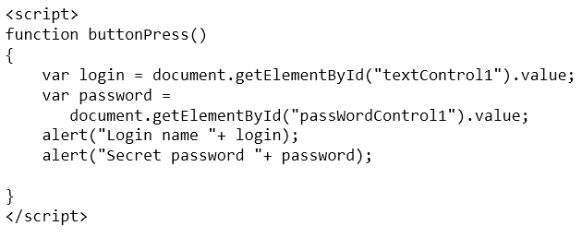
Recap: Programs You’ve Seen So Far Is Sequential Execution
Each instruction executes from beginning to end, one after the other
When the last instruction is reached then the program ends
START
END

Slide 5
New Program Writing Concepts (Non-Sequential)
Making decisions (branching)
Looping (repetition)
Grade point >= 1.0
True
False
Alert(“Passed”)
Alert(“Failed”)
START
Run game
Y
Play again?
N
END GAME

Slide 6
New Terminology
Boolean expression: An expression that must work out (evaluate to) to either a true or false value.
  e.g., it is over 45 Celsius today
  e.g., the user correctly entered the password
Body: A block of program instructions that will execute under a specified condition.
  Style requirement
    The ‘body’ is indented (4 spaces)
    A “sub-body” is indented by an additional 4 spaces (8 or more spaces)
function() {
Alert("Fake virus!");
};
When the webpage includes instructions to run the function (the ‘body’ of the function executes).

Slide 7
Branching: IF
JavaScript
  if
  if, else
  Similar to Excel if-then
  if, else if, else
  Similar to Excel nested ifs
  Multiple-ifs
When to use
  React when true
  React true & false
  At most only one if-case can be true (“select one of the following”)
  A series of conditions must all be independently checked (“select all that apply”)

Slide 8
Allowable Operators For Boolean Expressions
if (value operator value)
JavaScript Mathematical
operator equivalent Meaning Example
< < Less than 5 < 3
> > Greater than 5 > 3
== = Equal to 5 == 3
<= ≤ Less than or equal to 5 <= 5
>= ≥ Greater than or equal to 5 >= 4
!= ≠ Not equal to value !=
password

Slide 9
Decision Making With ‘If’
Boolean
True
Execute an
instruction or instructions
False
Remainder of
the program

Slide 10
If: General Format
if (<Boolean expression>)
{
<body>; // Indent the body by an additional 4 spaces
}
Unlike the Excel ‘IF-function’, the programming language ‘IF’ is not is a function.
  Excel IF-function: returns a value for true or false cases
  Programming language IF: Executes one or more instructions in the body (any programming language instruction).
    More powerful

Slide 11
If: An Example
Name of example: 1if.html
  <script>
  function main()
  {
  var age = -1;
  age = prompt("Enter your age (zero or greater):","37");
  if (age < 0)
  {
  alert("Age cannot be negative");
  }
  };
  window.onload=main;
  </script>

Slide 12
Decision Making With An ‘If, Else’
Used when different Actions (separate bodies) are required for the true result (IF-case) vs. the false result (ELSE-case)

Slide 13
Decision Making With An ‘If, Else’
Boolean
True
Execute an instruction
or instructions (if-body)
False
Execute an instruction
or instructions (else-body)
Remainder of
the program

Slide 14
If-Else: General Format
Similar to the Excel If-Then
Format:
  if (<Boolean expression>)
  {
  <body if>;
  }
  else
  {
  <body else>;
  }

Slide 15
If-Else: Example Usage
Example:
  if (age < 0)
  {
  alert("Age cannot be negative");
  }
  else
  {
  alert("Age verified as OK");
  }

Slide 16
If-Else: An Example
Name of example: 2ifElse.html
  <script>
  function main()
  {
  var age = -1;
  age = prompt("Enter your age (zero or greater):","37");
  if (age < 0)
  {
  alert("Age cannot be negative");
  }
  else
  {
  alert("Age verified as OK");
  }
  };
  window.onload=main;
  </script>

Slide 17
Logic Can Be Used In Conjunction With Branching
Typically the logical operators AND, OR are used with multiple conditions/Boolean expressions:
  If multiple conditions must all be met before the body will execute. (And)
  If at least one condition must be met before the body will execute. (Or)
The logical NOT operator can be used to check if something has ‘not’ occurred yet
  E.g., If it’s true that the user did not enter the correct password then the program will end.
  Typically used in the form of a ‘not equals’ check
  if (response != password)

Slide 18
Logical Operators
Logical operation JavaScript Example
AND && if (x > 0 && y > 0)
OR || if (x > 0 || y > 0)

Slide 19
Logic: The “OR” Operator
Format:
if ((Boolean expression) || (Boolean expression))
{
body;
}
Name of complete example: 3ifOr.html
gpa = prompt("GPA: ","4.0");
  xp = prompt("Years of job experience: ","6");
  if ((gpa > 3.7) || (xp > 5))
  {
  result = "Hire applicant";
  }
  else
  {
  result = "Insufficient qualifications";
  }
  alert(result);

Slide 20
Hiring Example: Example Inputs & Results
if ((gpa > 3.7) || (experience > 5))
GPA | Years job experience | Result
2 | 0 | Insufficient qualifications
1 | 10 | Hire
4 | 1 | Hire
4 | 7 | Hire

Slide 21
Logic: The “AND” Operator
Format:
if ((Boolean expression) && (Boolean expression))
{
body;
}
Name of complete example: 4ifAnd.html
  salary = prompt("Salary: ","100000");
  years = prompt("Years of employment: ","0");
  if ((salary >= 100000) && (years < 2))
  {
  result = "Fired!";
  }
  else
  {
  result = "Retained";
  }
  alert(result);

Slide 22
Firing Example: Example Inputs & Results
if ((salary >= 100000) && (years < 2))
Salary | Years on job | Result
1 | 100 | Retained
50000 | 1 | Retained
123456 | 20 | Retained
1000000 | 0 | Fired!

Slide 23
What To Do When Multiple Conditions Must Be Checked
Case 1: If each condition is independent of other questions
  Multiple if expressions can be used
  Example (each question must always be asked regardless of the answer to the previous question)
  Q1: Are you an adult?
  Q2: Are you a Canadian citizen?
  Q3: Are you currently employed?

Slide 24
What To Do When Multiple Conditions Must Be Checked (2)
Case 2 (mutually exclusive): If the result of one condition affects other conditions (when one condition is true then the other conditions cannot be true)
  If, else if, else should be used
  Which of the following is your place of birth? (Answering true to one option makes the options false)
    Calgary
    Edmonton
    Lethbridge
    Red Deer
    None of the above

Slide 25
Decision Making With Multiple Ifs
Q1: Boolean 1
False
  Each question is independent (previous answers have no effect on later questions because all questions will be asked).
  Q1: Are you an adult?
  Q2: Are you a Canadian citizen?
  Q3: Are you currently employed?
True
Instruction or
instructions
Q2: Boolean 2
False
True
Instruction or
instructions
Remainder of
the program

Slide 26
Multiple Ifs
Any, all or none of the conditions may be true
Employ when a series of independent questions will be asked
Format:
if (Boolean expression 1)
{
body 1;
}
if (Boolean expression 2)
{
body 2;
}
...
statements after the conditions

Slide 27
Multiple Ifs: Example
All questions must all be asked
Name of complete example: 5multipleIfs.html
age = prompt("Age: ","17");
city = prompt("Current city: ","Calgary");
if ((age >= 6) && (age <= 17)) {
response = "Grade schooler ";
}
else {
response = "Other ";
}
if (city == "Calgary") {
response = response + " in the most important city";
}
else {
response = response + " some other place..";
}

Slide 28
Multiple Ifs: Mutually Exclusive Conditions
At most only one of many conditions can be true (zero can be true as well).
Can be implemented through multiple ifs (poor approach)
Name of complete example: 6multipleIfsInefficient.html
if (letter == "A") {
gpa = 4;
}
if (letter == "B") {
gpa = 3;
}
if (letter == "C") {
gpa = 2;
}
if (letter == "D") {
gpa = 1;
}
if (letter == "F") {
gpa = 0;
}

Slide 29
Decision Making With if, else if, else
Boolean
True
Instruction or
instructions
False
Boolean
True
Instruction or
instructions
False
JT’s note: once the first ‘true’ case is encountered all remaining and related Boolean expressions (using ‘else if’) are skipped
Instruction or
instructions
Remainder of
the program

Slide 30
Multiple if, else if, else: Use With Mutually Exclusive Conditions
Mutually exclusive
One condition evaluating to true excludes other conditions from being true
Example: having your current location as ‘Calgary’ excludes the possibility of the current location as ‘Edmonton’, ‘Toronto’, ‘Medicine Hat’
Similar to the Excel nested-If (only one case is true)
Format:
if (Boolean expression 1) {
body 1;
}
else if (Boolean expression 2) {
body 2;
}
...
else {
body n;
}
Statements after the conditions

Slide 31
If, Else If, Else: Example
All questions must all be asked
Name of complete example: 7IfElseIfElse.html
if (letter == "A") {
gpa = 4;
}
else if (letter == "B") {
gpa = 3;
}
else if (letter == "C") {
gpa = 2;
}
else if (letter == "D") {
gpa = 1;
}
else if (letter == "F") {
gpa = 0;
}
else {
letter = "'" + letter
+ "'"
+ " not standard grade";
}

Slide 32
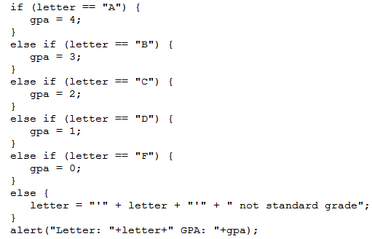
If, Else If, Else: Analysis
This approach is more efficient when at most only one condition can be true.
Extra benefit:
The body of the else executes only when all the Boolean expressions are false. (Useful for error checking/handling).

Slide 33
JavaScript: If, Else-If And Excel: Nested-Ifs
These two concepts are comparable:
JavaScript:
  if (grade >= 4) {
  letter = "A";
  }
  else if (grade >= 3) {
  letter = "B";
  }
  else if (grade >= 2) {
  letter = "C";
  }
  else if (grade >= 1) {
  letter = "D";
  }
  else {
  letter = "F";
  }
  Excel (display different messages for different grade points e.g. Display “Perfect” if grade point is 4.0 or greater):
=IF(D2>=4, "A",
IF(D2>=3, "B",
IF(D2>=2, "C",
IF(D2>=1, "D",
"F"))))

Slide 34
Recall Excel (Spreadsheet) Nesting
Conditions that are dependent upon or are affected by previous conditions.
‘Nesting’ refers to conditions that are ‘inside of other conditions’

Slide 35
JavaScript (Programming Language): Nested-IFs
Similar to the IF, ELSE IF: Decision making is dependent.
  One branch is ‘nested’ inside of another branch
  The first decision must evaluate to true (“gate keeper”) before successive decisions are even considered for evaluation.
Unlike the IF, ELSE IF more than one case can be true:
Question 1?
Question 2?
True
True
Statement or
statements
False
False
Remainder of
the program

Slide 36
Nested Decision Making
One decision is made inside another.
Outer decisions must evaluate to true before inner decisions are even considered for evaluation.
Format:
if (Boolean expression) {
if (Boolean expression) {
body;
}
}
Both (or all if 2+ IFs) must evaluate to true before the inner-most body will execute.
Outer body
Inner body

Slide 37
Nested Decision Making: Indenting
  if (Boolean expression)
  {
  if (Boolean expression)
  {
  body;
  }
  }
4 more spaces (4+4 = 8)
4 spaces

Slide 38
Nested IFs: Simple ‘Toy’ Example
Name of complete example: 8IfNested.html
  num1 = prompt("First number","1");
  num2 = prompt("Second number","1");
  if (num1 > 0)
  {
  result = "Num1 positive - ";
  if (num2 > 0)
  {
  result = result + "Num2 positive";
  }
  }
  else
  {
  result = "Num1 not positive, didn't check num2";
  }
  alert(result);

Slide 39
Looping/Repetition
How to get the program or portions of the program to automatically re-run
  Without duplicating the instructions
  Example: you need to calculate tax for multiple people
Ask for income
Loop: allows you to repeat the same tasks over and over again
Calculate deductions
Display amounts

Slide 40

Looping/Repetition (2)
The entire program repeats
START
Play game again?
Run game
Y
Play again?
N
www.colourbox.com
END GAME

Slide 41
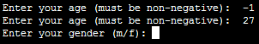
Looping/Repetition (3)
Only a specific part of the program repeats
Re-running specific parts of the program
Flowchart
Invalid input?
N
Y
Ask for input again
…rest of program

Slide 42
Types Of Loops
Fixed repetition loops: runs some integer ‘n’ times e.g., generates taxes for 10 clients
  For-loop
Variable repetition loops: runs as long as some condition holds true
  e.g., while the user doesn’t quit the program re-run the program
    How many times does the program run? It depends upon the whims of the user (variable).
  e.g., while the user enters an erroneous value ask the user for input.
  While-loop

Slide 43
For Loops: General Format
for (<Set counter to initial value>;
<Boolean Expression>;
<Update counter>¹)
{
<Body>; // Indent 4 spaces
}
Note: the three statements in the form loop do not have to reside on three separate lines.
1 Although the update is usually an increase or decrease by one any valid mathematical expression can be employed.

Slide 44
For Loops: An Example
Name of example: 9forLoop.html
  <script>
  function main()
  {
  var i = -1;
  var last = -1;
  last = prompt("Enter last value in number series: ", "");
  for (i = 0; i <= last; i = i + 1)
  {
  alert("i=" + i);
  }
  };
  window.onload=main;
  </script>

Slide 45
While Loops: General Format
Start
while (Boolean Expression)
{
<Body>; // Indent 4 spaces
}
Condition?
F
T
Body
After loop

Slide 46
Programming Style: Variable Names
In general variable names should be self-descriptive e.g., ‘age’, ‘height’ etc.
Loop control variables are an exception e.g., ‘i’ is an acceptable variable name
  It’s sometimes difficult to come up with a decent loop control name
  Also loop control variables are given shorter names so the line length of a loop isn’t excessive
  var loopControl = -1;
  loopControl = 1;
  while (loopControl <= 4)
  ...

Slide 47
While Loops: An Example
Name of example: 10whileLoop.html
  <script>
  function main()
  {
  var i = -1;
  var last = -1;
  last = prompt("Enter last value in number series: ", "");
  i = 0;
  while (i <= last)
  {
  alert("i=" + i);
  i = i + 1;
  }
  };
  window.onload=main;
  </script>

Slide 48
Loops That Never Execute
Word document containing the complete program: 11nonExecutingLoops.html
  var i = -1;
  i = 5;
  while (i <= 4)
  {
  alert("i=" + i);
  i = i + 1;
  }
  for (i = 5; i <= 4; i = i + 1)
  {
  alert("i=" + i);
  }

Slide 49
Exercise #1: Loops
The following program that prompts for and displays the user’s age.
  loopExercise.html
  function main()
  {
  var age = -1;
  age = prompt("Enter age (zero or greater): ", "0");
  alert("Age: " + age);
  }
  Modifications:
  As long as the user enters a negative age the program will continue prompting for age.
  After a valid age has been entered then stop the prompts and display the age.
  Hint: Use a do-while loop (not a for-loop)

Slide 50
Nesting
Nesting: one construct is contained within another
  What you have seen: nested branches:
  if (Boolean) {
  if (Boolean) {
  body;
  }
  }
Branches and loops can be nested within each other
  while (Boolean) {
  if (Boolean) {
  body;
  }
  }

Slide 51
Indenting: Any Form Of Nesting
General format (loops or branches):
Outer (Boolean)
{
Inner (Boolean)
{
body;
}
}
4 more spaces (4+4 = 8)
4 spaces

Slide 52
Example: Nesting
Write a program that will count out all the numbers from one to six.
For each of the numbers in this sequence the program will determine if the current count (1 – 6) is odd or even.
  The program display the value of the current count as well an indication whether it is odd or even.
Which Step (#1 or #2) should be completed first?

Slide 53
Step #1 Solution
  Full program name: 12nestingPart1.html
  function main()
  {
  var i = -1;
  i = 1;
  while (i <= 6)
  {
  i = i + 1;
  }
  };
  window.onload=main;
  </script>

Slide 54
Step #1 Completed: Now What?
For each number in the sequence determine if it is odd or even.
This can be done with the modulo (remainder) operator: %
  An even number modulo 2 equals zero (2, 4, 6 etc. even divide into 2 and yield a remainder or modulo of zero).
  If (counter % 2 = 0) then 'Even
  An odd number modulo 2 does not equal zero (1, 3, 5, etc.)
Pseudo code visualization of the problem
  Loop to count from 1 to 6
  Determine if number is odd/even and display message
  End Loop
  Determining whether a number is odd/even is a part of counting through the sequence from 1 – 6, checking odd/even is nested within the loop

Slide 55
Step #2 Solution
  Full program name: 12nestingPart2.html
  function main()
  {
  var i = -1;
  i = 1;
  while (i <= 6)
  {
  if (i % 2 == 0)
  {
  alert(i + " even");
  }
  else
  {
  alert(i + " odd");
  }
  i = i + 1;
  }
  };

Slide 56
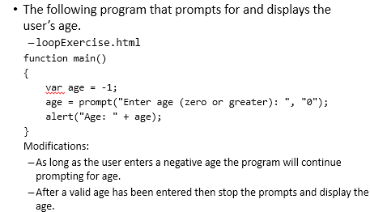
Exercise #2: Loops & Error Messages
Exercise #1:
Modify your previous solution so that whenever a negative is entered the program will display an appropriate error message.

Slide 57
Loops: A More Complex Example
Learning concepts:
  How JavaScript can change a document contents via document.write()
  Using a loop to produce ‘special effects’
    Change the image to be added

Slide 58
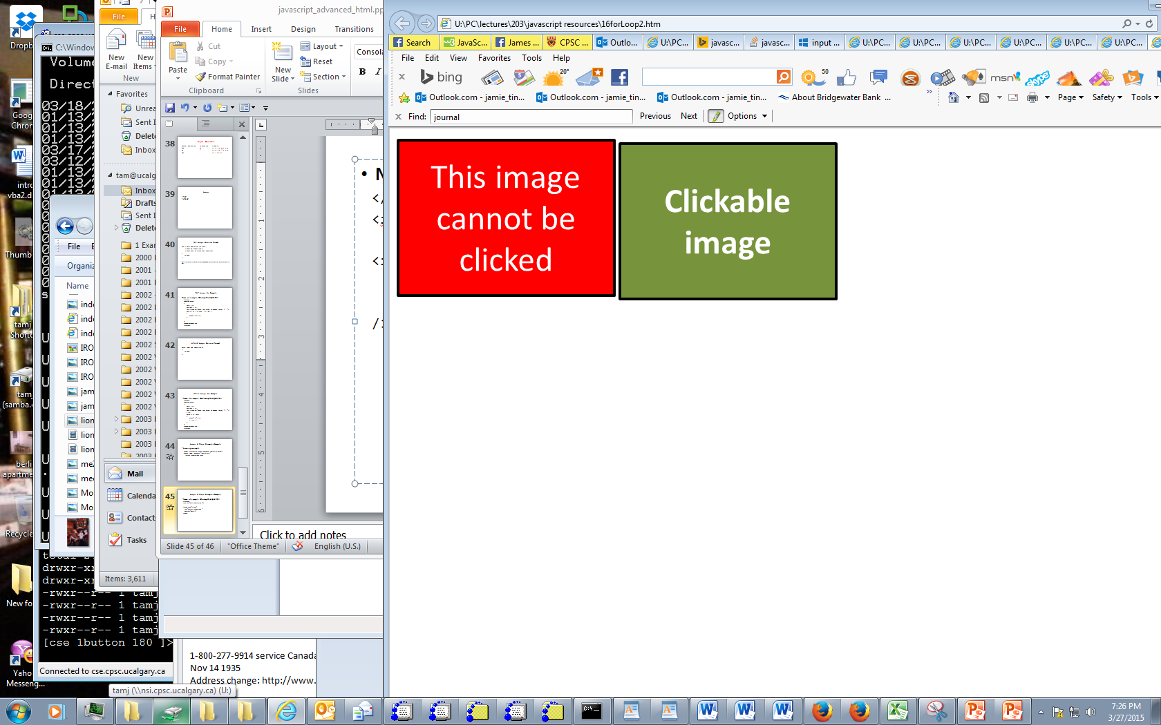
Loops: A More Complex Example (HTML Portion)
Name of complete example: 13documentWrite.html
  </script>
  <img src="pics/noClick.png">
  <input type="image"
  src="pics/clickable.png"
  onclick="main()"
  /><br>

Slide 59


Loops: A More Complex Example (JavaScript Portion)
  // Nesting again, writing to a webpage via document.write()
  <script>
  function main()
  {
  var i = -1;
  funImage = ("<img src='pics/funGuy.jpg'>");
  fungiImage = ("<img src='pics/fungi.jpg'>");
  for (i = 1; i <= 4; i = i + 1)
  {
  prompt("Hit ok to continue", i);
  if (i % 2 == 0) // % Modulo operator
  {
  document.write(funImage); // even
  }
  else
  {
  document.write(fungiImage); // odd
  }
  }
  }

Slide 60
Documentation Requirements
As specified in your assignment if there are special data requirements for your webpage and/or JavaScript program then this must be documented.
The previous program requires two images to be located in a specific location.
Program documentation:
  Requirements for program to run.
  * There is a subfolder called 'pics' in the folder where this
  program resides.
  * The pics folder must contain images with the exact names (you
  can substitute your own images if you wish (content doesn't
  matter just the name): 'fungi.jpg', 'funGuy.jpg', 'noClick.png',
  'clickable.png'.
  Etc.

Slide 61
Writing HTML Tags To A Document
Most any html tag can be written to a document via “document.write()”
The tags are treated as strings and like tags added to page without write() they must be enclosed in angled brackets.
Format:
    document.write(<"tag">);
Example:
    document.write(<"br">);

Slide 62
Writing Multiple Lines To A Document
Name of complete example: 14multilineWrite.html
  function main()
  {
  document.write("<b>Line1</b>: Part 1");
  document.write("<b>Line1</b>: Part 2");
  document.write("<br><b>Line2</b>:");
  };

Slide 63
Arrays (If There Is Time)
Unlike ‘simple’ variables such as integers and real numbers, an array can hold multiple values e.g., a number variable can store one student’s grades while an array can store the grades for an entire class.

Slide 64


Accessing Simple Variables Arrays
~Simple variable
Access entire the house via the address “123 University Dr. NW”
#123 University Dr. NW
~Array
Individual suites can be accessed via the suite address e.g. “#11 2500 University Dr. NW”
Access entire the apartment via the apartment address “2500 University Dr. NW”
11
12
13
14
Images: www.colourbox.com
2500 University Dr. NW

Slide 65
Declaring Array Variables
Format (creating an array):
  var <array name> = new Array(<Number of elements>);
Example (creating an array):
  var grades = new Array(4);
  // Specify just the array name affects the whole array // (creates whole array)
  // (~apartment address)

Slide 66
Accessing Array Elements
Use array name and an ‘index’ (~apartment suite address)
  The first index begin at zero
  The last index ends at (size of the array minus 1).
  Example: an array of size 10 will have index values from 0 to (10-1 or 9)
Format (assigning value to an element):
  <array name>[<index>] = value;
Example (assigning value to elements):
  grades[0] = 4;
  grades[1] = 3;
  grades[2] = 2;
  grades[3] = 3;

Slide 67
A More Realistic Example Program (HTML Portion)
Name of example: 15array.html
  <img src="pics/noClick.png">
  <input type="image" src="pics/clickable.png" onclick="main()" /><br>
  Requirements for program to run.
  * There is a subfolder called 'pics' in the folder where this
  program resides.
  * This folder contains 4 images with the following names: 0.jpg,
  1.jpg, 2.jpg, 3,jpg

Slide 68





A More Realistic Example Program (JavaScript Portion)
  function main()
  {
  var SIZE = 4;
  var pics = new Array(SIZE);
  var i = 1;
  for (i = 0; i < SIZE; i = i + 1)
  {
  pics[i] = "<img src='pics/" + i + ".jpg'>"
  }
  for (i = 0; i < SIZE; i = i + 1)
  {
  prompt("Hit ok to continue","");
  document.write(pics[i]);
  }
  }
i = 0
i = 1
i = 2
i = 3

Slide 69
Reminder: Backup Your Work Frequently!
This is always a good idea but imperative when writing JavaScript programs.
JavaScript will NOT give you helpful error messages!
  Usually you get no error message at all.
  Determining where the problem lies can be a great challenge!

Slide 70
Example Program With An Error (Or Errors)
  Program name: error2.html
  function main()
  {
  const SIZE = 4;
  var pics = new Array(SIZE);
  var i = 1;
  for (i = 0; i < SIZE; i = i + 1)
  {
  pics[i] = "<img src='pics/" + i + ".jpg'>"
  }
  for (i = 0; i < SIZE; i = i + 1)
  {
  prompt("Hit ok to continue","");
  document.write(pics[i]);
  }
  }

Slide 71
Backups: Benefit
If you accidentally introduce an error to your program and you cannot find the error.
You can always:
  Compare the backup version vs. the current version in order to more easily find the difference
  Simply revert to the backup (if you cannot find the error)
    Starting working from the last working backup file.
When you make backups always ensure that your backup is working prior to making a backup.
You have been forewarned!
  Failure to make a proper set of backups won’t allow you to get an extension.

Slide 72
If All Else Fails
What to do if you still didn’t take this advice and you are desperately trying to find the error.
First: there are no guarantees with this technique.
Second: make generous use of comments
  “Comment out” the entire body of the function save for alert(s) (to tell you which parts of the function is running properly).

Slide 73
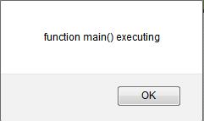
“Commenting Out Code” Previous Example
  function main()
  {
  alert("function main() executing");
  /*
  const SIZE = 4;
  var pics = new Array(SIZE);
  var i = 1;
  for (i = 0; i < SIZE; i = i + 1)
  {
  pics[i] = "<img src='pics/" + i + ".jpg'>"
  }
  for (i = 0; i < SIZE; i = i + 1)
  {
  prompt("Hit ok to continue","");
  document.write(pics[i]);
  }
  */
  }

Slide 74
“Commenting Out Code”: Gradually Move The Comments To Expose More Code
  function main()
  {
  alert("function main() executing");
  /*
  const SIZE = 4;
  var pics = new Array(SIZE);
  var i = 1;
  for (i = 0; i < SIZE; i = i + 1)
  {
  pics[i] = "<img src='pics/" + i + ".jpg'>"
  }
  for (i = 0; i < SIZE; i = i + 1)
  {
  prompt("Hit ok to continue","");
  document.write(pics[i]);
  }
  */
  }
As you ‘uncomment’ code take care that you don’t introduce new errors e.g., mismatch braces

Slide 75
Finding Errors
This technique of “commenting out” JavaScript code will not work if the error is in your html tags.
(Recall: documentation is used only conjunction with programming instructions and html does not include programming instructions).
Example: documentation will not help, what you were taught was commenting out JavaScript code (so BACKUP YOUR WORK)
  <script>
function main()
{
alert("function main() executing");
}
  </script>
  <img src="pics/noClick.png">
  <input type="image" src="pics/clickable.png" onclick="main" /><br>
Using documentation for “commenting out” only works here

Slide 76
Strings
A series of characters: alpha, numeric and other values that can be entered via the keyboard.
A string has a length
Examples:
  var string1 = "a12!"; // 4 characters
  var string2 = ""; // 0 characters
The length method will return the length
Format:
  <string>.length;
Example:
  userInput = alert("Name: ", "Bruce Lee");
  userInput.length == 0 // userInput must be a String

Slide 77
Example Using The Length Method
  Program name: 16stringLength.html
  function main()
  {
  var userInput = document.getElementById("input1").value;
  if (userInput.length == 0)
  {
  alert("Input field empty!");
  }
  else
  {
  alert(userInput);
  }
  }
  </script>
  <input type="button" value="Press me" onclick="main()"/><br>
  Enter some text and press the button <input type="input" id="input1"/>

Slide 78
Changing Capitalization
This can be done with the methods:
  <string>.toUpperCase();
  <string>.toLowerCase();
Format:
  <string variable> = <string>.toUpperCase();
  <string variable> = <string>.toLowerCase();
Example:
  userInput = alert("Name: ", "Bruce Lee");
  userInput = userInput.toUpperCase(); //userInput must be
  //a string

Slide 79
Example Of Changing Case
  Program name: 17changingCase.html
  function main()
  {
  var userInput = document.getElementById("input1").value;
  if (userInput.length == 0)
  {
  alert("Input field empty!");
  }
  else
  {
  userInput = userInput.toUpperCase();
  alert(userInput); // All caps
  userInput = userInput.toLowerCase();
  alert(userInput); // All lower now
  }
  }
  </script>
  <input type="button" value="Press me" onclick="main()"/><br>
  Enter some text and press the button <input type="input" id="input1"/>

Slide 80
Strings Are Indexed
Similar to arrays each character in a string is indexed from: 0 to (length – 1).
Example:
  var aString = "ab1";
The <string>.indexOf() method can be used to find the index of the first occurrence of a character.
  If the character is not found then the method returns -1 (minus one).
Format:
  <variable> = <string>.indexOf(<character>);
Example:
  index = aString.indexOf("!");
Elements: a b 1
Index: 0 1 2

Slide 81

Example: Finding Location
  Program name: 18findingIndex.html
  <input type="button" value="Press me" onclick="main()"/><br>
  Character to search for <input type="input" id="data"/><br>
  Search string <input type="input" id="search"/>
  function main()
  {
  var searchCharacter =
  document.getElementById("data").value;
  var stringSearched =
  document.getElementById("search").value;
  if ((searchCharacter.length == 0) ||
  (stringSearched.length == 0))
  {
  alert("Unable to search. Either search string or
  character empty");
  }

Slide 82
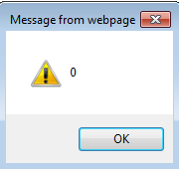
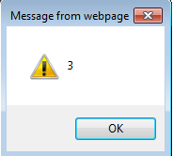
Example: Finding Location (2)
  else
  {
  // Index of character in input field
  var index = stringSearched.indexOf(searchCharacter);
  alert(index);
  // Index of exclamation mark '!'
  var index = stringSearched.indexOf("!");
  alert(index);
  }
  }

Slide 83
Additional Online Resources
http://www.w3schools.com/js/
https://msdn.microsoft.com/en-us/library/ie/ms535262(v=vs.85).aspx
http://trainingtools.com/online/javascript/index.htm

Slide 84
After This Section You Should Now Know
Branching/decision making mechanisms:
  if
  if-else
  if, else if, else
Valid operators for Boolean expressions
Valid logical operators

Slide 85
After This Section You Should Now Know (2)
Getting JavaScript instructions to repeat using looping mechanisms:
  For
  While
Changing the contents of a webpage via document.write()
How to create an array and how to access the elements
Common string operations
  Determining length
  Converting case
  Finding the location of the first instance of a character
The importance of backing up and versioning your webpage and JavaScript program
  Using documentation to find JavaScript errors

