Slide 1
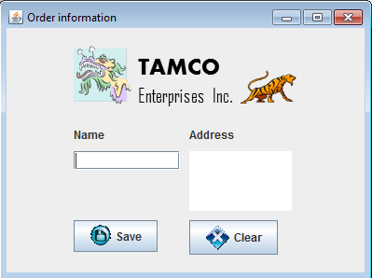
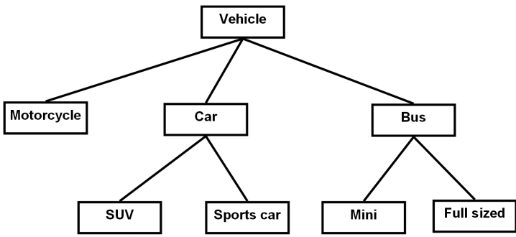
Introduction To CPSC 219
James Tam
Java
Object-Orientation
Graphical-user interfaces
Images courtesy of James Tam

Slide 2
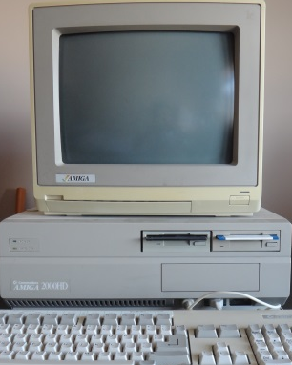

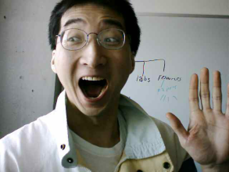
Then And Now…
Take-away point: your programs will of course be much larger and more complex than the ones from 217
CPSC 217: What was it like then
CPSC 219: What will it be like now
A Lot of work! (Psychedelic Amiga by James Tam)
…but don’t forget how much smarter you’ve became!
Image of James Tam: courtesy of James Tam
Even more work!!!

Slide 3


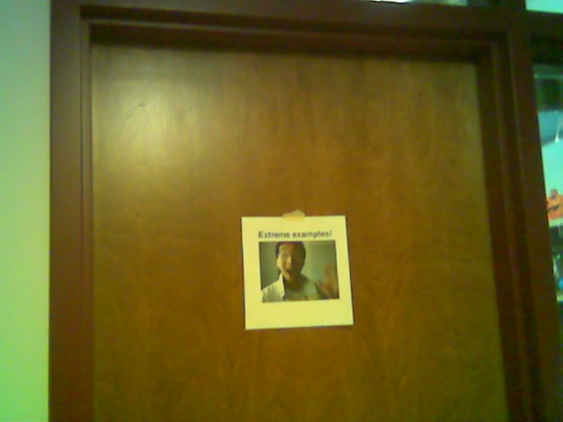
Administrative (James Tam)
Contact Information
  Office: ICT 707
  Email: tam@ucalgary.ca
  Make sure you specify the course name and number in the subject line of the email ‘CPSC 219’
Office hours
  Office hours:
    T: 14:00 - 14:50 (If I’m not in my office give me a few minutes or check the lecture room).
    W & R: 15:00 – 15:30
My Office
Images: courtesy of James Tam

Slide 4
Course Resources
Required resources:
  Course website: http://pages.cpsc.ucalgary.ca/~tamj/2017/219W/index.html
  Get the notes off the course webpage before lecture)
Recommended but not required:
  "Absolute Java (6th Ed)" Walter Savitch, (Pearson)
  Alternately you can pick out one of the ‘free’ online texts from the university library:
  http://proquest.safaribooksonline.com.ezproxy.lib.ucalgary.ca/

Slide 5
How To Use The Course Resources
They are provided to support and supplement this class.
  The notes outline the topics to be covered
  At a minimum look through the notes to see the important topics.
  However the notes are just an outline and just looking at them without coming to class isn’t sufficient to do well
  You will get the details (e.g., explanations) during lecture time
    Take notes!

Slide 6






Your Engagement Level ---> Your Learning
+
Learning
colourbox.com
Computer programs
Computer program

Slide 7


Tam’s “House Rules”
I will endeavor to keep the lecture within the prescribed time boundaries
You won’t pack up and leave before time is up

Slide 8





Tam’s “House Rules”
No recordings/captures without permission during class please
(Recall that learning tends to increase with additional levels of engagement).
Colourbox.com

Slide 9


Tam’s “House Rules”
Quiet whispering is OK…
…but make sure if it is *quiet*. If it’s loud enough for me to hear then it’s likely that others are being disturbed by the noise as well.
Images from colourbox.com

Slide 10
Students: Assumed Knowledge
You completed CPSC 217 (or the equivalent) with a grade of C- or higher.
You do not need to know Python programming for this class.
  However sometimes I will refer briefly to Python programs just to contrast what (most/all) students already know with what they need to learn.
You are proficient at using common procedural programming tools e.g., branching, loops, decomposition into functions etc.
If you are new to the CPSC network then you should (quickly) familiarize yourself.
  One starting point (Topic #0):
  http://pages.cpsc.ucalgary.ca/~tamj/2017/219W/starting/index.html

Slide 11
Course Outcomes
Describe the difference between the procedural and Object-Oriented approach for program decomposition.
Describe core Object-Oriented concepts such as encapsulation and inheritance as well as apply these concepts in practice in an actual program.
Represent classes and class relationships diagrammatically using the UML (Unified Modeling Language).
Write/trace:
  A Java program that use core programming concepts such as branching and loops.
  An event-driven Java program that employs a graphical user interface.
  A program that employs the Java event handling model for error handling.

Slide 12
Course Outcomes (2)
Write/trace:
  A program that employs Java text-based file input or output classes.
  A recursive equivalent of an iterative implementation and given there is time in semester students can implement more complex problems.
Define a design pattern as well as specify some common design patterns and indicate when they should be used.

Slide 13
How To Succeed In This Course: A Summary
Practice things yourself
Make sure that you keep up with the material
Look at the material before coming to lecture
Start working on things early

Slide 14
Evaluation Components
Assignments, tutorial quizzes and mini assignment (35%)
Examinations (65%)

Slide 15
Assignments
Regular assignments (5 assignments, 32% total):
  Marking is based on a number of factors (such as program functionality, documentation, style)
  Assignment 1: worth 5%
  Assignment 2: worth 5%
  Assignment 3: worth 8%
  Assignment 4: worth 8%
  Assignment 5: worth 6%
Tutorial quizzes (2.5% of total)
  Take the lowest score is dropped – absolutely no “make up” quizzes
  ‘Mini-exam’: The goal is to create a small and relatively simple program in order to learn basic programming concepts such as Java syntax
  Closed book, write in tutorial
Mini-Assignment (0.5% of total)
  Mini-A5: A smaller and less complex version of A5 to ‘ease’ you into GUI (Graphical User Interface) programming

Slide 16
Assignments & Tutorial Quizzes
Assignments & quizzes must be individually completed and individually submitted.
  There is no group work allowed for this class.
  Students should not see the computer program code of other students.
Assignments and quizzes will be marked by the tutorial instructor.
  Grades will be posted in D2L
  You can contact him/her for the grade and/or the completed marking sheet.
  If you still have questions or issues after contacting your TA then feel free to contact your course instructor.

Slide 17
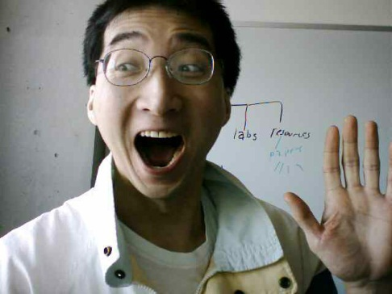
Submitting Assignments
Bottom line: it is each student’s responsibility to make sure that the correct version of the program was submitted on time.
Late assignments will not be accepted.
If you are ill then medical documentation is required for late assignment submissions (recall there are no make up quizzes)
  Contact your course instructor and not your tutorial instructor to get permission for a late submission
(Further details will be available during the term).
I am the ‘course instructor’ person

Slide 18
How To Verify Submissions In DropBox
There is a help link provided with each assignment description.
Teaching Assistants will cover in conjunction with Assignment zero.
  Not graded but important practice
Resource file
  http://pages.cpsc.ucalgary.ca/~tamj/resources/Verifying%20D2L%20Submissions.pdf

Slide 19
Examinations
There will be three exams: two midterms and one final.
Midterm examinations (together worth 30% of the overall term grade)
  Midterm #1: in class Feb 9
  Midterm #2: in class Mar 9
Final exam (worth 35% of the overall term grade
  Date/time/location determined by the Office the Registrar.
  (That means I find out these details at the same time that you do).
  You can find information about your final exams online via the university PeopleSoft portal.
All examinations will completed on paper (not in front of a computer).

Slide 20
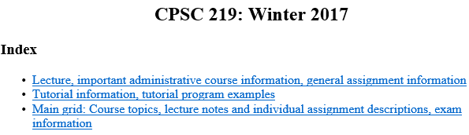
Examinations (2)
Information about the examinations will be available on the main grid sometime before the respective test:
  Under the main index:
    Main grid: Course topics, lecture notes and individual assignment descriptions, exam information
Note: you need to pass the weighted average of the exam component (midterms and final) in order to receive a grade of C- or higher in this class.

Slide 21
Grades For Each Component
The official grading mechanism for this (and most) universities is a letter grade/grade point e.g. A/4.0, A-/3.7 etc.
Term grades must be stated as a letter grade.
Component grades (assignment, exam etc.) can either be a letter grade or a raw score (e.g. percentage)
For this class each major component will be awarded a grade point (and not a percentage) and this is the value used to determine the term grade.

Slide 22
Mapping Raw Scores To Grade Points: Assignments
For simplicity assignment marking keys will specify grade points only
  Example (purely for illustration purposes):
    Program features completed:
      computes average sales = 0.3 grade points,
      graphs results = 0.1 grade points etc.,
      the user can re-run calculations with different data = 1.0 grade points.
  Sum the grade points for each feature in order to yield the grade point awarded for the assignment e.g., 0.3 + 0.1 + 1.0 = 1.4 GPA earned

Slide 23
Mapping Raw Scores To Grade Points: Exams
For examinations the mapping between a raw score and a grade point occurs one way (raw score mapped to grade point)
  Example (purely for illustration purposes) 65 – 69% = C/2.0, 70 – 74% = C+/2.3
  But grade points don’t correlate back to percentages
    e.g. I was awarded a 66% on midterm and then I see this is a 2.0 GPA (out of 4.0)
    Does this mean that my percentage ‘went’ from a 66% to a 50%!!!???
    No.
      A C/2.0 does not mean that 50% was awarded as a course grade.
      To put this in perspective a passing grade point in this university is a 1.0/D in a course. If a grade point mapped back to a percentage this would mean that anyone getting a 25% or higher would pass any course here.
  The mapping of the midterm to grade point will be posted sometime after the midterm grades have been released.
  The mapping of the final exam to grade point will be posted sometime after the final exam grades have been released.

Slide 24
Estimating Your Overall Term Grade Point
To determine your weighted term grade point simply multiply each grade point by the weight of each component.
  Percentages won’t be used to determine the term grade point/letter
Sum the weighted grade points to determine the term grade.
Simple and short example (not exactly the same as this term but it should be enough to give you an idea of how to do the specific calculations required this semester):
    Assignments: weight = 30%, example score = A
    Midterm: weight = 30%, example score = B+
    Final: weight = 40%, example score = C-
    Weighted assignments: 0.3 * 4.0 = 1.2
    Weighted midterm: 0.3 * 3.3 = 0.99
    Weighted final: 0.4 * 1.7 = 0.68
    Total term grade point = 1.2 + 0.99 + 0.68 = 2.87
  (In this case the term letter is B-)

Slide 25
Estimating Your Overall Term Grade Point (2)
Use the spreadsheet on the course web page to estimate your term letter grade:
  http://pages.cpsc.ucalgary.ca/~tamj/2017/219W/grade_calculator.xlsx
The grade point to letter grade mapping employs the official university cutoffs:
  http://www.ucalgary.ca/pubs/calendar/current/f-2.html
  (I may employ a more lenient set of cutoffs at the end of term but the official cutoffs will provide you with a ‘worse case’ estimate of your grade).
  Also an “A+” doesn’t have a specified letter grade that is different from an “A” for term letter grades.
    I’ll likely extrapolate the pattern e.g. C+ = 2.3, B+ = 3.3 so an A+ will be higher than a 4.0 and a bit lower than 4.3 (because not all course components allow for an A+ to be awarded)
1 Note: to keep things simple the formula in the spreadsheet does not check if the exam component was passed or not (you can do the check manually or add it in yourself)

Slide 26
Examination Content
Multiple choice questions:
  Partial program traces e.g., what’s the program output
  Basic program structure e.g., find the errors, which function or operator is needed for a particular mathematical operation
  More examples and details coming during the semester
Written questions:
  Write a small/partial computer program.
  Trace the execution of a computer program e.g., what is the ‘output’.
  Conceptual (lower weight for this type of question) e.g., definition of a technical term.
  Likely there will be a smaller proportion of written questions on the midterm vs. the final.
I will be grading the exams.
  (I’ll do the best I can to get them done in a timely fashion but remember this is often a high enrollment class).

Slide 27
Examination Content (2)
More sample ‘exam type’ questions will be provided during the semester.
  Sometimes ‘on the fly’ in lecture so pay attention to these and take notes.

Slide 28


Feedback
Wow I am the greatest speaker in the world!
What is he talking about???
Let me know how things are going in the course:
  Am I covering the material too slowly or too quickly.
  Can you read the slides and my hand writing.
  Can you hear me in the class.
  Etc.
(Image copyrights unknown)

Slide 29
Copyright Notification
“Unless otherwise indicated, all images in this presentation are used with permission from Microsoft.”
Sound effects (due to budgetary constraints) were produced by James Tam

